Slide 1
Marcy Ward
Extension Livestock Specialist
2023 Joint Stockmen Convention 12/13/23

Slide 2
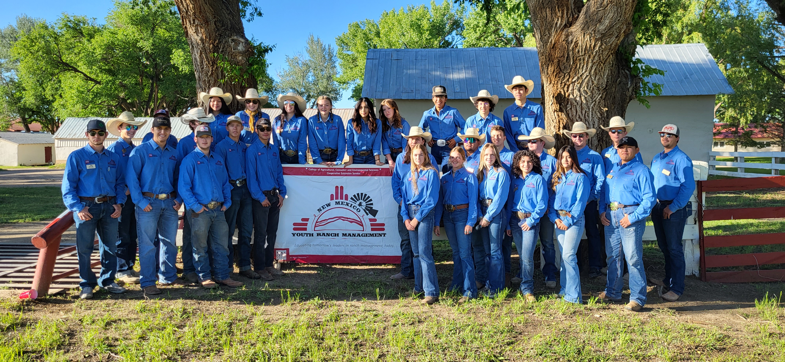
Educating Youth In New Mexico
Educated over 300 youth since 2010.
70% go on to major in Ag related fields in college.
Many participants claim it was the experience of attending the camp that helped guide their career choices.
Have now had youth from 7 other states attend (from Ca to NY)
nmyrm.nmsu.edu

Slide 3
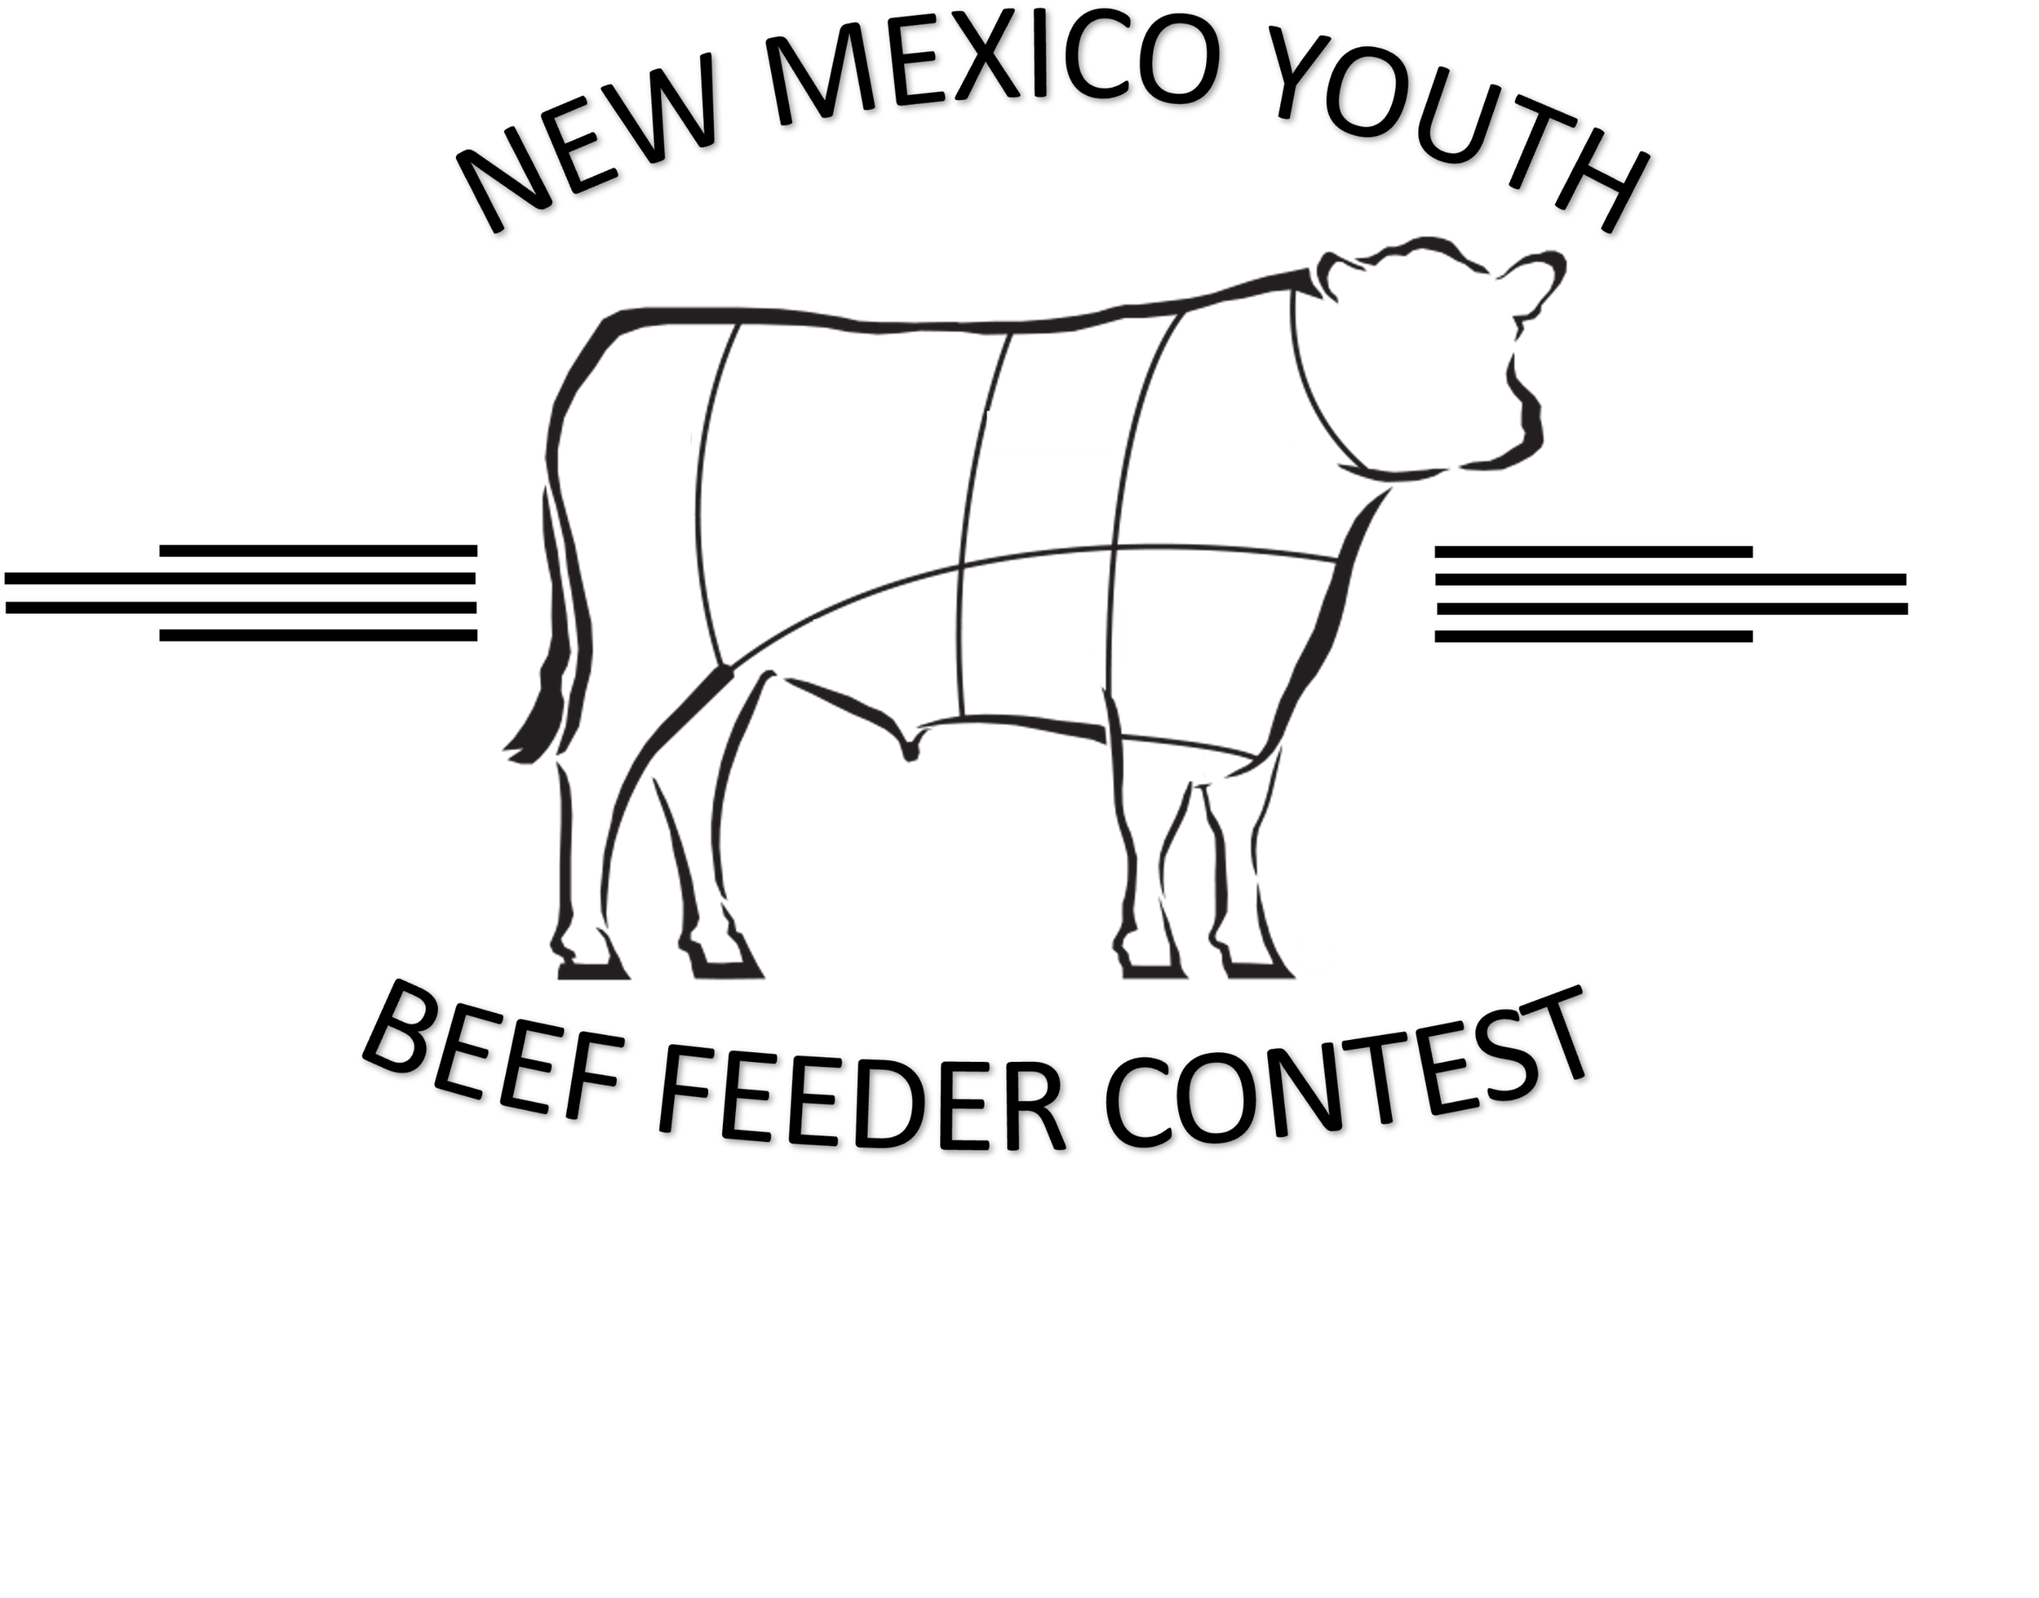
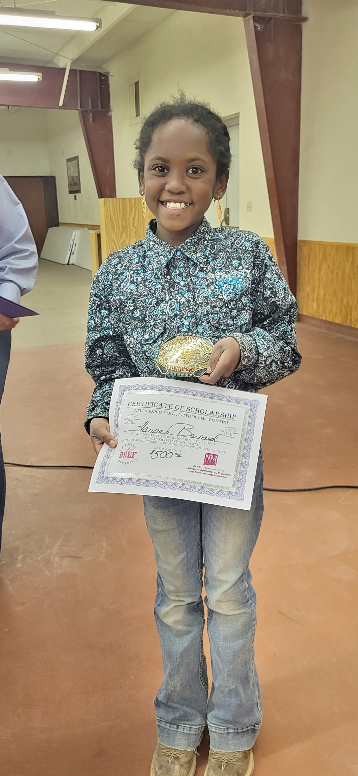
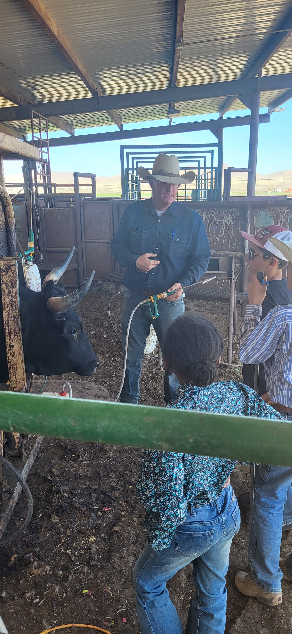
Educating Youth In New Mexico
Ages 8 to 18
Raise a steer to 850 lbs at home
Steer is finished in a commercial feeding environment.
Record keeping with Excel©
Records, carcass, and calf performance are ranking metrics
Beef advocacy equally important
Poster
Speech
Promotional video
Producer partnerships/family options
Great awards and scholarships available!
nmyouthbeef.nmsu.edu

Slide 4
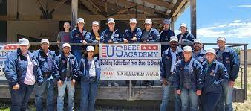
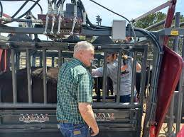
Educating Youth In New Mexico
Graduate and Veterinary Students
Intensive week of education and hands on training
Nutrition
Reproduction
Genetics
Carcass fabrication
Students from across the US attend.
Strong support of industry partners
nmyouthbeef.nmsu.edu

Slide 5
US Dairy Education & Training Consortium (USDETC)
nmyouthbeef.nmsu.edu

Slide 6
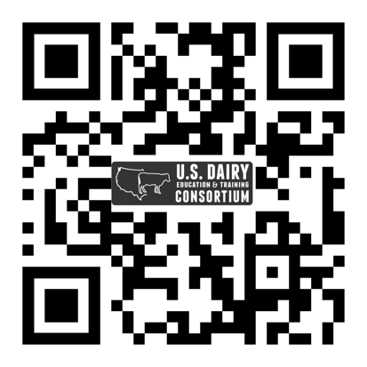
US Dairy Education & Training Consortium (USDETC)
Need: without any dairy training resources in the 3rd largest and rapidly expanding milkshed in the Southwestern US, three universities in 2008 proposed to counter this tide with a multi-university hands-on training program in Clovis, NM in one of the most technologically advanced dairy centers in the US: a model for practical education.
Program:
6-wk. program in Clovis, NM
Nationally recognized faculty
Hands-on & classroom teaching
Internship & job opportunities
Credit towards Dairy Minor
Total reach in 15 yrs:
664 students from
62 universities
Impact:
4 out of 5 students find employment in agriculture
2 out of 3 students find employment in dairy industry
1 out of 3 students working on or managing a dairy
15% goes on to become veterinarians
Source: https://usdetc.tamu.edu

Slide 7
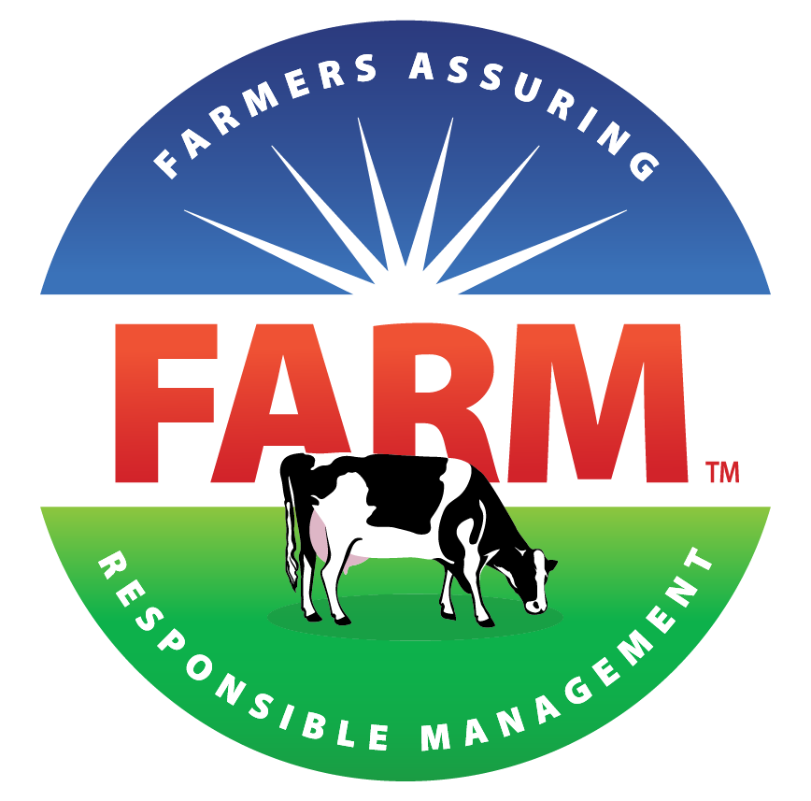
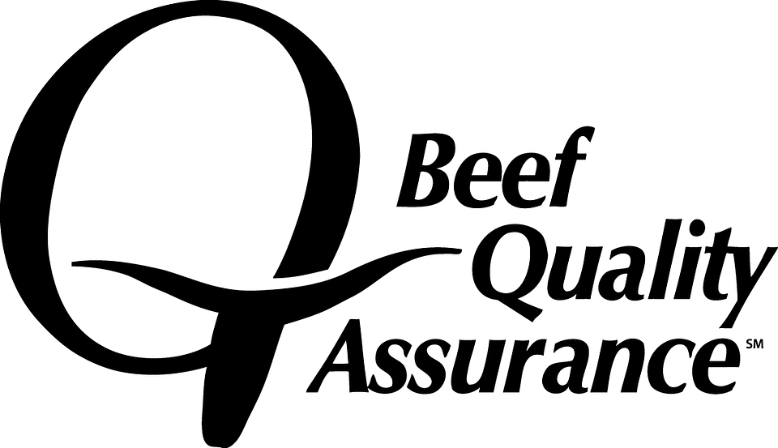
Dairy Workforce Development & Training
Need: average herd size of New Mexico dairies is roughly ten times the U.S. average herdsize. Effective training and development of current and future employees is imperative. Middle management development is becoming increasingly important.
Program goal: improve employee performance metrics.
Program Impact:
Training modules on dairy safety awareness and animal handling
Modules available on mobile devices in English, Spanish & K’iche
One third of New Mexico dairy workforce trained
Idaho Dairymen’s Association (IDA) adopted program (2017)
NMPF created Workforce Development Taskforce (2018)
Taskforce developed Dairy Safety Reference Manual (2019)
Module Feeds & Feeding developed with Diamond V (2019)
Feeds & Feeding released on mobile devices for training (2020)
Maternity & Calf Care developed with IDA (2022)
Fitness to Transport developed with FARM & Elanco (2022)
Dairy West implementing program based on developed resources (2023)
CCQA (Calf Care Quality Assurance) being developed (23-24)
Source: https://dairy.nmsu.edu/index.html

Slide 8
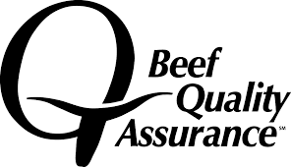
New Mexico Beef Quality Assurance
Have certified over 1000 NM producers
Is in the process of transitioning to align with the national BQA program.
Stay tuned!
nmbeef.nmsu.edu

Slide 9
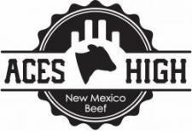
New Mexico Beef Quality Assurance
A way for NM producers to add value to their calves.
Third party vaccination verification program
Producers have averaged approximately $.10 to $.15/lb more than local market average.
Annual program schedule
February 1: Enrollment Begins
May 31: Enrollment Ends
First vaccination at branding
Wean by Date: TBD (late September / early October)
nmbeef.nmsu.edu

Slide 10
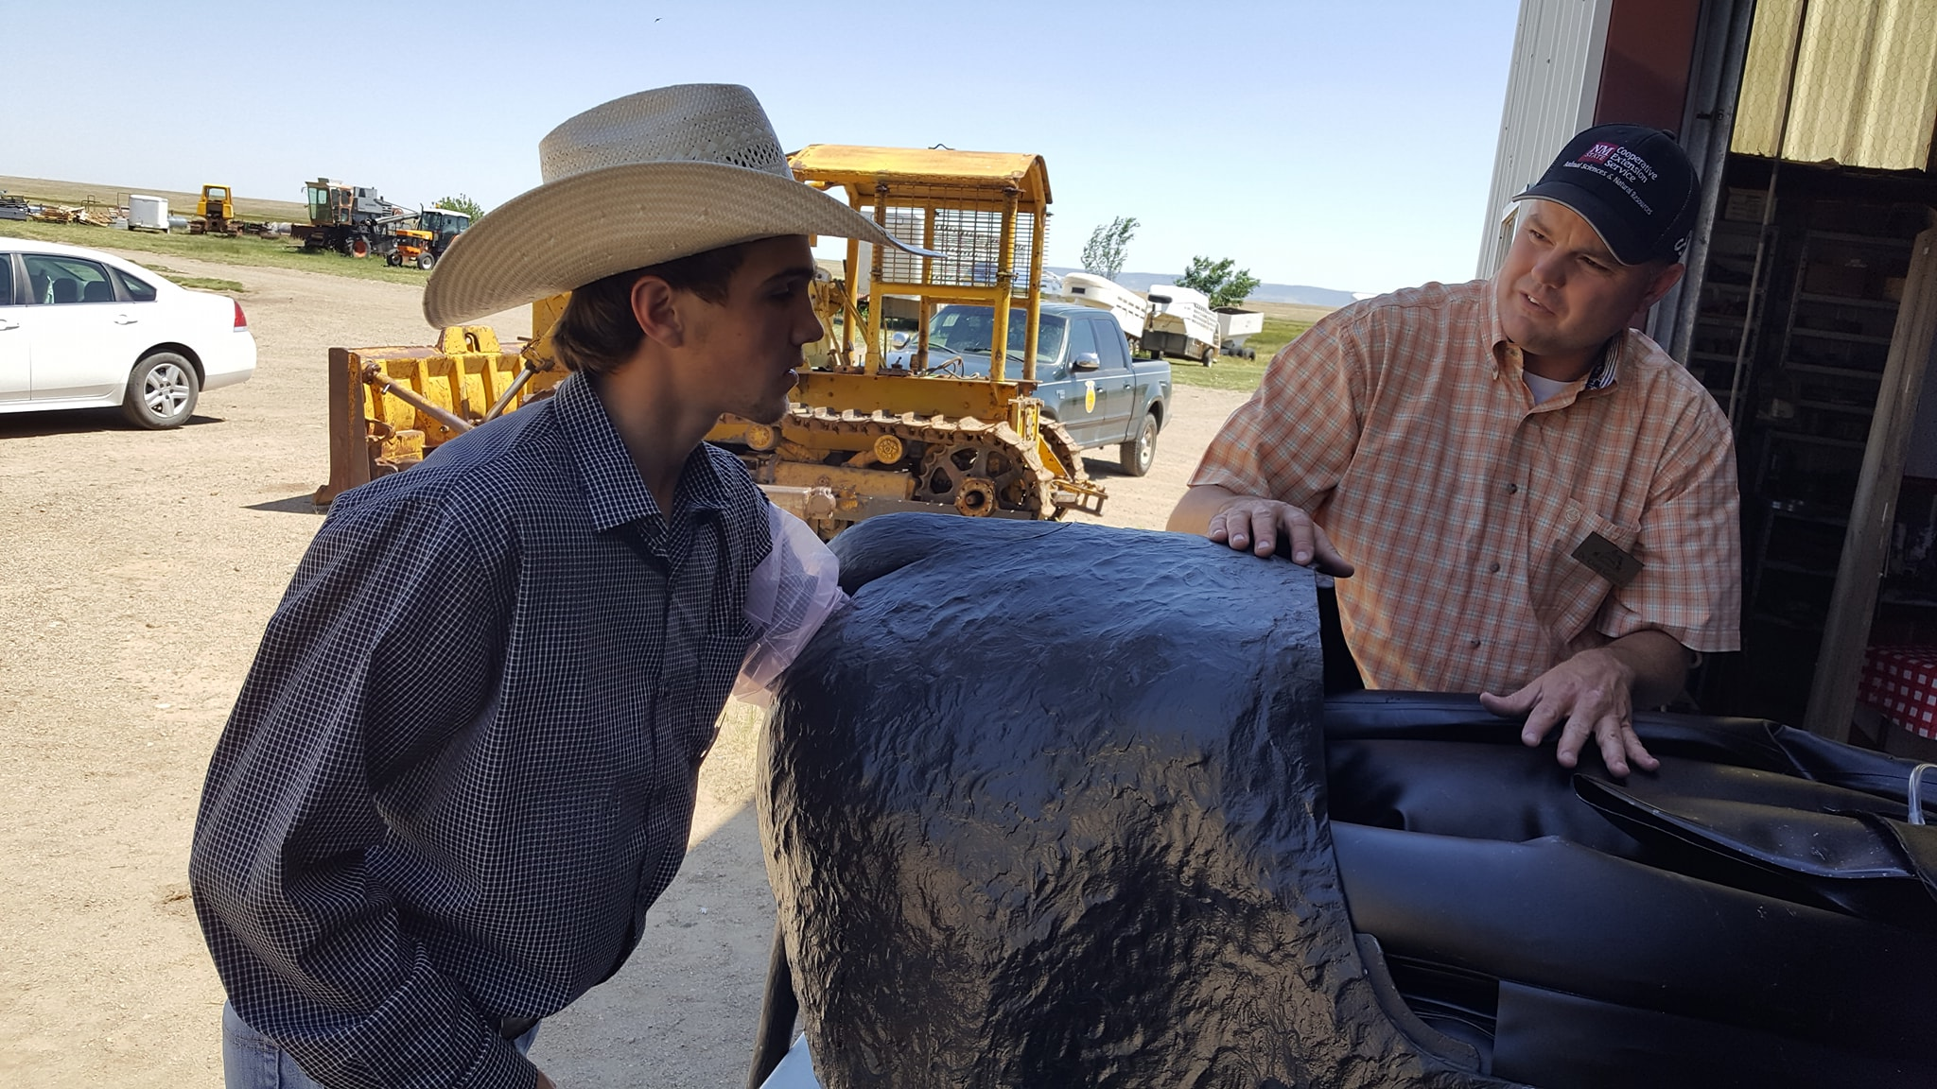
Artificial Insemination Schools
Online – technical training
Three-day hands on training
At least one per year (Spring)
Locations do change
nmbeef.nmsu.edu

Slide 11
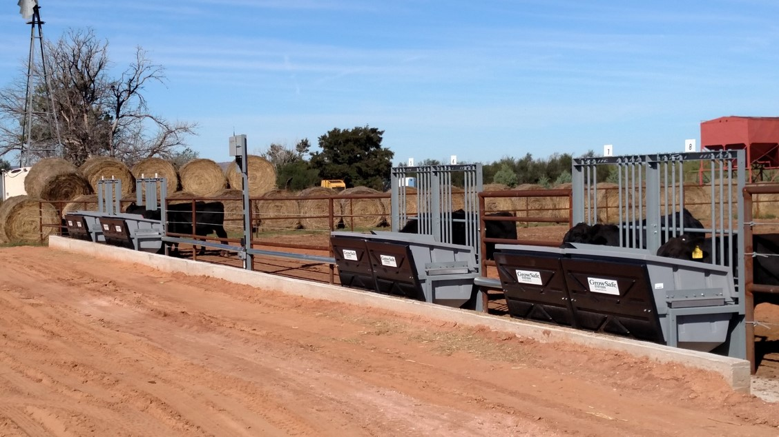
Tucumcari Bull Test
63rd Annual
156 Bulls on test
23 producers
8 breeds
Research partnerships
SALE: MARCH 9, 2024
https://tucbulltest.nmsu.edu/

Slide 13
New Programming
Ranches raise 3 steers to 850 lbs
Cattle are received at the Tucumcari Bull Test Station in March
Cattle are fed to finish
Cattle will be harvested through a USDA facility
Gain and feed efficiency data
Carcass data
Products will be marketed both privately and publicly
nmbeef.nmsu.edu

Slide 14
New Programming
Hosted by the New Mexico Producers and Marketing Association
Bulls will be fed for 60 days at a feedlot facility located near Abiquiu, NM
At the end of the feeding period, bulls will be tested for PAP and Fertility
Bull sale: SATURDAY MARCH 30, 2024

Slide 15
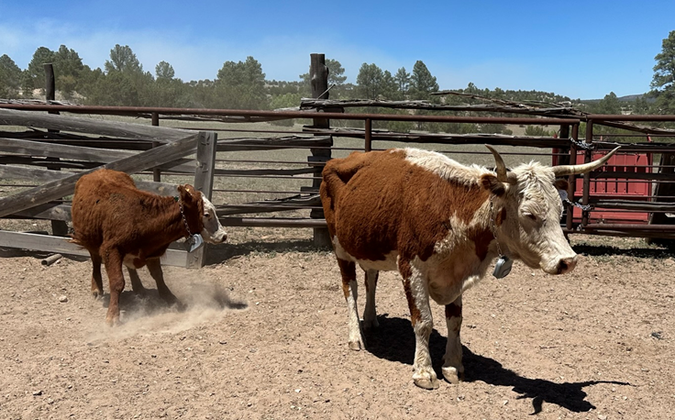
New Programming – Range Mgt
Novel Technologies
Use of Drone and Satellite Multispectral Imagery to assess rangeland conditions
Virtual fence collars tested and used across the state
Assessed practicality of use on Gila National Forest post-fire
Optimizing vegetation patch use and rotation at Chihuahuan Desert Rangeland Research Center
Provide a central location online to view and assess data through virtual fencing dashboard and Rangeland Data and Records Program (RaDAR)
Collar image here

Slide 16
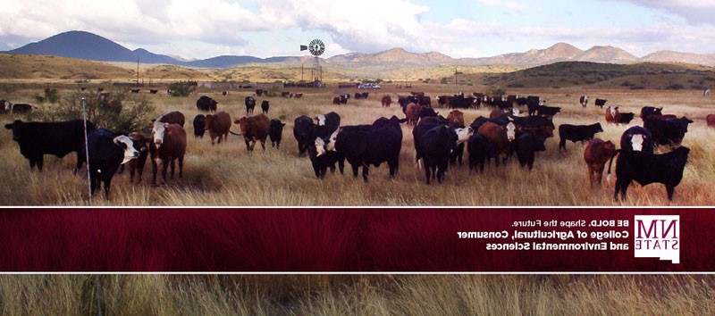
THANK YOU!
maward@nsmu.edu
575-644-3379

