Slide 1
Marketing Options and Expectations for Our Ranch Cattle in New Mexico: Historical Perspective
NMCGA Cattlemen’s College, 2023
Craig Gifford, Extension Beef Cattle Specialist

Slide 2
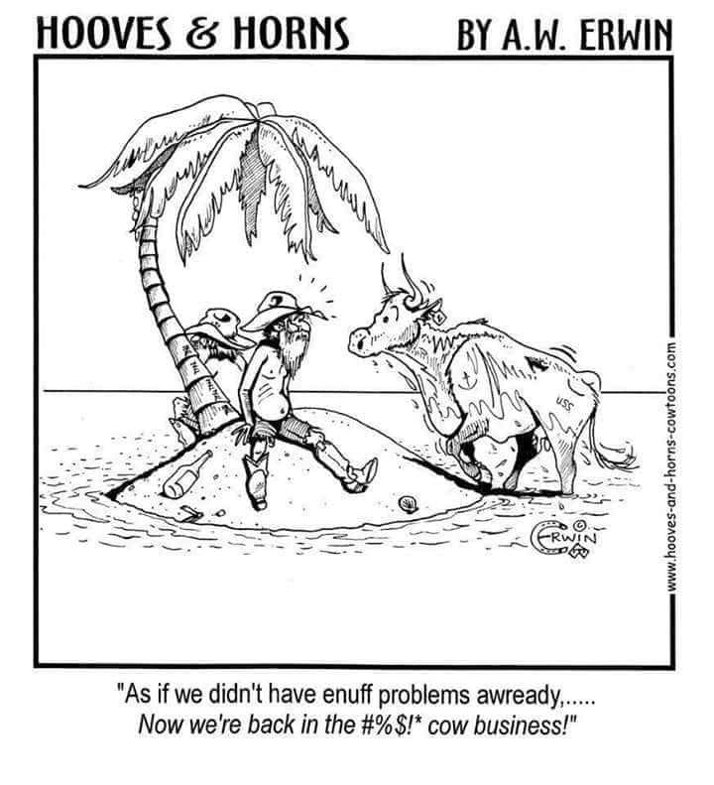
Marketing: How did we get here?

Slide 3
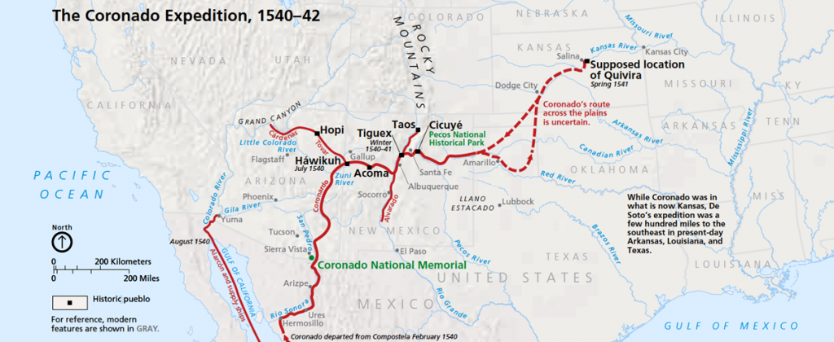
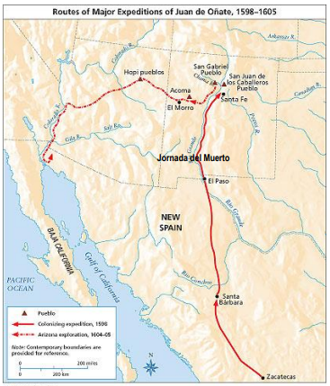
First Cattle Market in New Mexico
Coronado expeditions 1540
  Cattle primarily food source
Onate in 1598
  Sheep prominent
  Work animals
https://www.legendsofamerica.com/coronados-expedition/

Slide 4
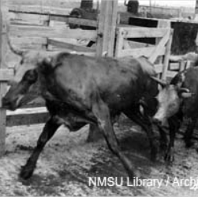
Cattle Industry Early 1800s
War (Pueblo Revolt of 1680 for example) limited expansion of cattle in NM from Onate to mid-1840s.
Development of the New Orleans market and eventually California Gold Rush developed a supply chain in West Texas.
  “Neat Cattle”: Spanish derived, smaller, yield little milk and less desirable beef product than “Eastern breeds” (Love, 1916)

Slide 5
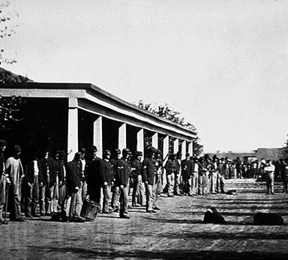
Fort Sumner
Congressional authorization in 1862.
Significant impact on development of the cattle market in New Mexico
  Market Demand
  More stability in the region

Slide 6
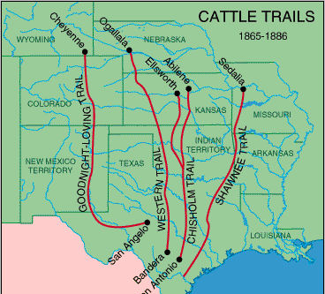
Goodnight-Loving Trail: 1866
Opening of markets outside of New Mexico
Cattle to stock the Northern Plains
Take cattle to northern railroad depots
110,000 head on a single drive from Roswell to CO in 1874 (1880 Gov Report)

Slide 7
Origin of Goodnight-Loving Trail Important
Set the stage for the early cattle types in New Mexico
Open range
  Little focus on grazing management or breed type
Major Cattle Types:
  Texas Longhorns
  Mexican (or Spanish) which were smaller than Longhorns and shorter horned
  Chino or curly-haired Texan cattle (noted to be large well-formed cattle)
  Brown wild cattle with a striped back and blue horns were reported but gone by 1880

Slide 8
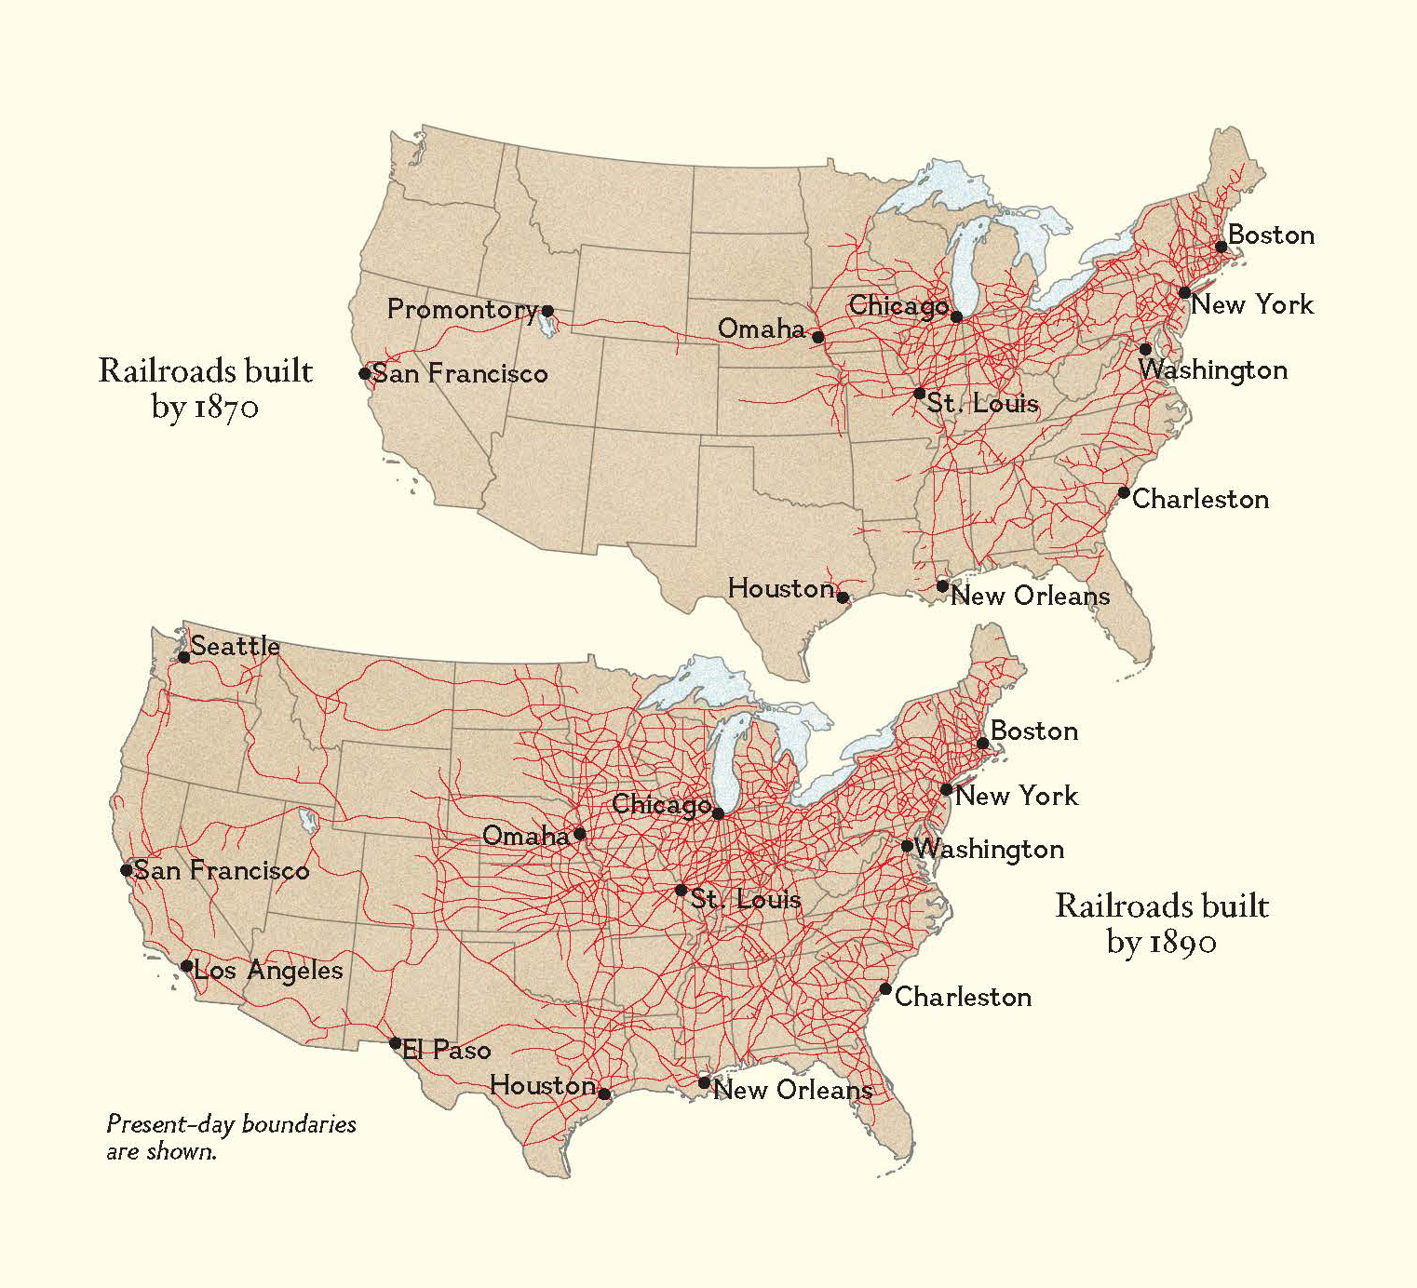
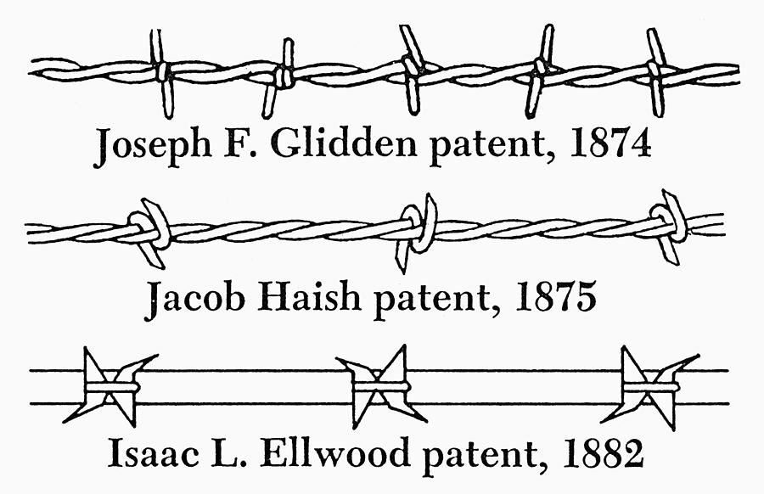
2 Major Advancements in 1880s
1880: 3 strand barbed-wire fence with posts 25 feet apart = $125/mile (1880 Gov Report

Slide 9
New Mexico is a Harsh Environment
Railroads opened new markets in the Midwest
  Military, settlers, and ranchers
Fences meant genetics could be improved
“Storms and short-forage affect the well-bred animal quicker than the coarse ranger”
“Whether the common or high blood should predominate, depends on the market to be reached”
The Midwest markets fed grain and strongly preferred better bred stock

Slide 10
Spanish Cattle Dominated 300+ Years
New markets = new customers = new approach
J.W. Roberts brought Shorthorn cattle to Arizona via Lincoln County in 1874 (Wagoner, 1951)
Purebred Shorthorn suffered heavy losses in the harsh environment, but…
“The improvement of the breeds of cattle and sheep will greatly enhance the profits, and this fact has become so apparent that it is believed in a short time the cattle and sheep will equal those of the best grazing· regions of the United States.”
Launched the next 140-year journey to develop quality cattle that can also flourish in the harsh environment

Slide 11
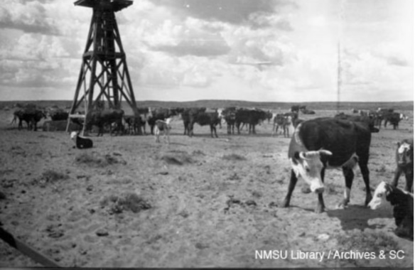
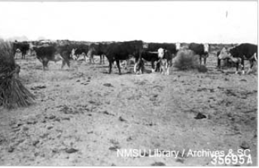
Hereford Revolution
Appeared in TX in the 1870s (Miller; History of Herefords)
Herefords were reported in Nogales in the early 1880s, so likely in NM around that time
About this time, many Spanish-blood cattle were spayed
By 1941 most cattle in NM Hereford (Culbert)

Slide 12
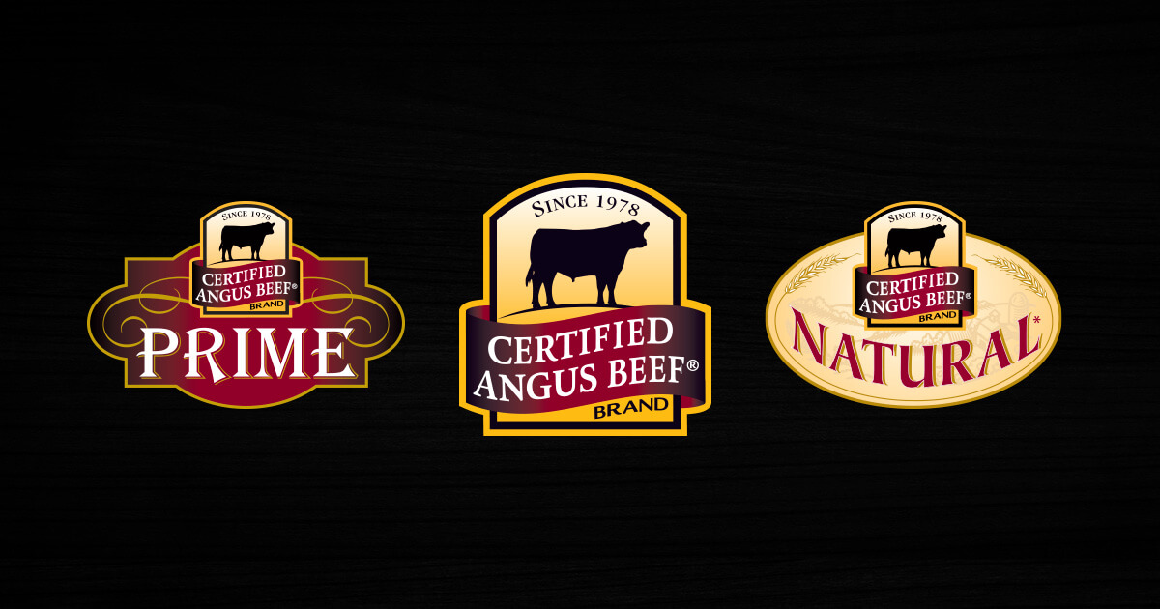
1978 Start of a National Shift

Slide 13
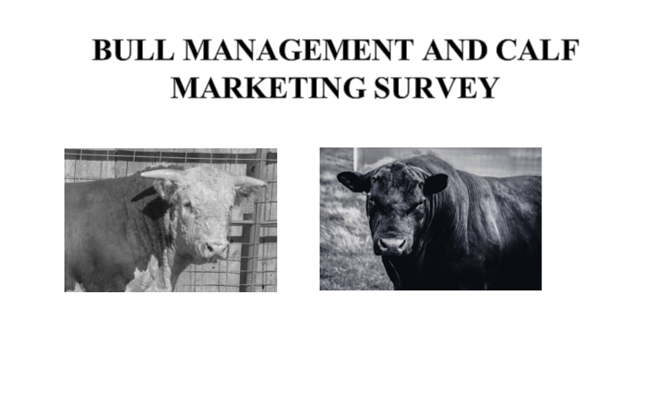

Slide 15
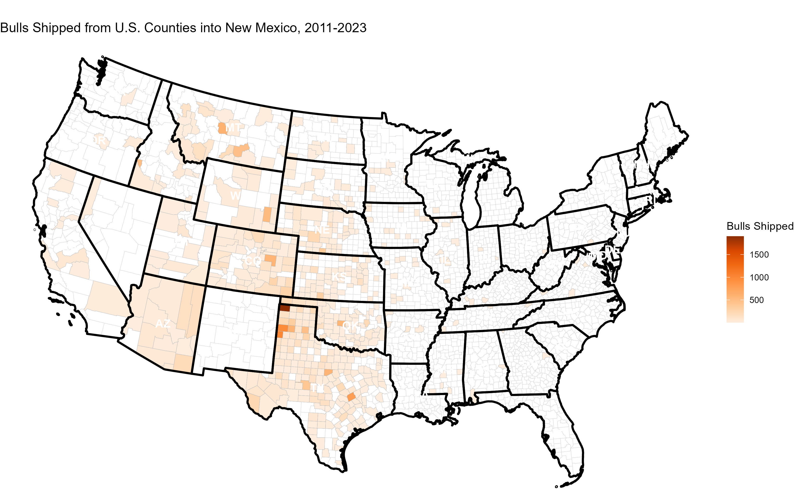
Bull Imports and Genetics
Import 2200 +/- beef bulls/year

Slide 16
Marketing: Where is our current market?

Slide 17
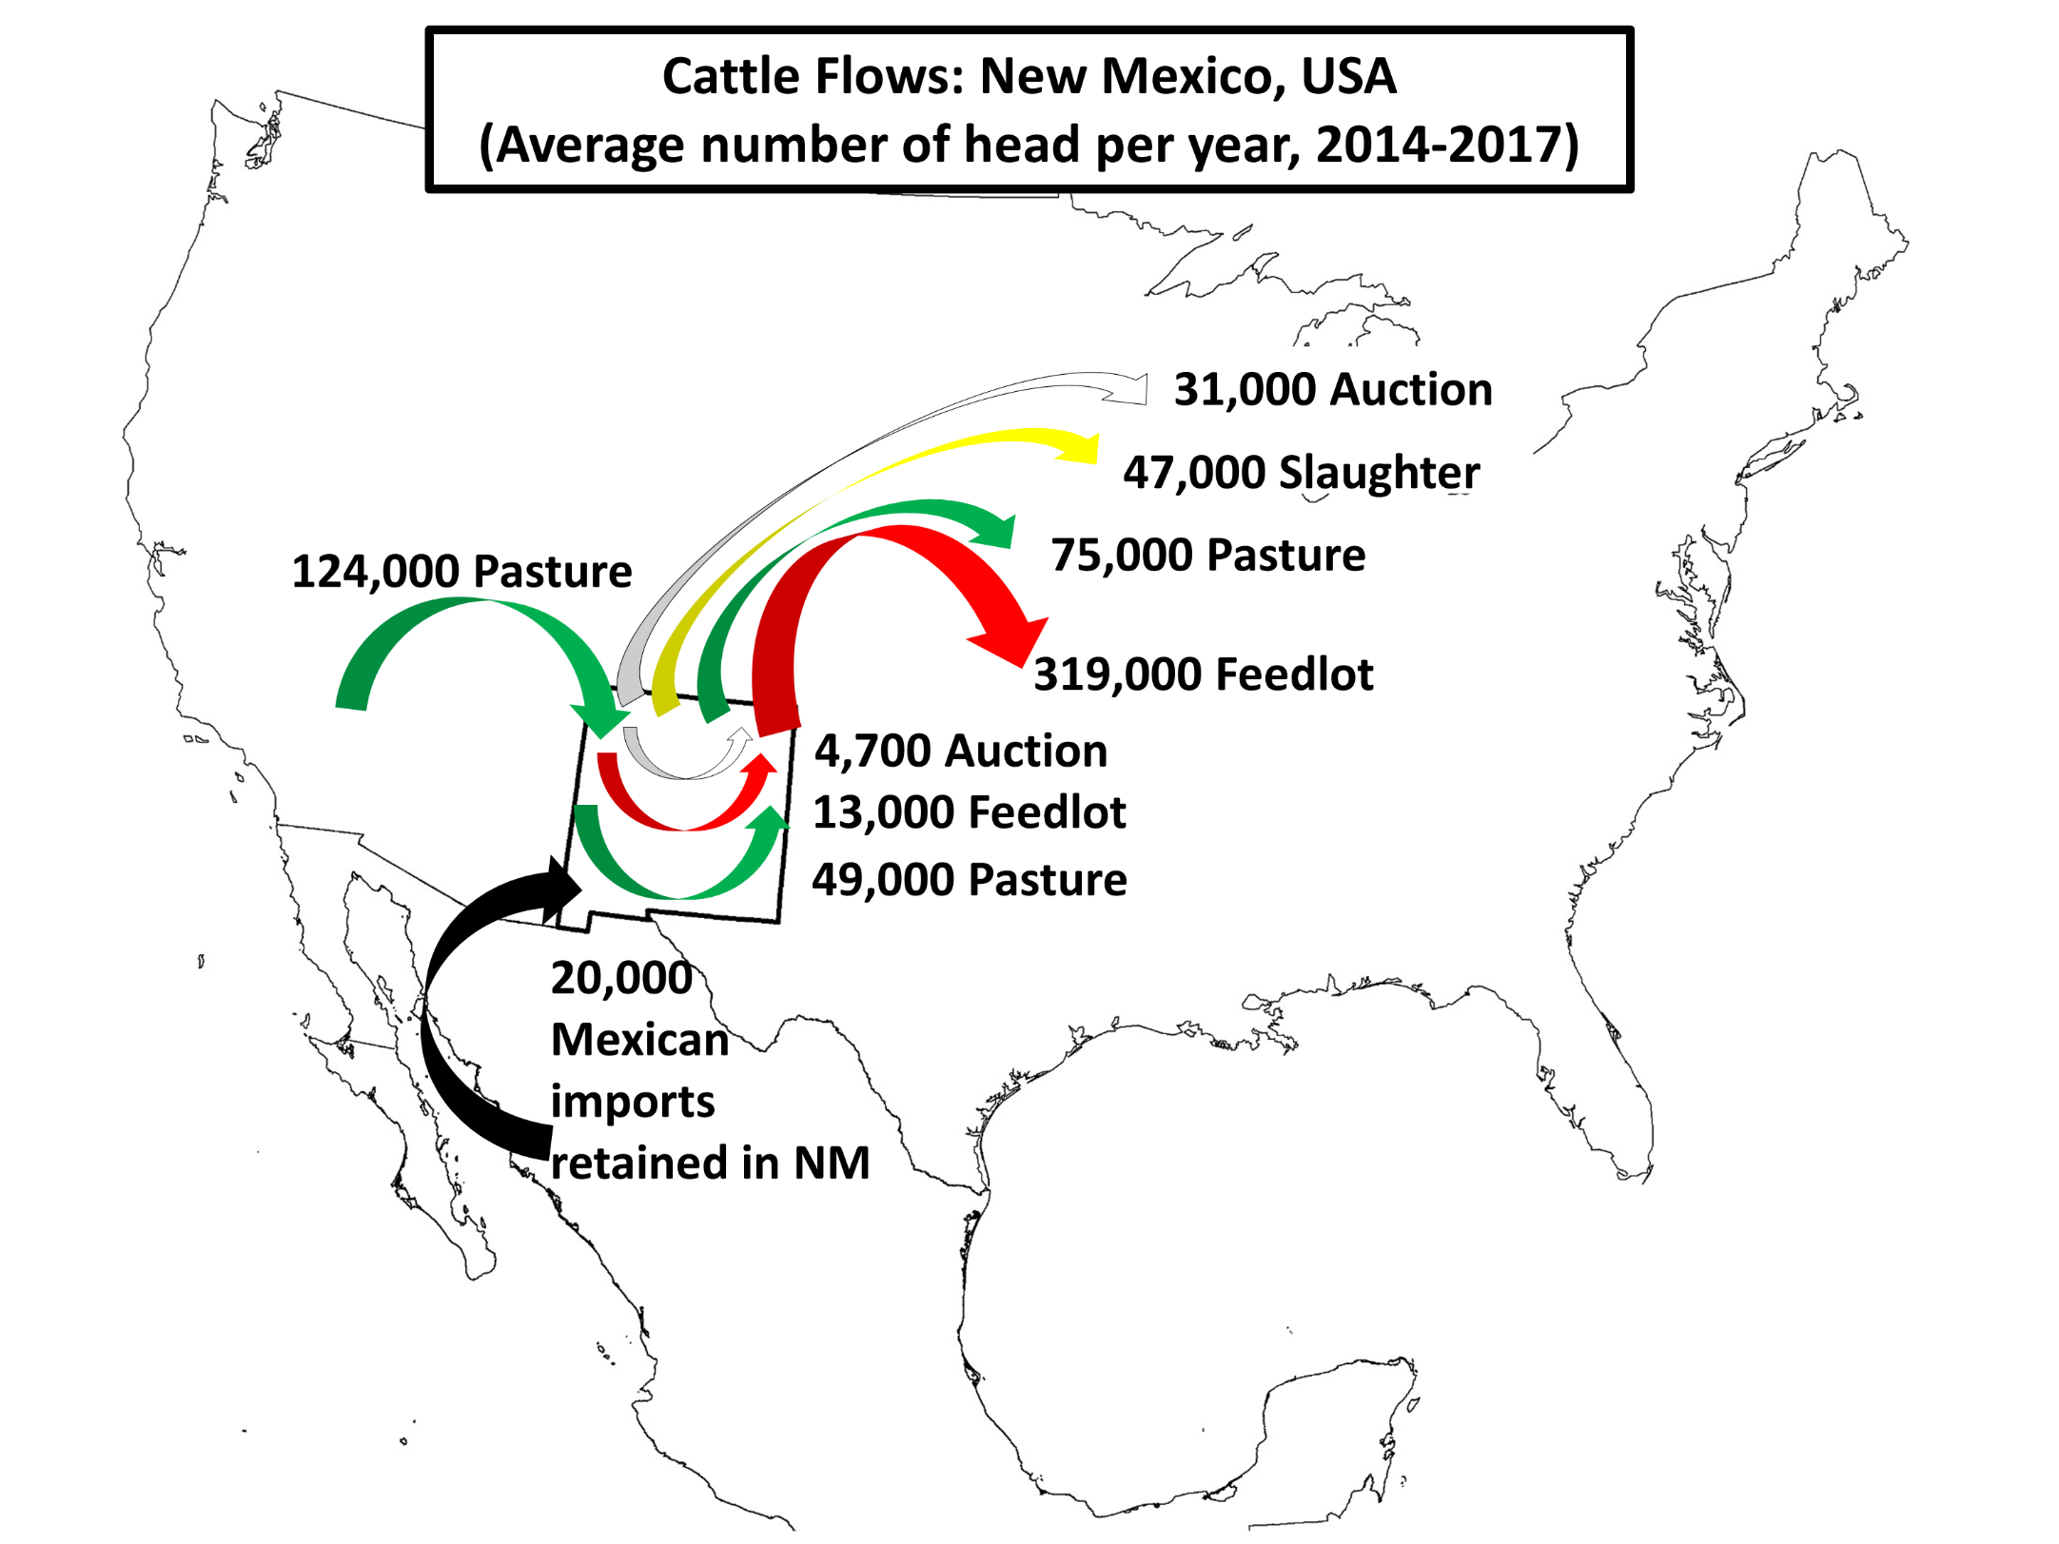

Slide 18
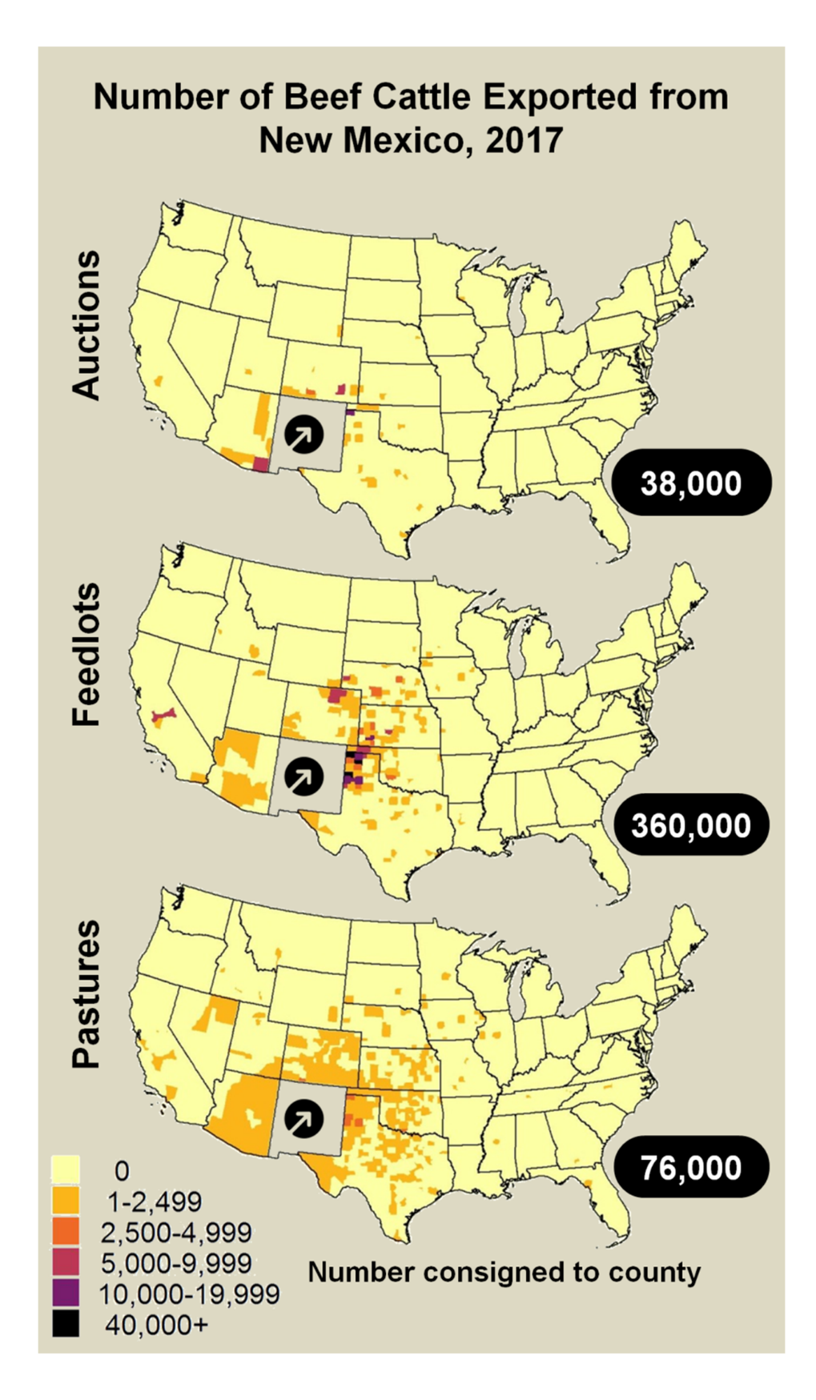

Slide 19
Considerations
NM Calf Crop < 5% of the feeding capacity in Panhandle region
Means calves MUST fit that system to market there
  Feedlot vs Wheat

Slide 20
Marketing: Other Considerations?

Slide 21

Quote
Person A (talking to rancher): “If I were you, I would……”
Rancher: “If you were me, you’d own a ranch and not be telling me what I need.”
No silver bullets and every ranch is different.

Slide 22
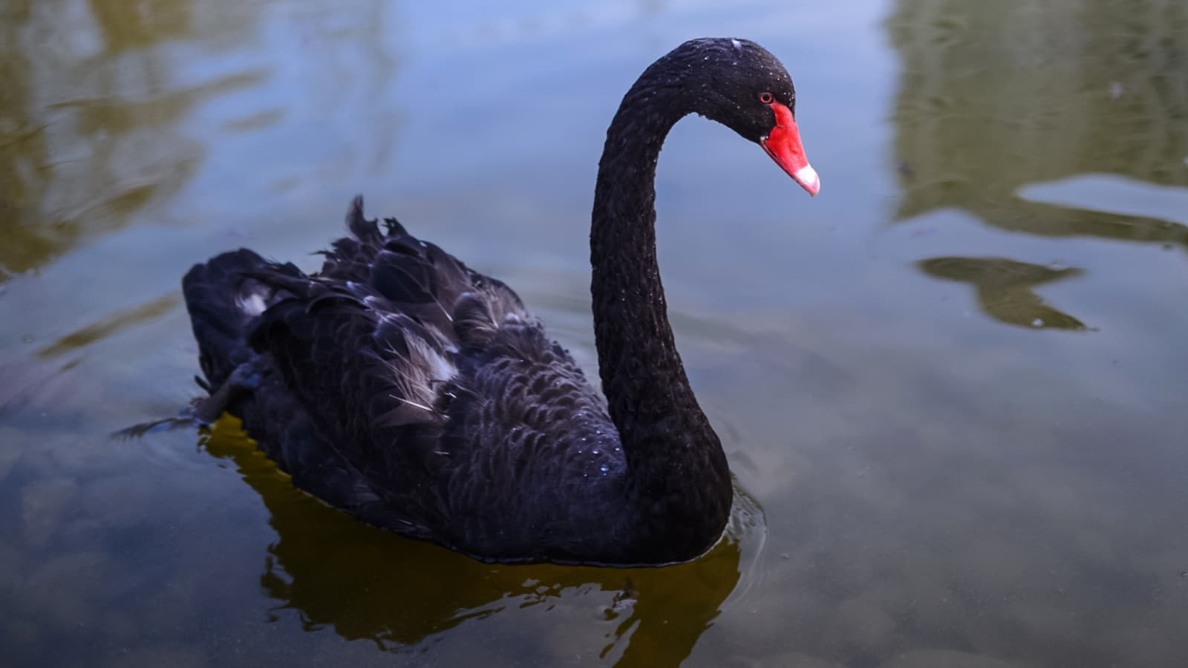
Black Swan Event
Metaphor that describes an event that comes as a surprise, has a major effect, and is often inappropriately rationalized after the fact with the benefit of hindsight.
Black swan or get used to adversity?

Slide 23
Marketing
When evaluating ranches, the main difference between profit levels, is input costs—Dr. Stan Bevers.
  Weather
  Prices *
  Politicians
  Fuel prices, inflation, etc.
Maximizing Resources

Slide 24
Measure!
Keep the future in mind…
Use standardized terms, definitions, methodologies, and protocols and to take measurements accurately
Measure what’s relevant to your area and your bottom line
  Exactly how much are you spending on supplement/cow?
  What percentage body weight is the pasture weaning?
    Identify big cows weaning small calves
  Etc.
Targeting bigger, greater than, or more is not always best

Slide 25
Flexibility
Drought management and resiliency standpoint
Develop marketing plan that allows for traditional avenues as well as:
  Retained ownership through 800-850 lbs
  Retained ownership through fat cattle
  Selling on the rail
  Direct market
Gather enough information that allows you to forward contract calves
Manage and minimize risk
Do what they pay you to do
Know your market

Slide 26
Current Marketing in NM
80-85% beef calves sold off the ranch (NMLB personal communication)
Sale barns
Packer direct
Consumer direct
  Corn fed/finished
  Grass fed/finished
  Rose beef
Grass calves

Slide 27

For Today
Think about your market
Think about potential market
Think about your resources
  Labor
  Time
  Resources
  Financials/debt
Think about your goals

Slide 28
Don’t forget you are in New Mexico. Cows here are adapted here.
Remember your limitations.
“Anything and everything can be considered marketing—so long as it grows the business.”—Ryan Holiday

Slide 29
Questions?
Craig Gifford
Extension Beef Cattle Specialist
Department of Extension Animal Sciences and Natural Resources
New Mexico State University
P.O. Box 3000, MSC 3AE
Las Cruces, NM 88003
cgifford@nmsu.edu
Phone: 575-646-6482

