Slide 1
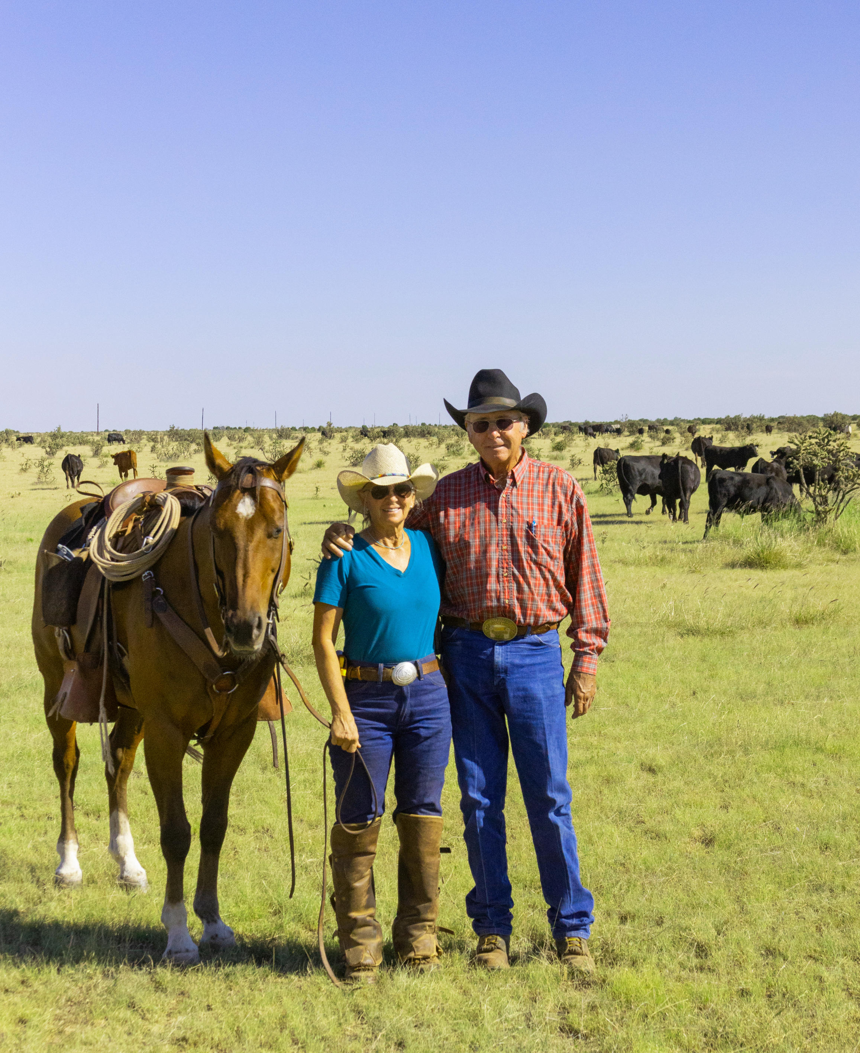
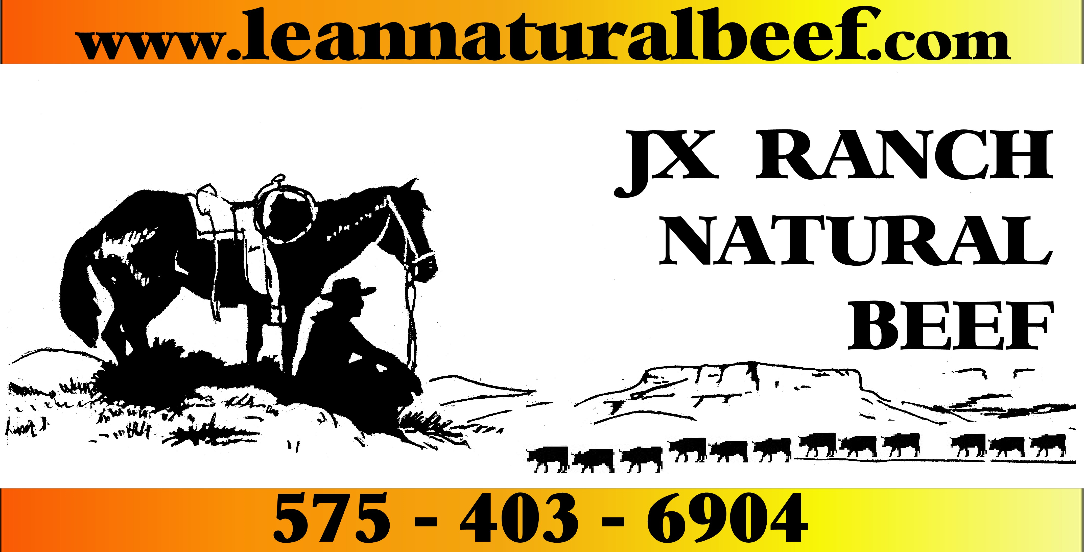
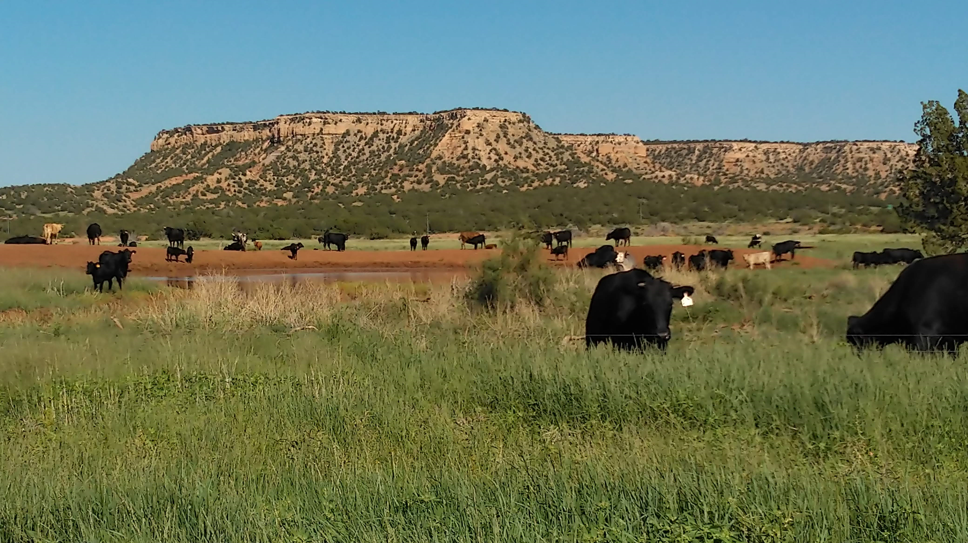

Slide 2
STARTED SELLING CUSTOM CUT DIRECT TO CONSUMER IN 2008:
FULFILL A GROWING DEMAND FOR NATURALLY RAISED BEEF
BE PASSIONATE ABOUT WHAT YOU DO AND PRODUCE
START SMALL, WATCH COSTS, BE RESOURCEFUL, “KISS”
CHOOSE CATTLE THAT FIT THE COUNTRY AND CLIMATE
YOUR CUSTOMER IS NOW YOUR BOSS! LISTEN…
MAKE THE BUSINESS FIT IN WITH YOUR LIFESTYLE

Slide 3
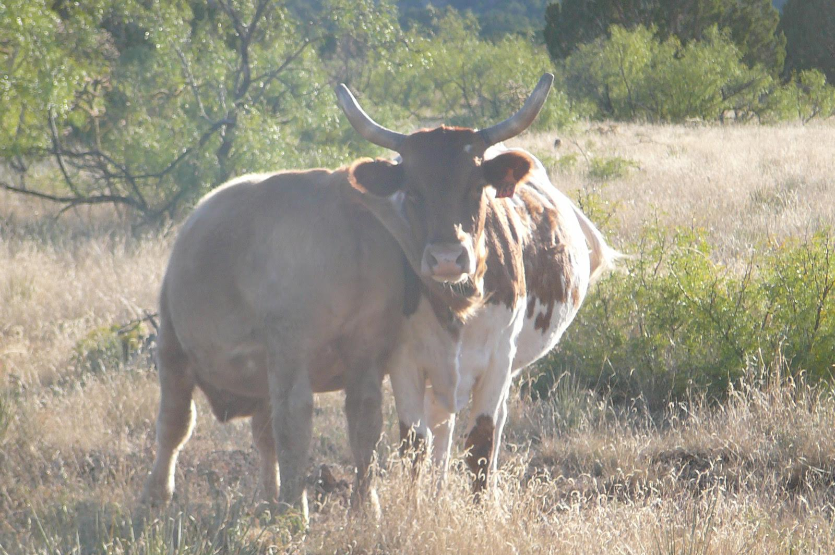
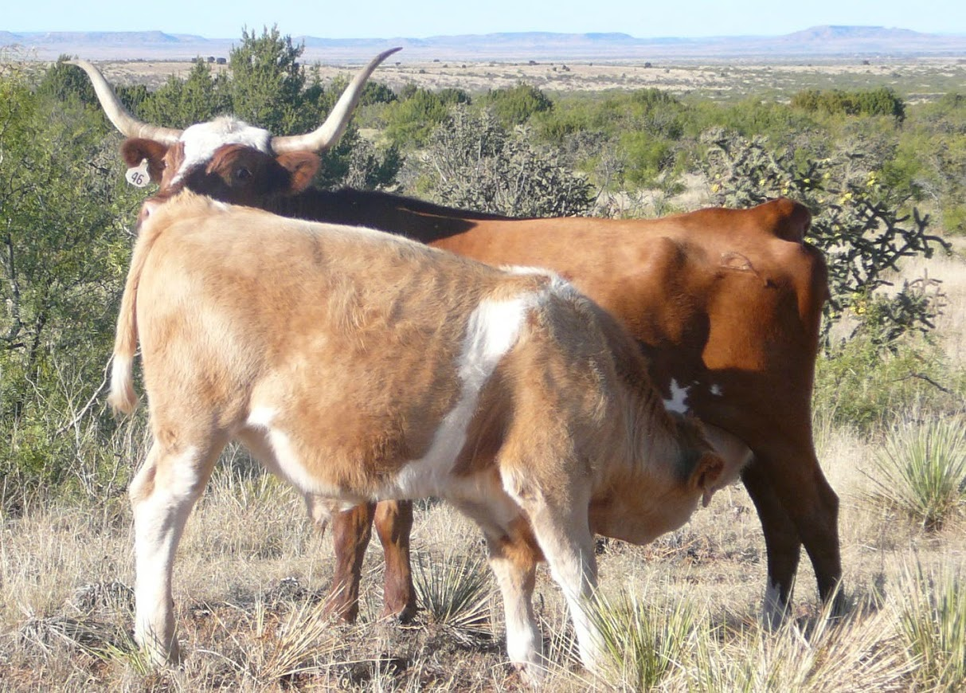
Our original cows were all Criollos, or Corrientes, which we bred to good Charolais bulls. At weaning the calves were towering over their mamas! A great cross; keeping the hardiness and resourcefulness of the cows, combined with a good meat breed bull.

Slide 4
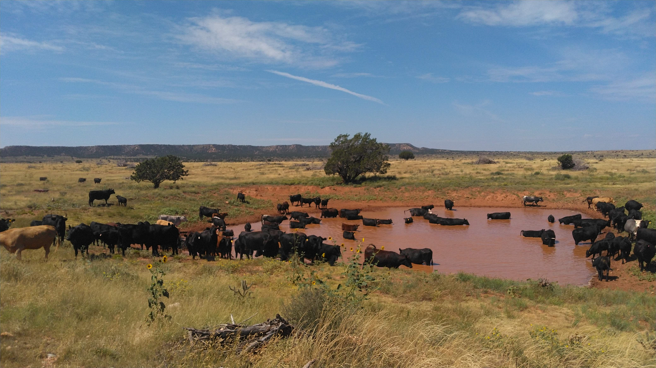
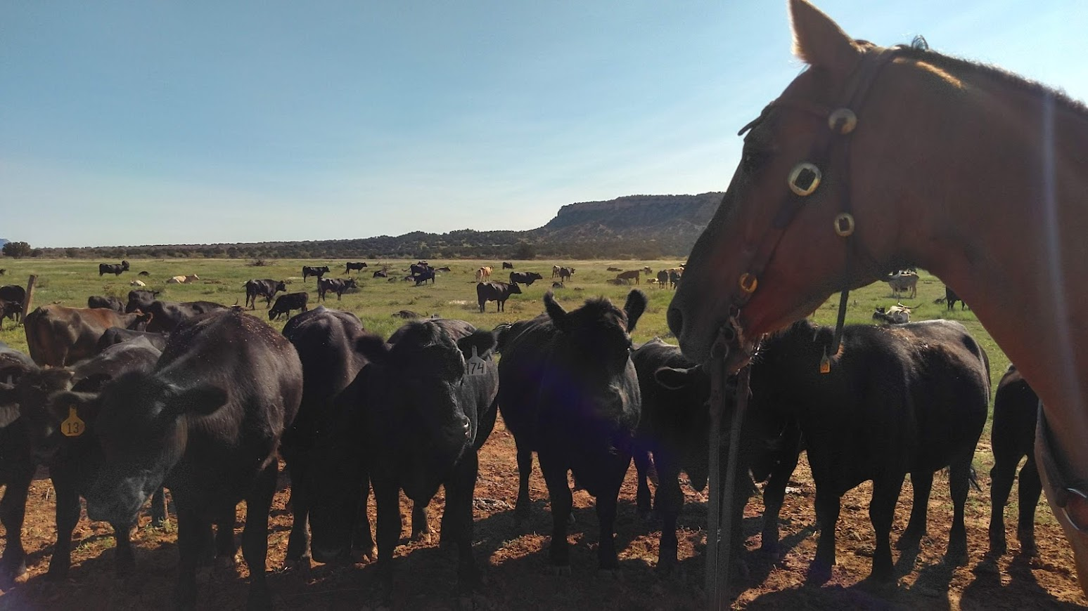
... bred back to quality Angus bulls = more marbling
Our cow are now mostly Angus/Criollo crosses = a moderately framed cow that
“fits the country”

Slide 5
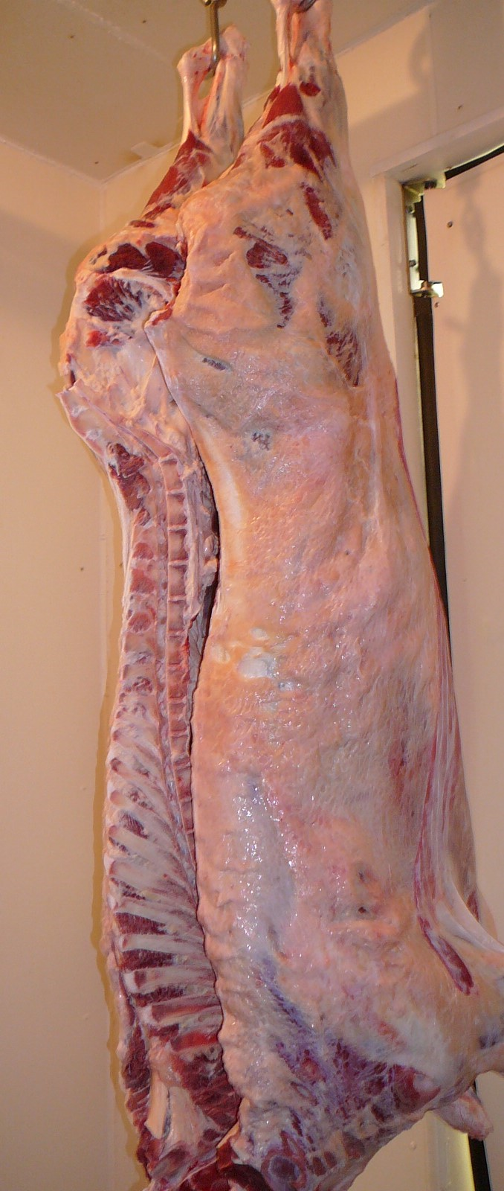
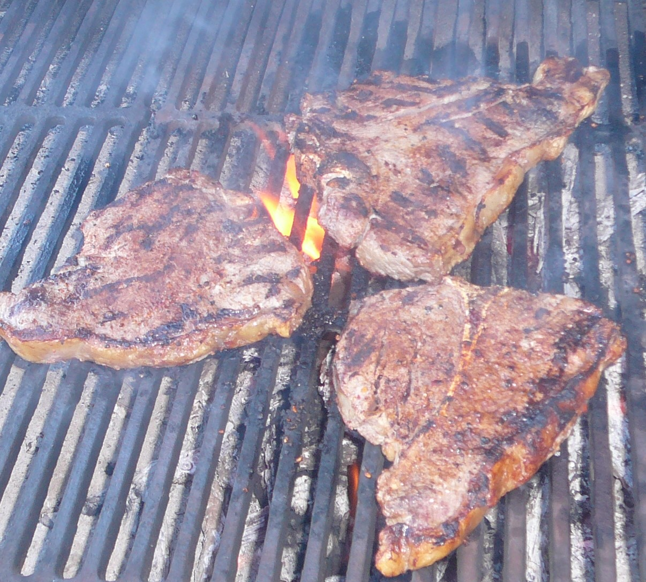
75 head / year
60 hd Custom Cut
+
15 hd Retail Sales
14 - 21 days dry-aging (hanging) is a must to delicious steaks sizzling on the grill!

Slide 6
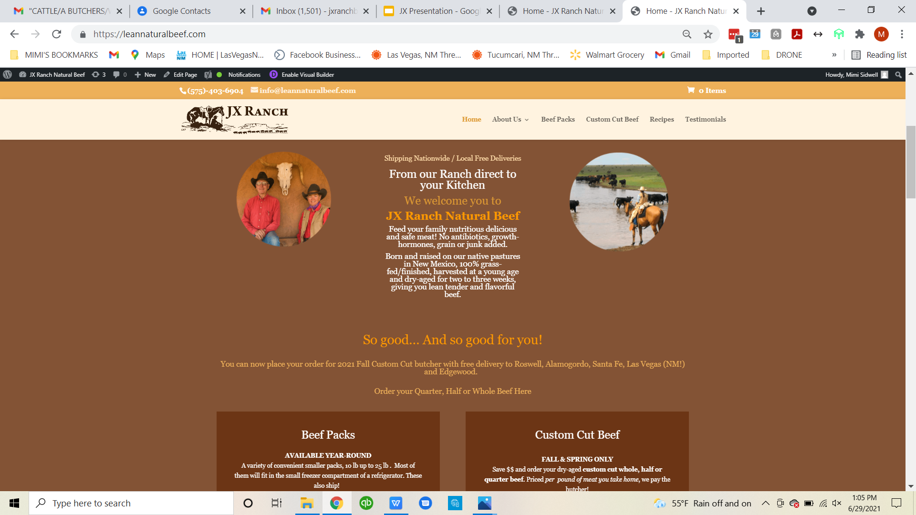
LEANNATURALBEEF.COM
Malibu sunset

Slide 7
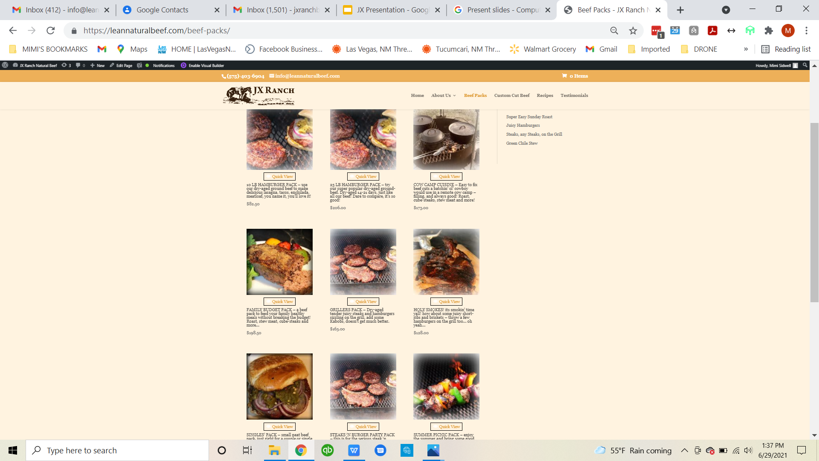
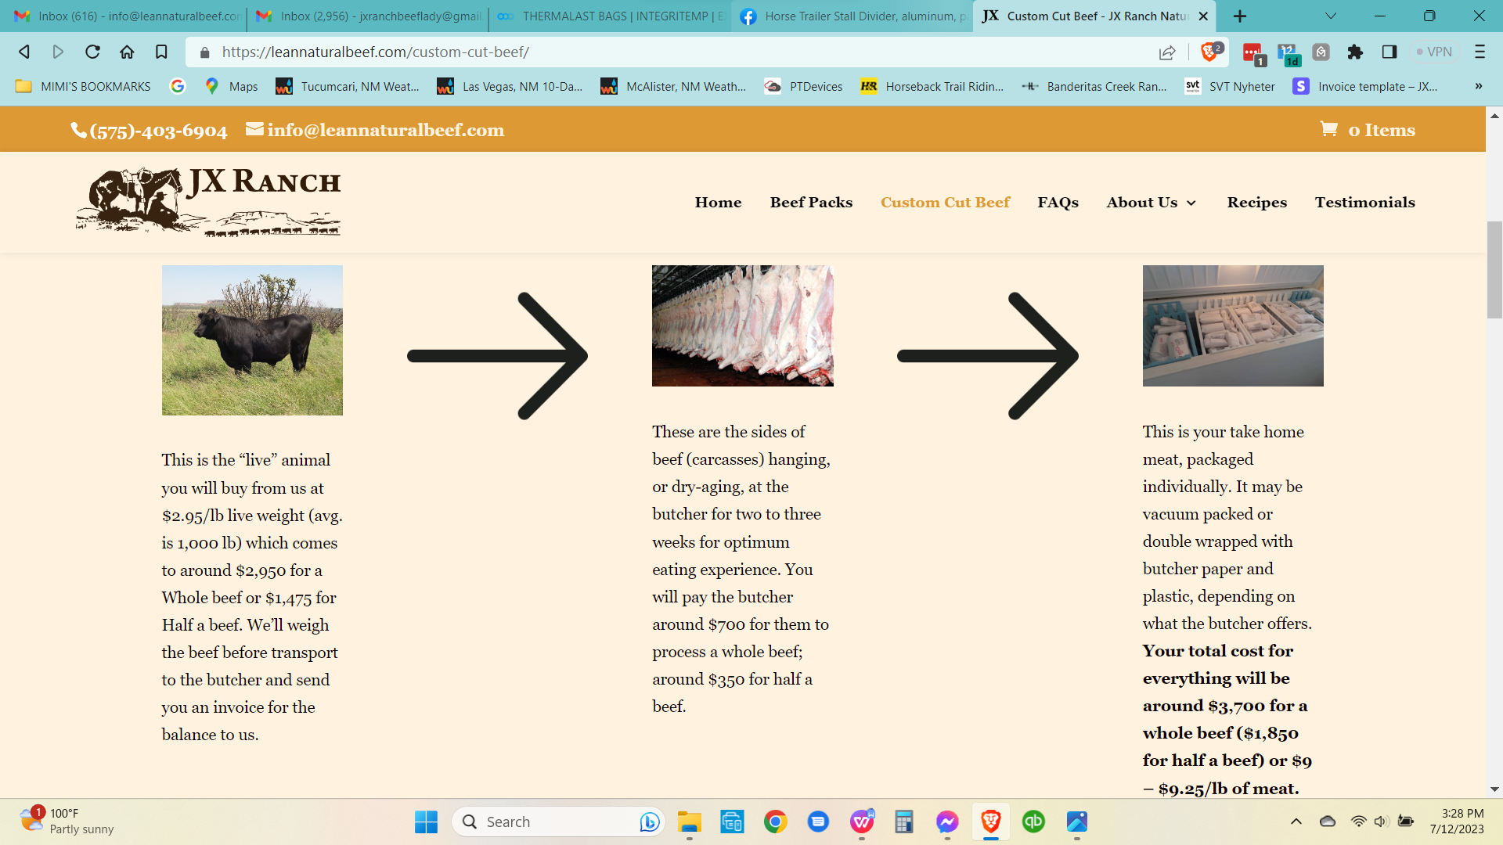
10 - 25 lb Beef Packs - Ship or Free Delivery Custom Cut Quarter, Half or Whole Beef

Slide 8
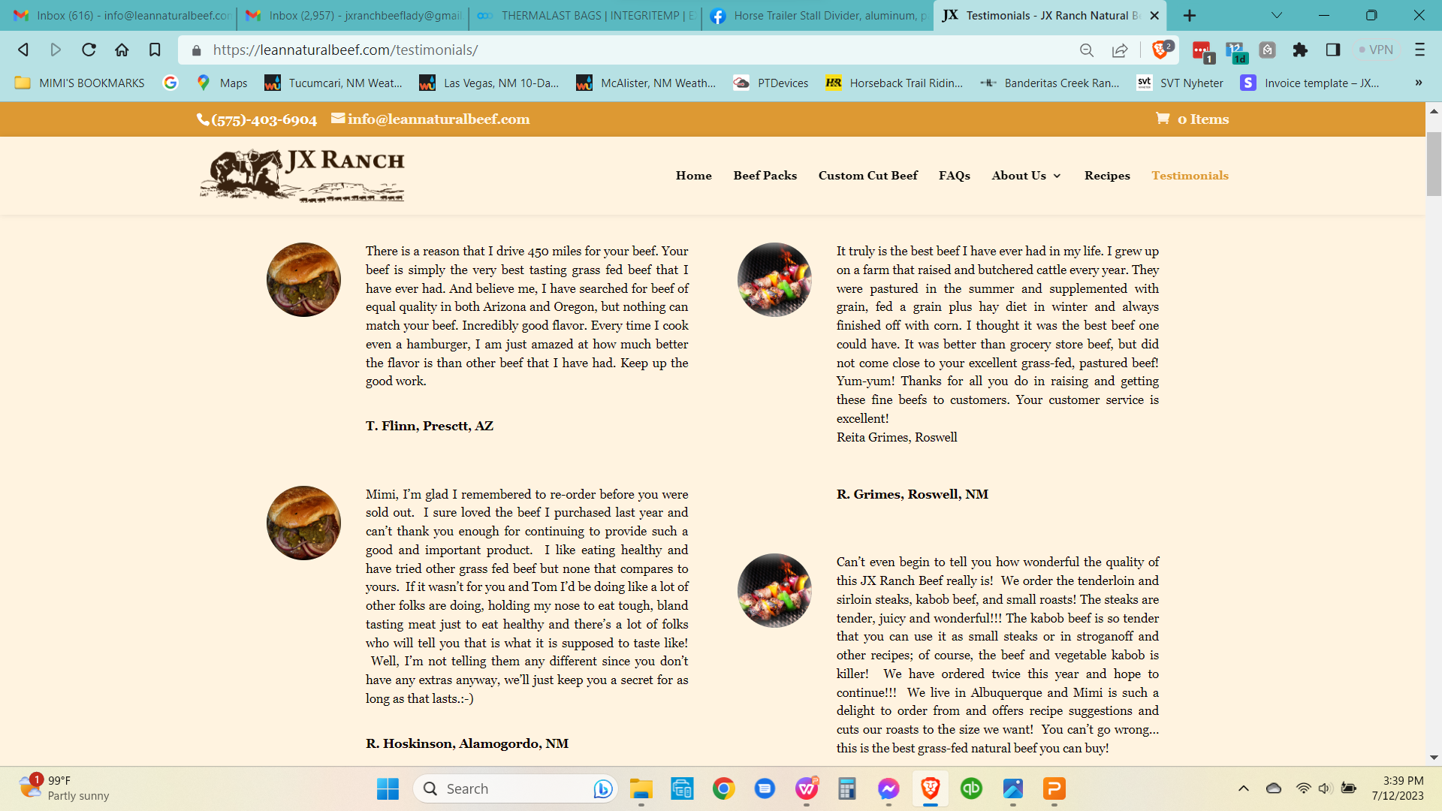
High Quality Meat + Excellent Customer Service = Happy Customers !

Slide 9
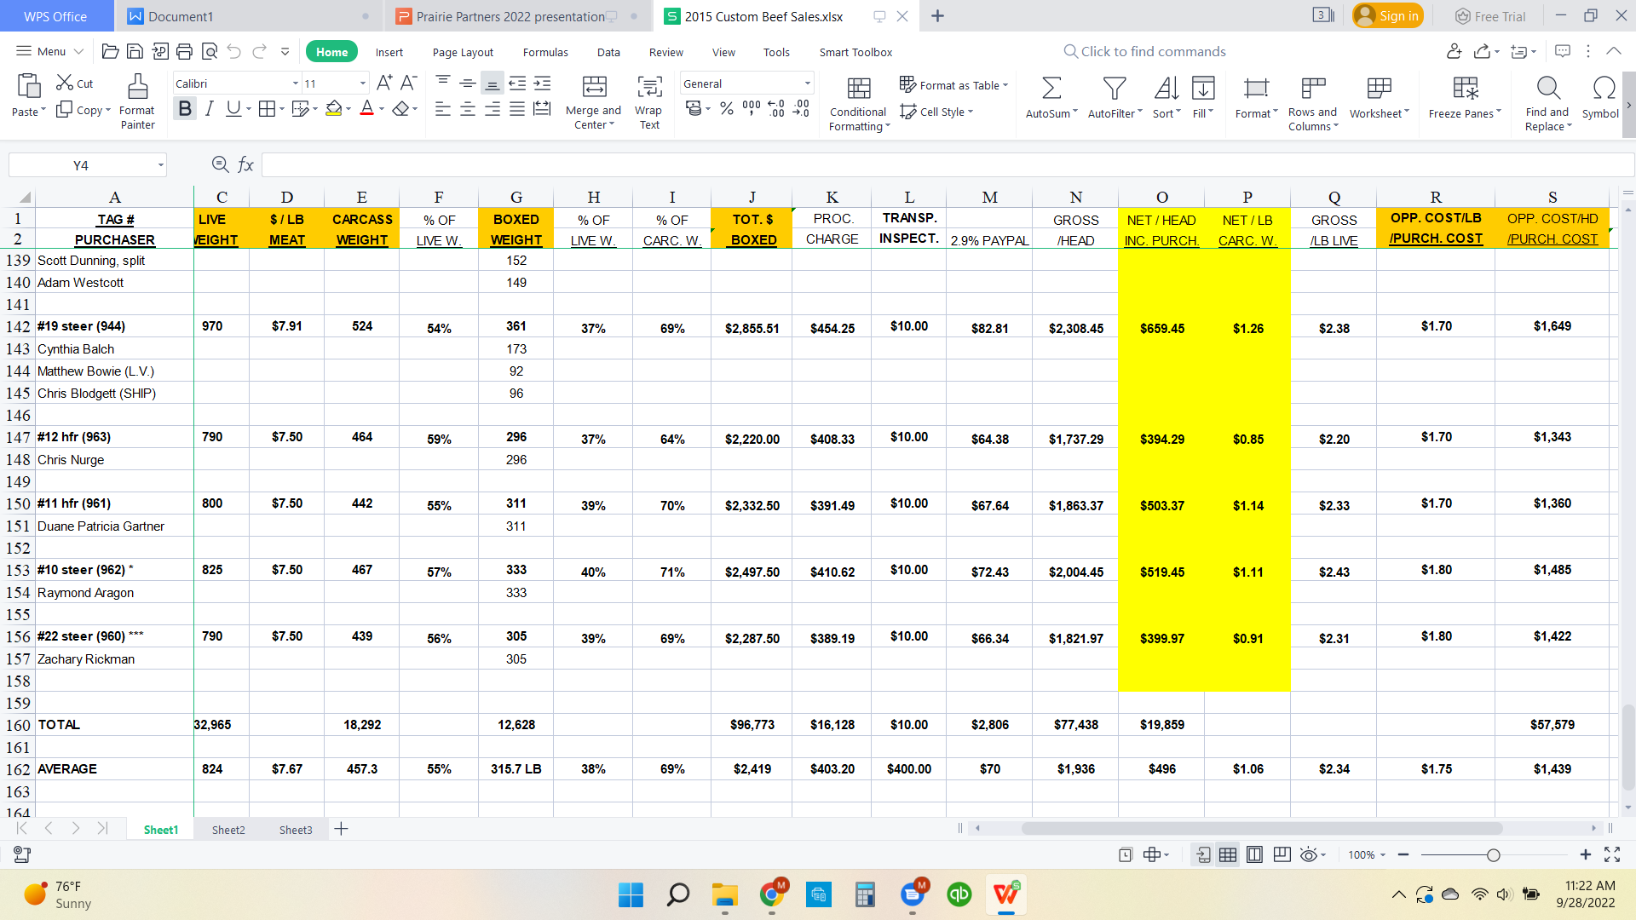
IMPORTANT BEFORE YOU START!
1. Know and figure in your opportunity cost -
What you would get for the steer (or hfr)
selling it through other outlets (see class!)
You have to get paid for the extra time and
work you put into this!
2. Are you good at dealing with customers from
all walks of life and various segments of the
population? Can you handle an unhappy
customer and make it right?
3. How are you going to market your product?
Website (customers can order/purchase)
Social Media - not for everyone, me included!
Farmers Market - do you have the time and
are you close to one?
Restaurants/schools; will you be able to offer
the consistency and supply in timely manner?
4. Do you have the time? Will it fit
in with your life style and your
schedule?
5. Be transparent, tell what you do and
don’t do; listen to your new bosses -
your customers!

Slide 10
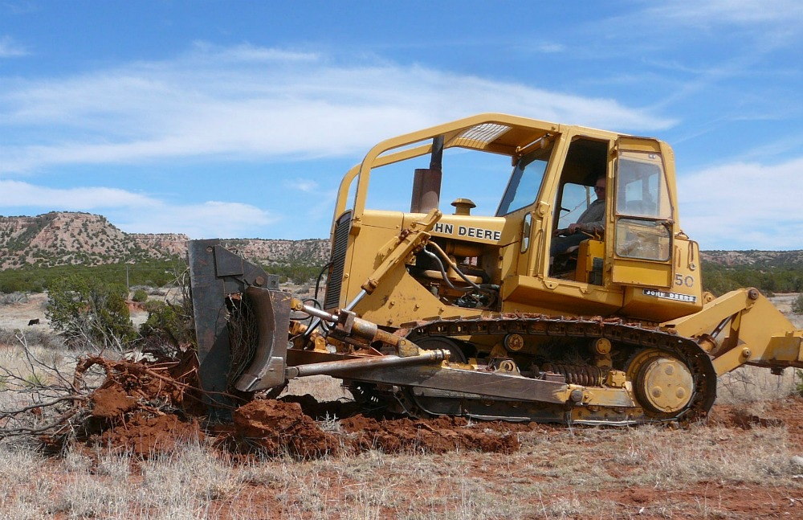
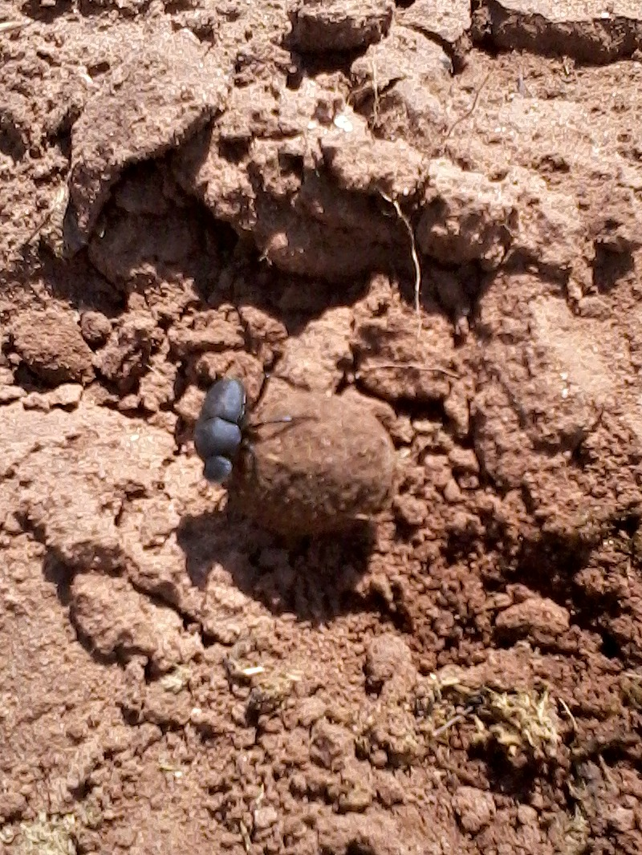
The BIG guy, and the LITTLE guy, both working on restoring the range!

Slide 11
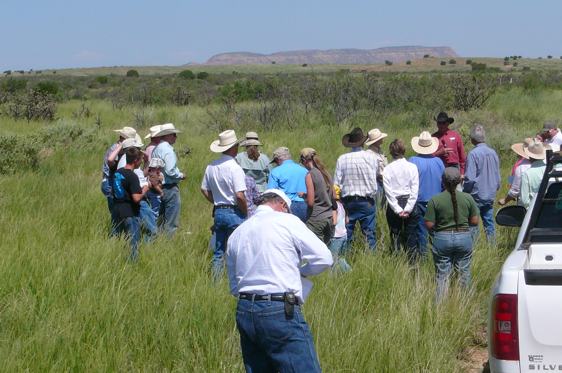
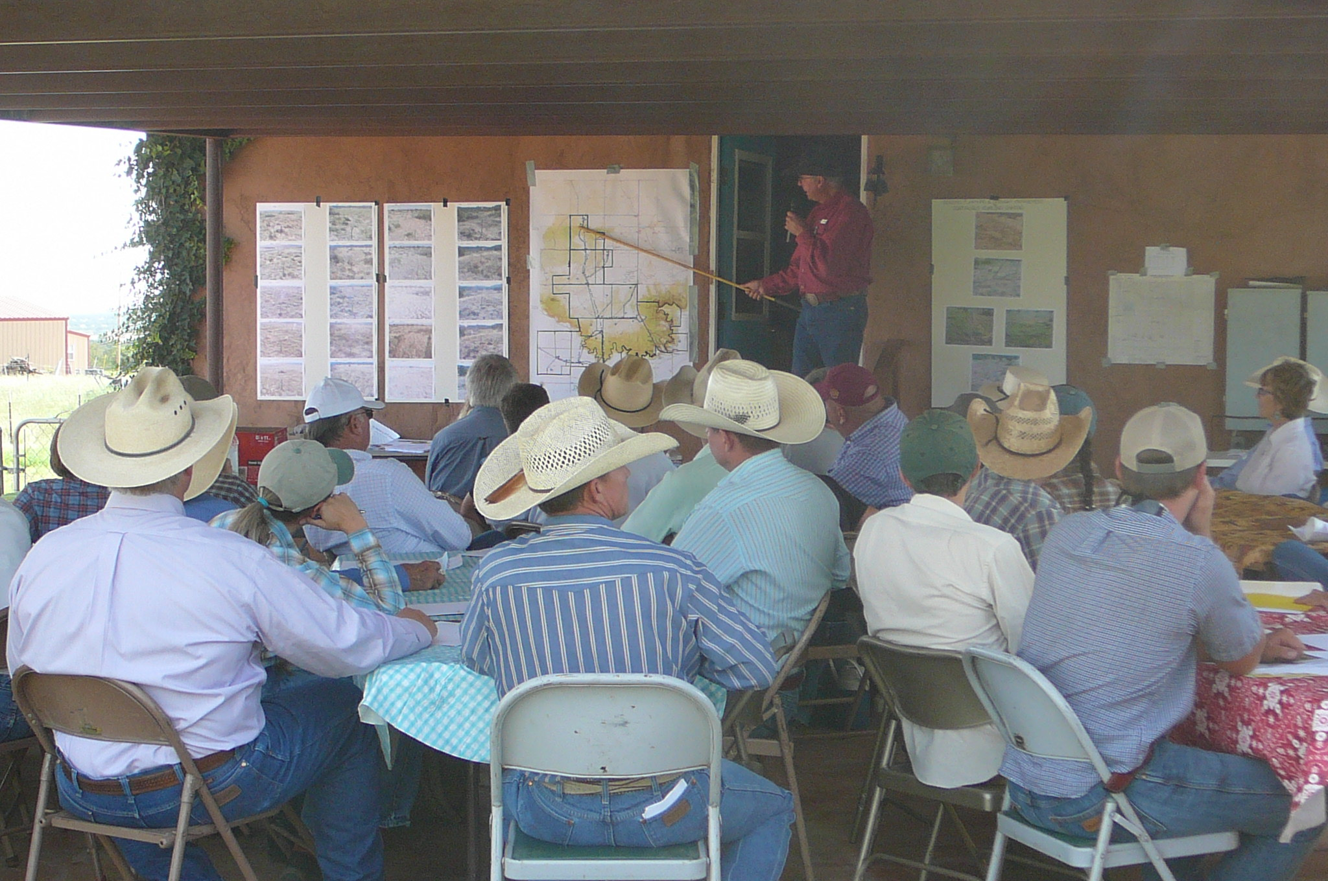
Regenerative / Restorative / Rotational / Holistic / Intensive / Planned / Whatchamacallit Grazing Management
Good grazing management goes hand in hand with direct marketing of beef
Tom have given numerous tours and classes with Holistic Management International
and Quivira Coalition.

