Slide 3
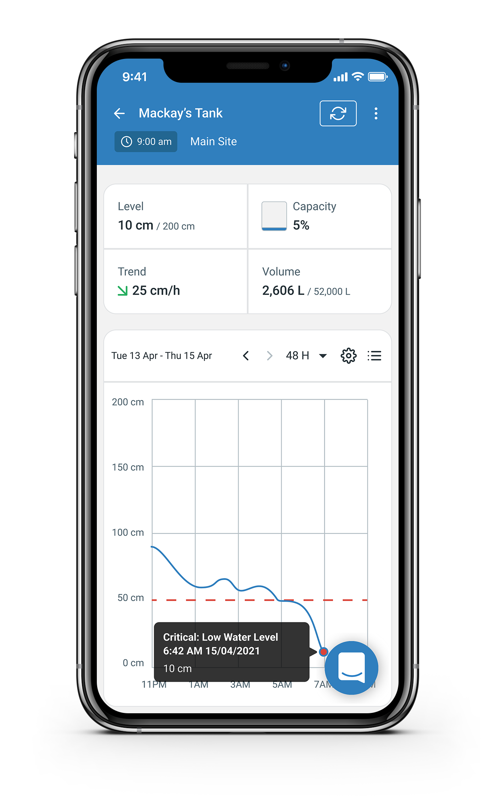
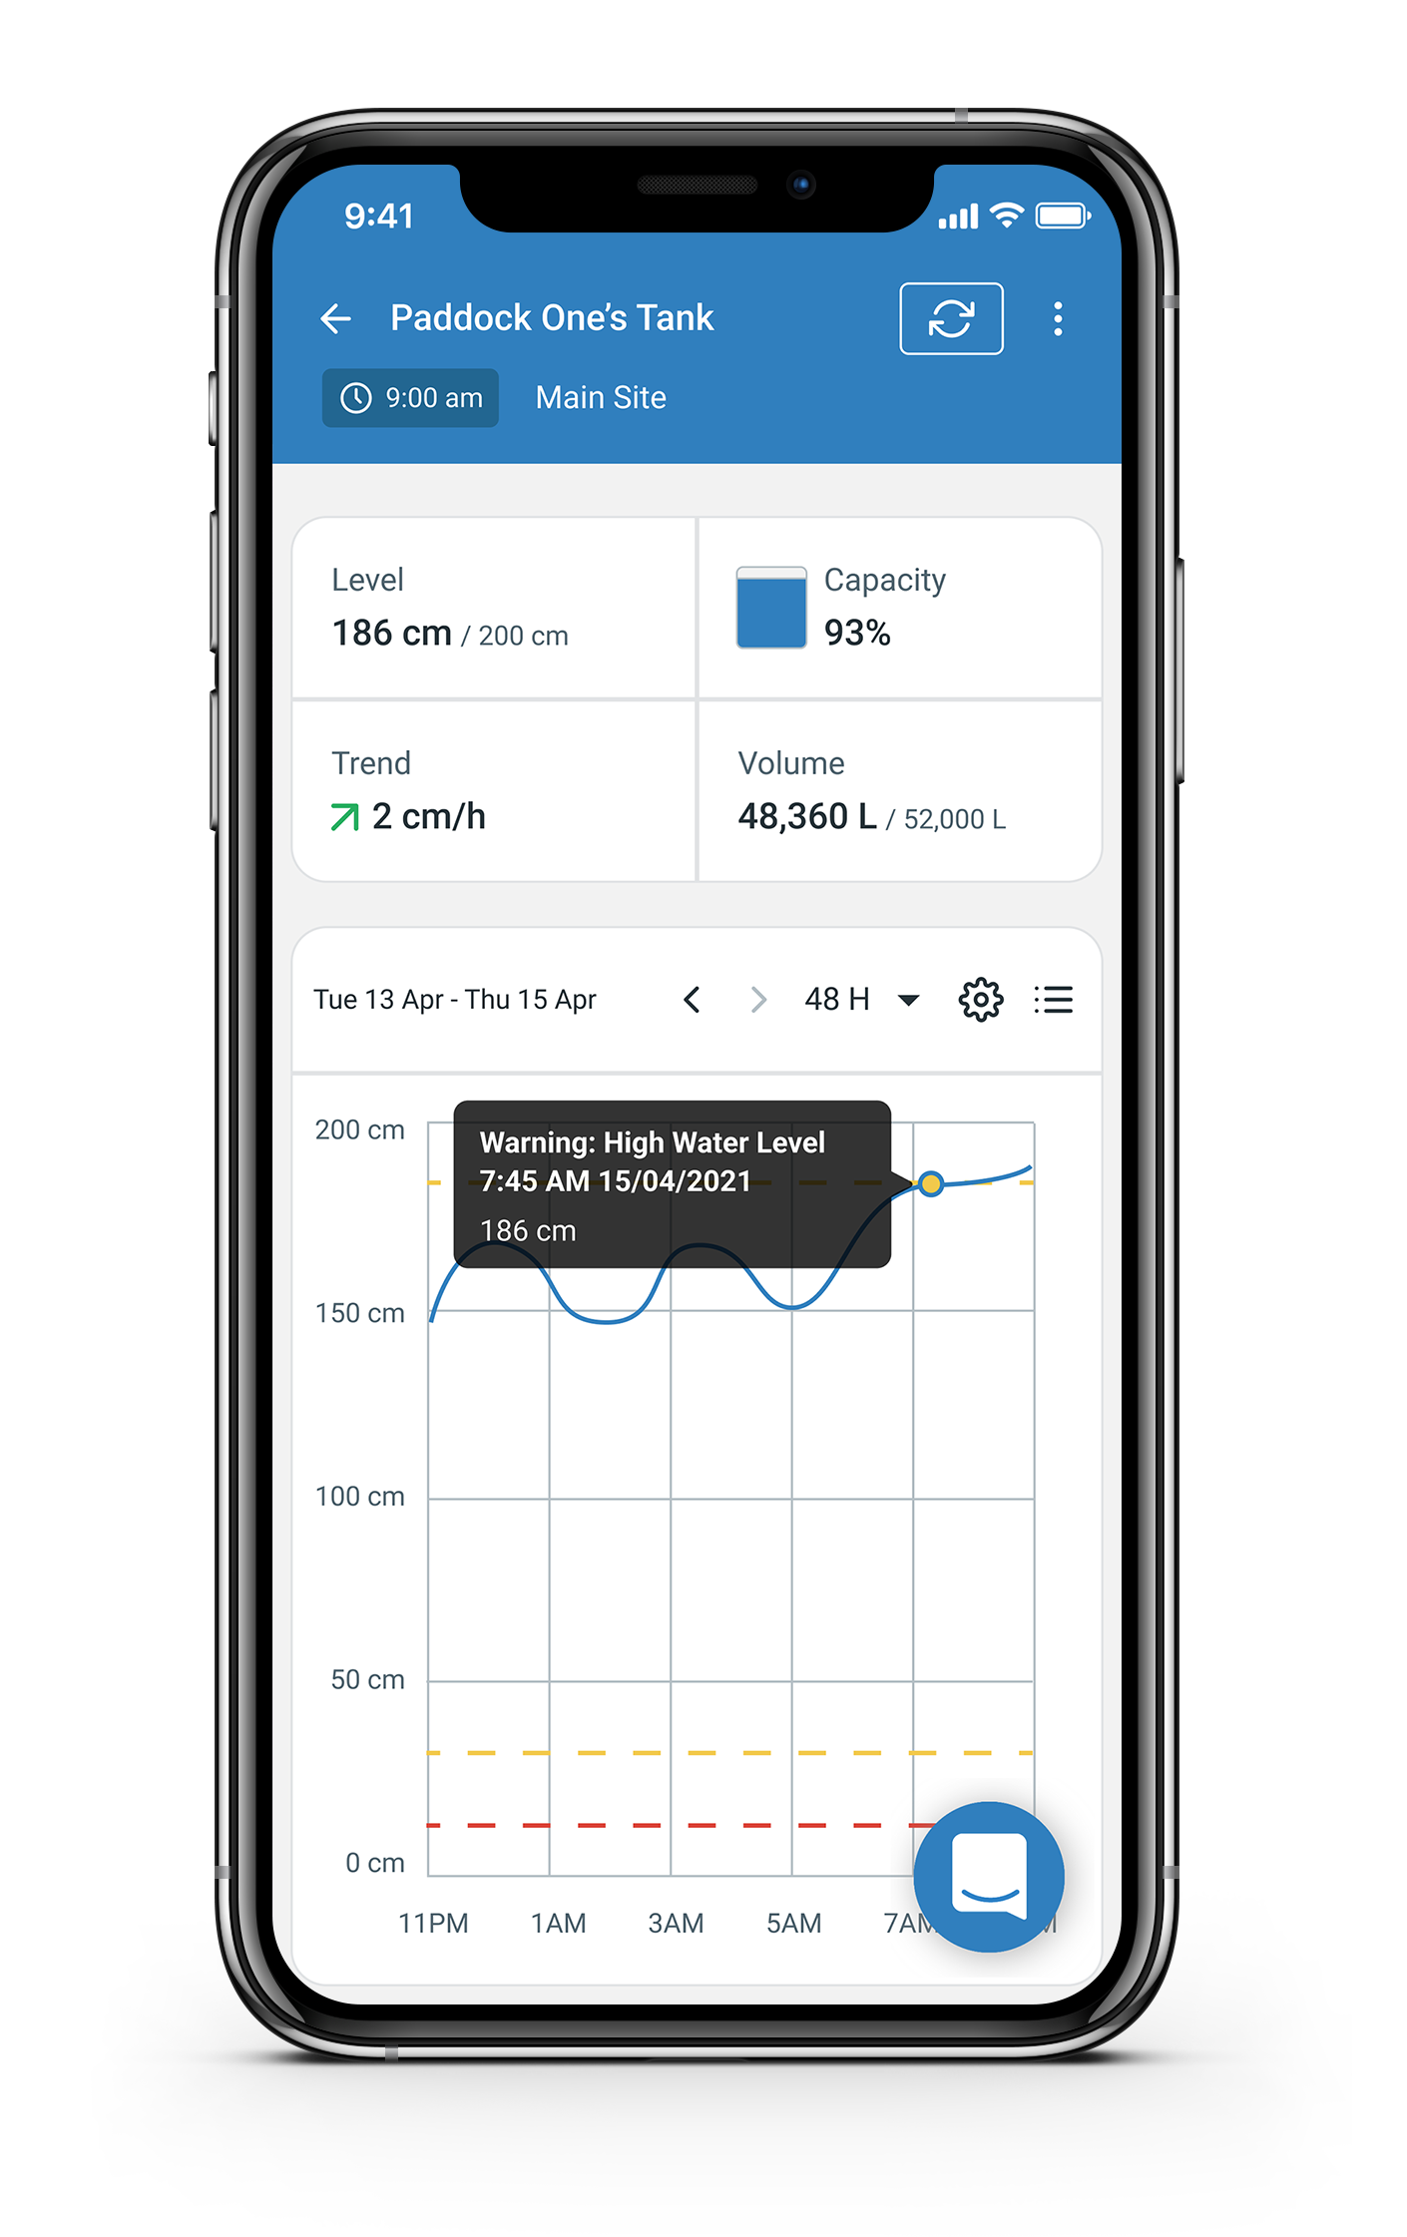
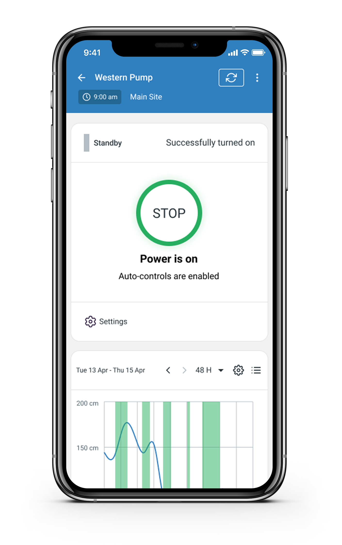
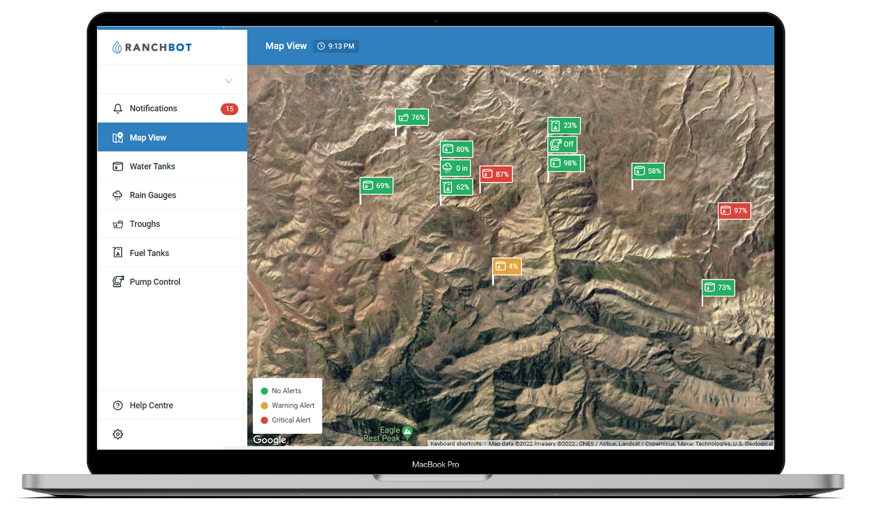
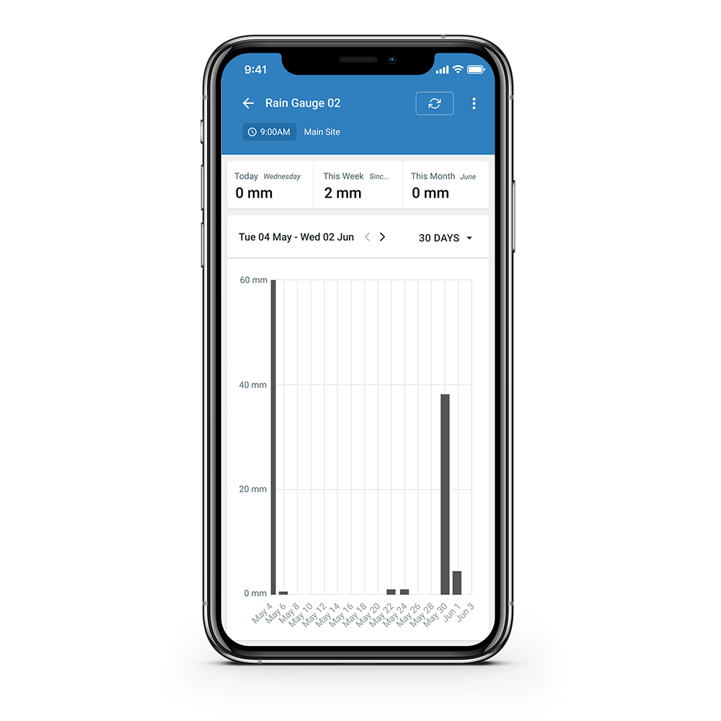
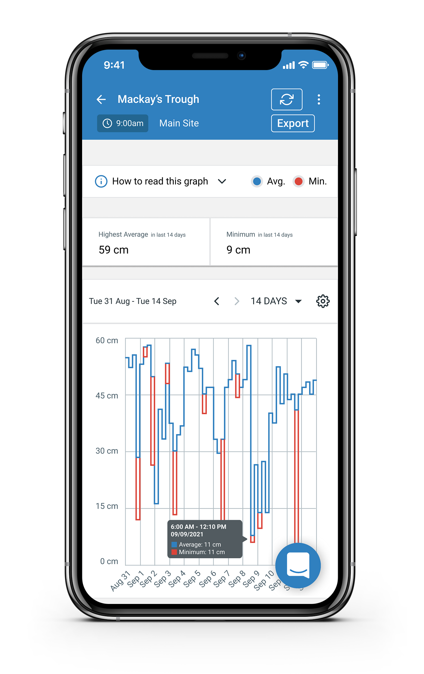
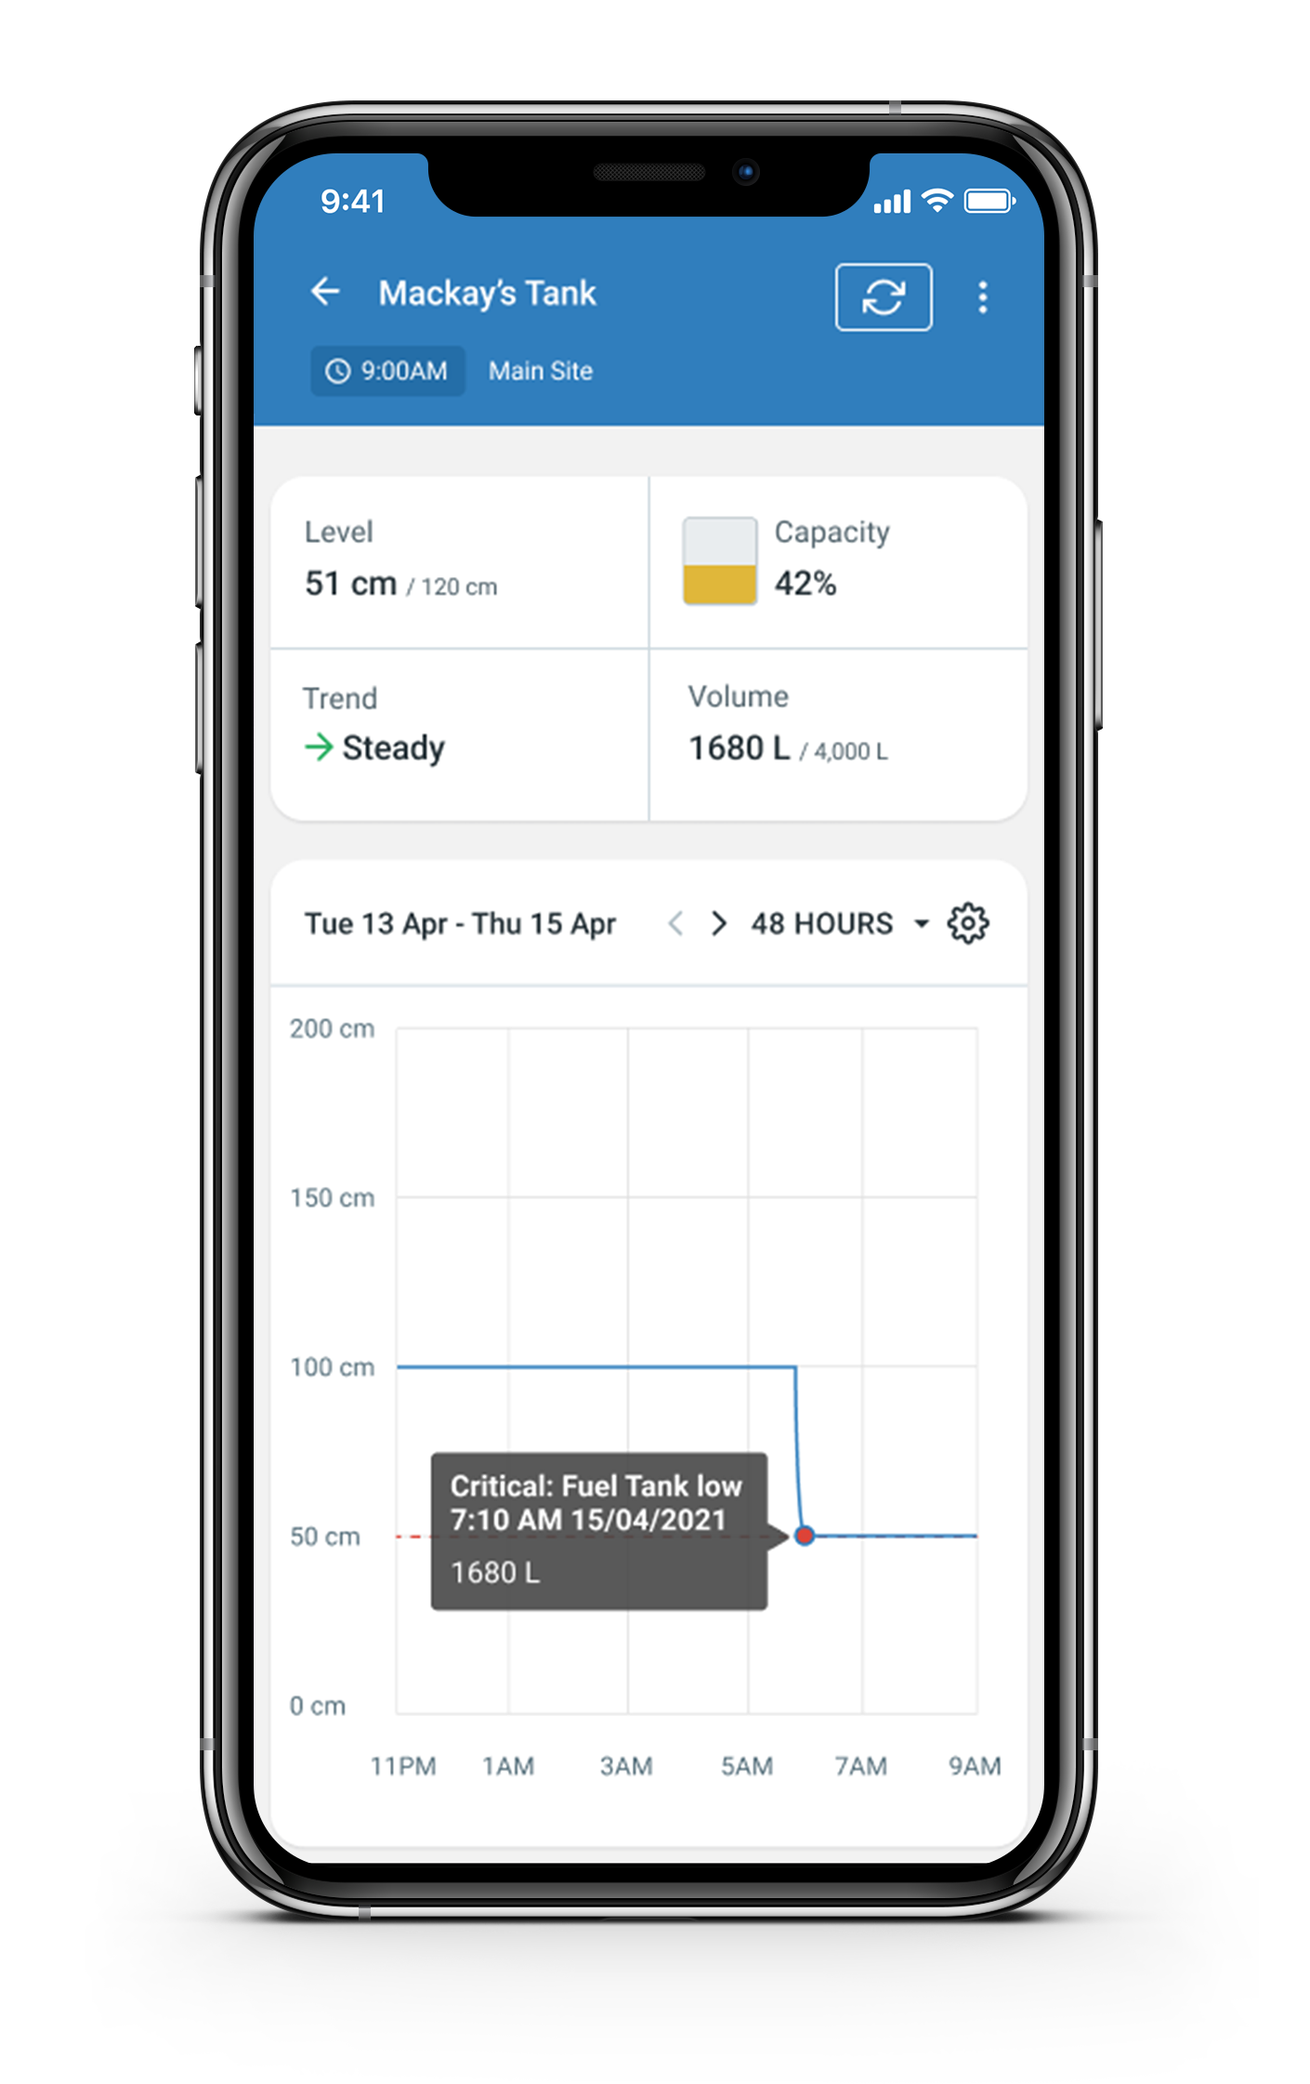
MyRanchbot Alerts
Tank Critical Alert
Pipe burst, tank split?
Tank High Level Alert
Over pumping?
Pump Off
Turn pump on
Know in real-time
Rainfall Detected
How much rain today?
Trough Low Alert
Avg. is below 6 in.
Fuel Tank Low
Order fuel

Slide 5
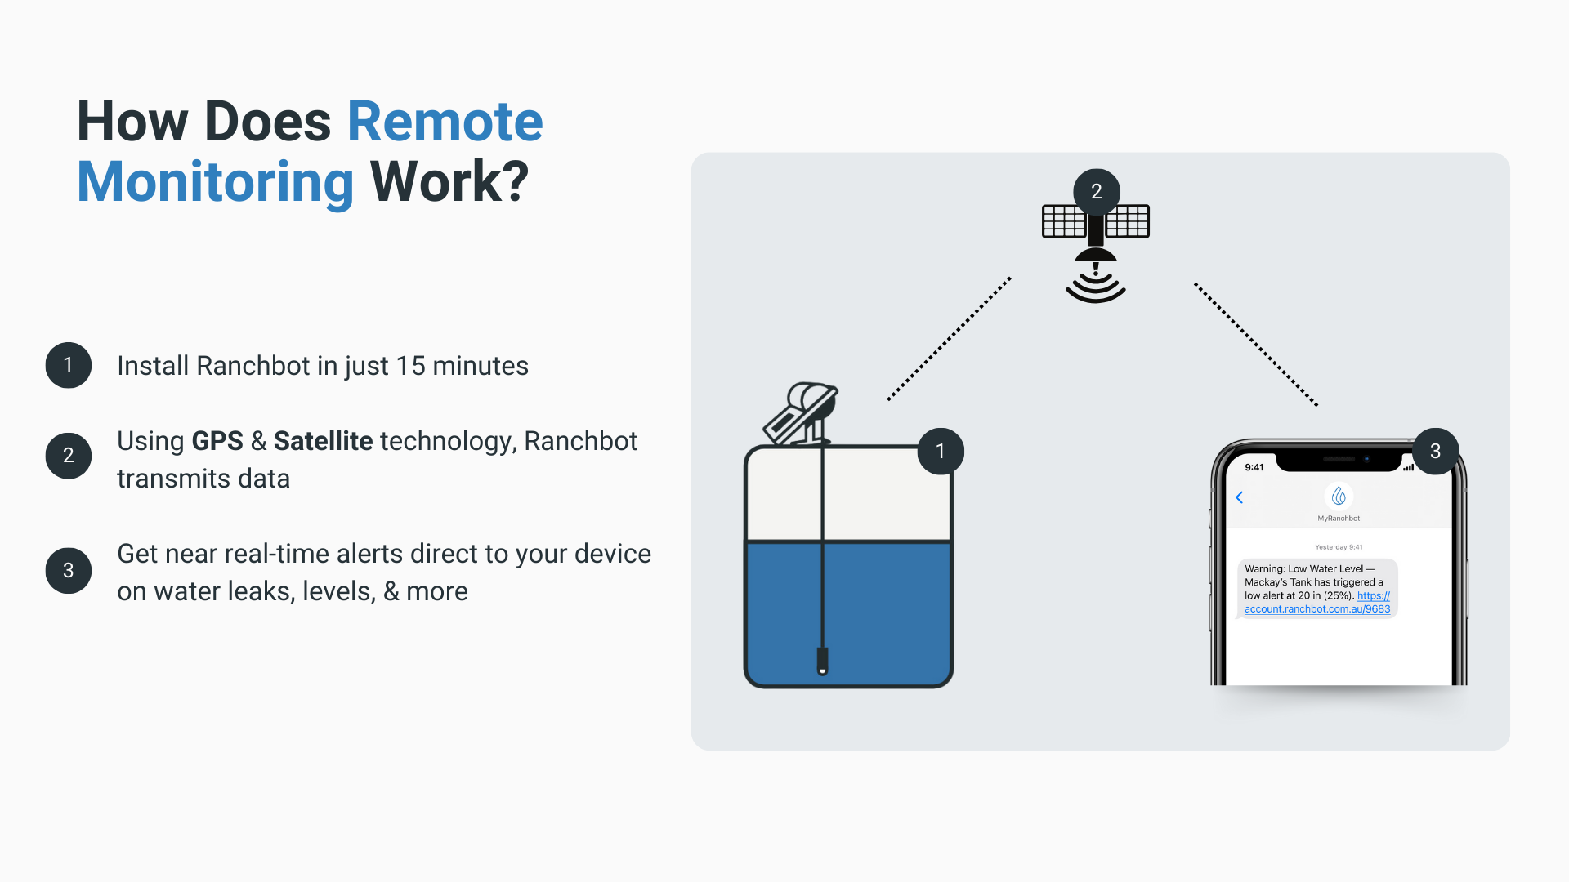

Slide 10
https://www.youtube.com/shorts/PQuzg88s3mI?feature=share

