Slide 1
Livestock Water Rights Permitting, Metering, and Reporting
Julia M. Shaver, Attorney, Office of the State Engineer
Cattlemen’s College
December 11, 2024

Slide 2
First things first…
Nothing in this presentation is intended to serve as legal advice.
This presentation is intended to provide you with an overview of permitting, metering, and reporting requirements from the OSE
If you have questions specific to an issue that you have, please consult with your own attorney.

Slide 3
What are we going to talk about today?
What is a water right?
How do you get a water right?
Now that I have a water right, what do I do?
What are some issues that can occur when exercising my water right?

Slide 4
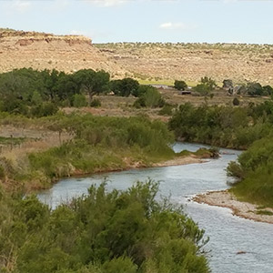
What is a water right?
Point of diversion (POD)
Place of use (POU)
Purpose of Use
Amount of Water
Priority date
Owner

Slide 5
Beneficial Use
“Beneficial use shall be the basis, the measure, and the limit of the right to the use of water.”
- NM Const. art 16, Section 3

Slide 6
Obtaining a water right

Slide 7
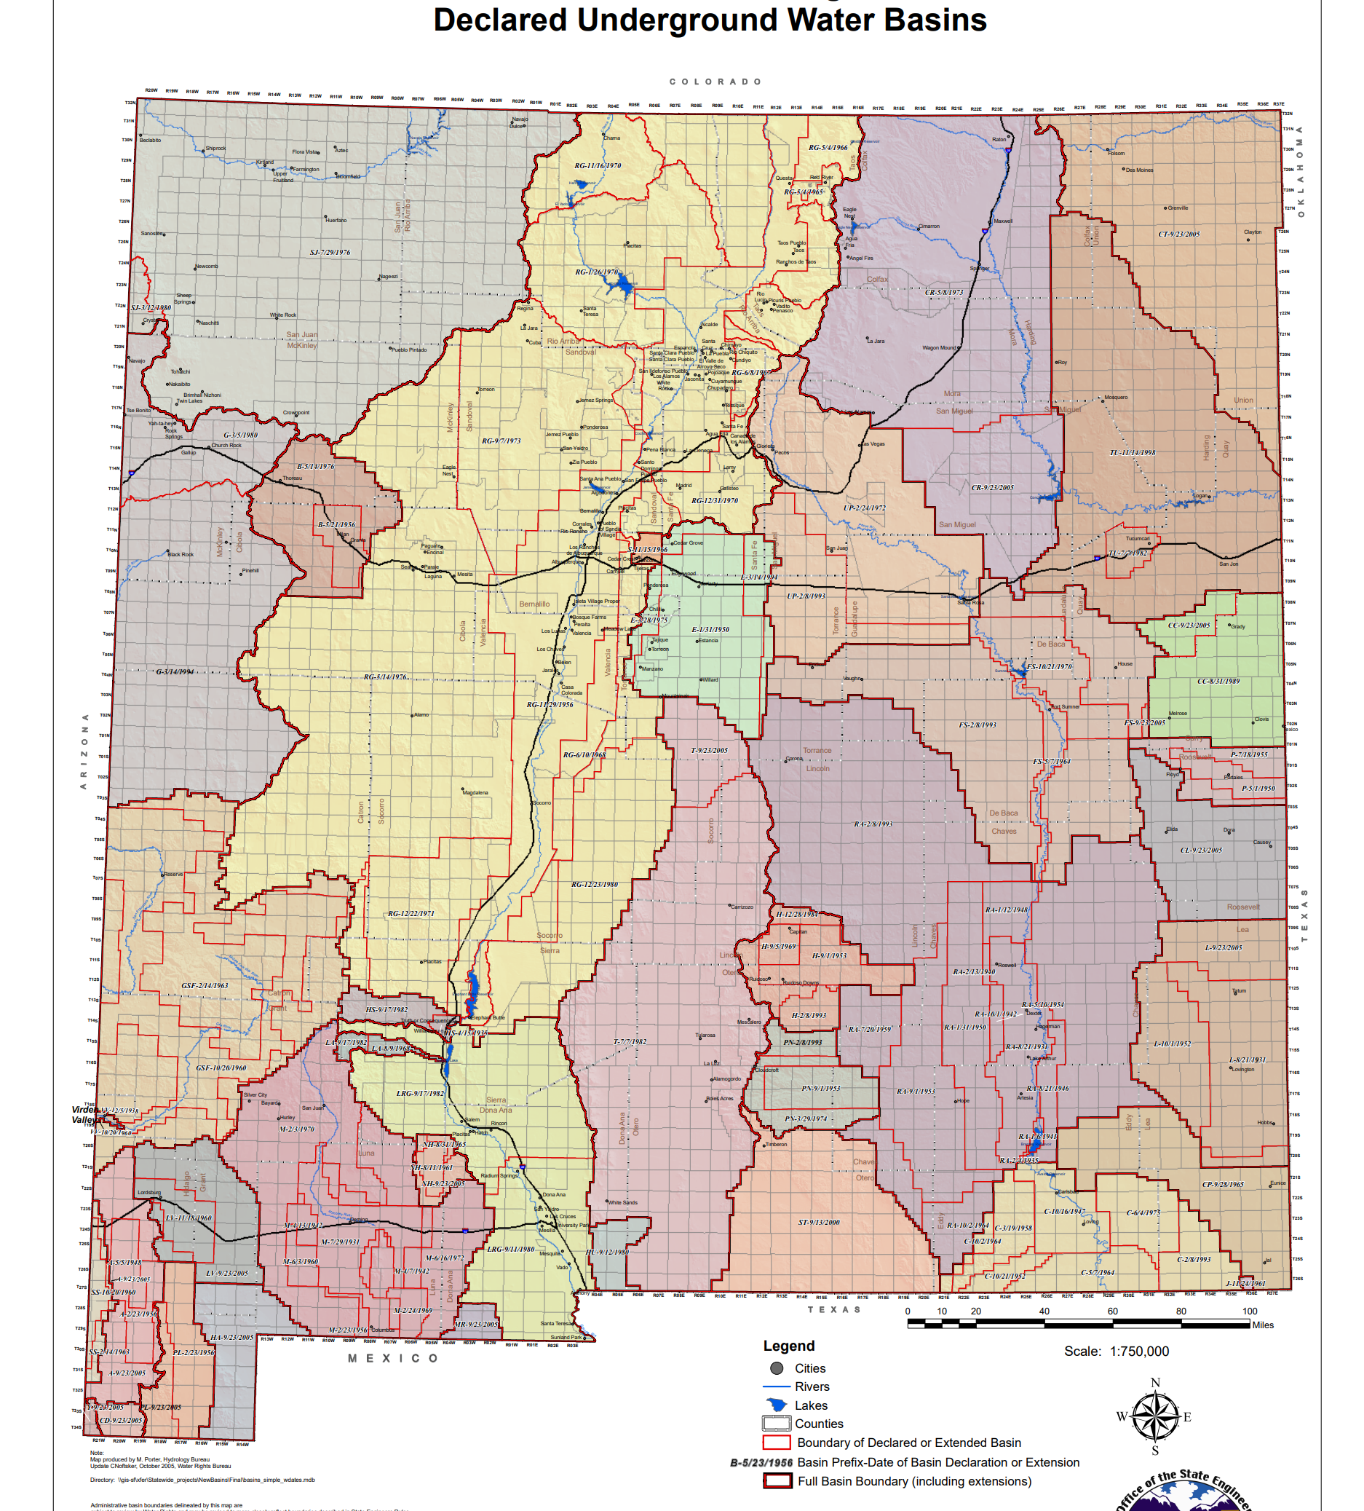
Streams and Basins in New Mexico

Slide 8
How do you get a water right?
Declaration
A declaration is a filing made with the OSE that sets forth the beneficial use of a water right prior to the declaration of an underground water basin (GW) or prior to the passage of the Water Code (SW)
Permit
A permit is obtained following application to the OSE
Depending on the application, the OSE will evaluate availability of water, impairment, conservation, and public welfare

Slide 9
Declaration
NEW MEXICO OFFICE OF THE STATE ENGINEER

Slide 10
Application for a Livestock Well
Section 72-12-1.2 (Underground public waters; livestock well permits)
Permits issued for purposes of watering livestock
If on state or federal land, applicant must submit proof of the following:
Legal entitlement to place livestock on the land where the water is to be used
Grant of access to the drilling site and the permission to occupy the portion of the state or federal land as is necessary to drill and operate the well

Slide 11
Permit (Application)
NEW MEXICO OFFICE OF THE STATE ENGINEER

Slide 12
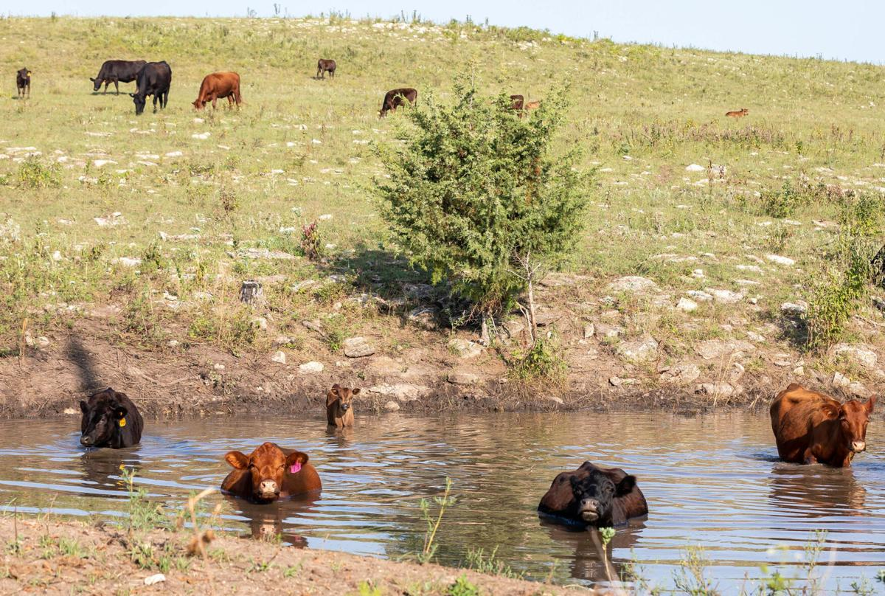
Historical and Other Impoundments
Can file a declaration for a livestock impoundment for an impoundment that was constructed prior to 2004
Declaration must set forth that the impoundment is 10 af or less and that the primary purpose of the impoundment is stock watering

Slide 13
Ponds for Livestock Use
10 acre-feet or less (Application Required)
NMSA, Section 72-9-3
Must not be on a perennial spring
More than 10 acre-feet (Application Required)
Must meet the requirements of filing applications for the appropriation and use of water pursuant to NMSA, Section 72-5-1, 72-5-22, 72-5-23, or 72-5-24
Must be for the use of watering livestock
Must show proof of entitlement to impound and use water on state and federal land
In determining whether an impoundment will be used for the watering of livestock, the state engineer may consider the maximum amount of water required per livestock unit, and shall also take into account regional and climatic conditions that affect consumption
Does not include impoundment for fishing, fish propagation, recreation or aesthetic purposes (if this is contemplated, it will require a permit pursuant to NMSA Section 72-5-1).

Slide 14
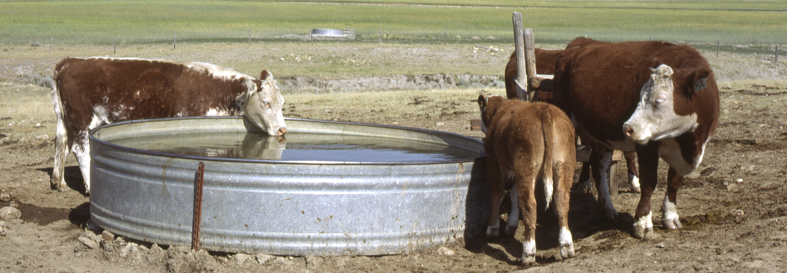
Stock Tanks
Stock tanks are treated in the same way as impoundments
Depending on the type of stock tank, you must have an OSE declared stock right, or permitted stock right to fill the stock tank

Slide 15
Best Practices: Filing an Application
All filings usually have a filing fee associated with them
District offices do not accept cash or credit cards (please bring a check!)
Make sure you have all the necessary signatures
Some signatures will need to be notarized
There is no such thing as a bad question!
It is better to ask a question before you have a filing returned to you for an issue
Some districts/basins have restrictions. Please check before filing!

Slide 16
Now that I have a water right, what do I have to do?

Slide 17
Metering (generally)
Diversions must be metered*
*There are some exceptions to metering requirements, particularly if you receive surface water from a ditch or an acequia
State Engineer, pursuant to NMSA, Section 72-12-27, may require pertinent data to be filed, and for water to be metered and reported

Slide 18
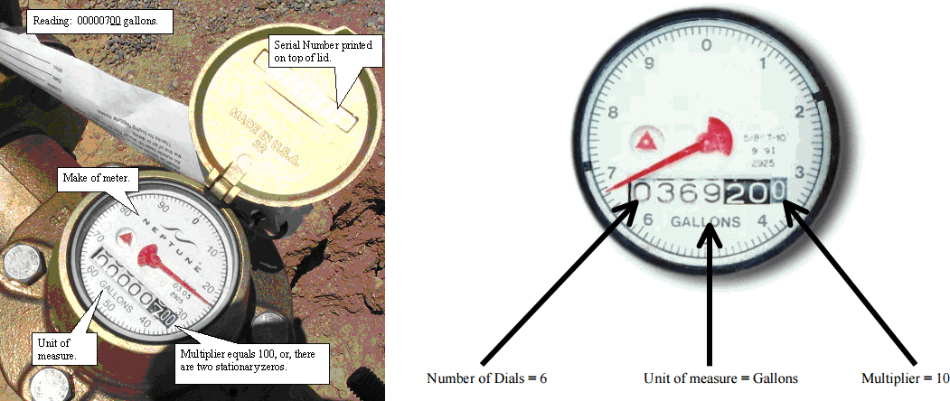
Metering (GW Livestock)
All districts require metering of water diverted under a livestock permit
The meter must be a totalizing flow meter with a register providing direct readings in gallons with a multiplier of 10
The totalizing flow meter must be a meter that is included on the OSE’s list of approved meters!
Requests to add approved meters to the OSE’s list must be initiated by the flow meter manufacturer

Slide 19
Reporting
If you have a meter reporting requirement, you must submit OSE form WR-26
Reporting for livestock well usage is submitted on a quarterly basis for the calendar year on or before the 10th day of January, April, July, and October for the preceding 3 months
Metering Information: Water Rights New Mexico Office of the State Engineer

Slide 20
What are some things that can occur with my water rights?

Slide 21
Return to Beneficial Use…
New Mexico constitution requires beneficial use
If you don’t use your water right, you could lose it!
One of the best ways to show you have beneficially used your water right is through meter readings.

Slide 22
Special Areas
Certain parts of our state are subject to additional restrictions on water use or the appropriation of water
These restrictions can come about because of settlements, decrees, adjudications, or State Engineer orders
For example:
State Engineer Order Number 197 limits the amount of water for livestock wells to 0.5 afy in the Upper Rio Nutria, Upper Rio Pescado, Nutria Springs, and Pescado Springs Critical Protection Area

Slide 23
Quick Note on Adjudications
Adjudications establish at a specific point in time:
Who owns a water rights
The amount
The purpose of use
The priority date
The place of use (for irrigation rights, the property to which the water is appurtenant)
After an adjudication has concluded, no new declarations may be filed.
*An adjudication does not prevent you from changing or losing your water right.*

Slide 24
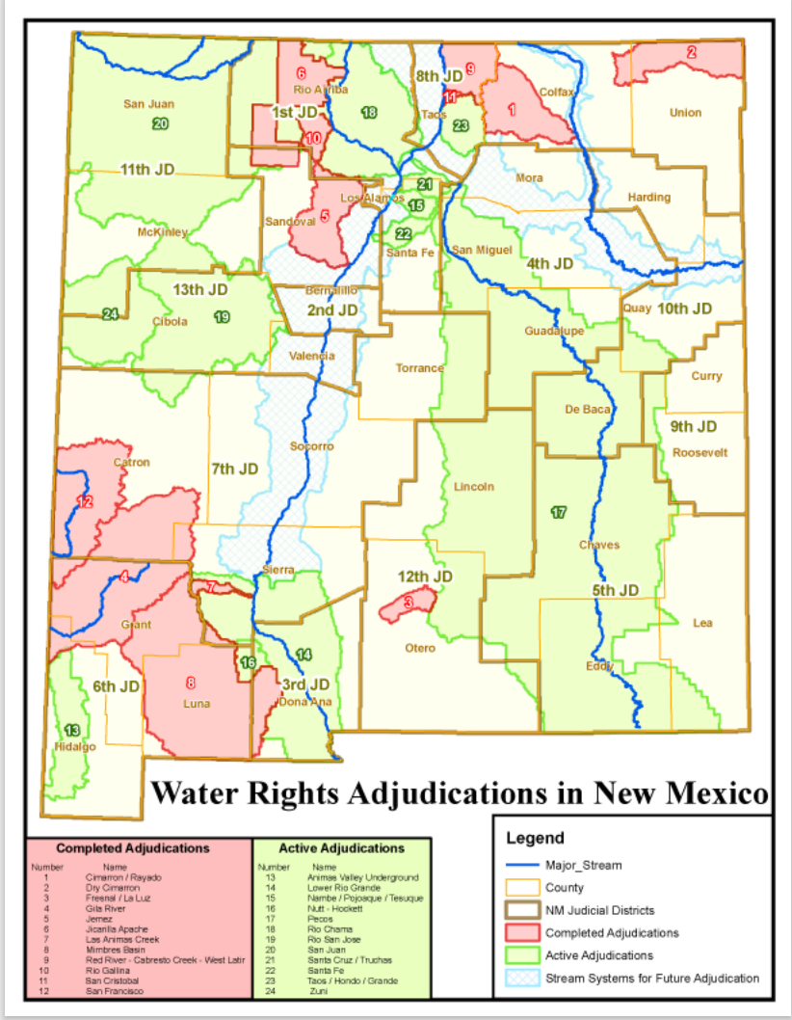
Active Adjudications
About 20% of the state has been adjudicated, and more than 50% of the state has adjudications in progress

Slide 25
Final Notes…
If you have a question about anything regarding your water right or how to obtain a water right, please reach out to the district office for the district in which your water right is located.

Slide 26
Thank you!
District | Address | Phone and Fax
Albuquerque, Water Rights District I | 5550 San Antonio Dr NE Albuquerque, NM 87109-4127 | Phone: (505) 383-4000 Fax: (505) 383-4030
Roswell, Water Rights District II | 1900 West Second St. Roswell, NM 88201 | Phone: (575) 622-6521 Fax: (575) 623-8559
Deming, Water Rights District III | 321 West Spruce Street Deming, NM 88030 | Phone: (575) 546-2851 Fax: (575) 546-2290
Las Cruces, Water Rights District IV | 1680 Hickory Loop, Suite J Las Cruces, NM 88005-6598 | Phone: (575) 524-6161 Fax: (575) 524-6160
Aztec, Water Rights District V | 100 Gossett Drive, Suite A Aztec, NM 87410 | Phone: (505) 383-4571
Santa Fe, Water Rights District VI | 407 Galisteo St. Suite #102 Bataan Memorial Bldg. PO Box 25102 Santa Fe, NM 87504-5102 | Phone: (505) 827-6120 Fax: (505) 827-6682
Cimarron, Water Rights District VII | PO Box 481 301 East 9th Street Cimarron, NM 87714 | Phone: (575) 376-2918 (575) 376-2410 Fax: (575) 376-4565

Slide 27
Photograph References
Photograph 1: Day Trips | Santa Rosa - Summer Fun
Photograph 2: Ponds can be a source of water for animals in pastures, but consider water quality
Photograph 3: Stock tank - Wikipedia
Photograph 4: Metering Information: Water Rights New Mexico Office of the State Engineer
Photograph 5: After 20 Years Of Drought, Western Slope Ranchers Face A Choice — Keep Adapting, Or Move Along

