Slide 1
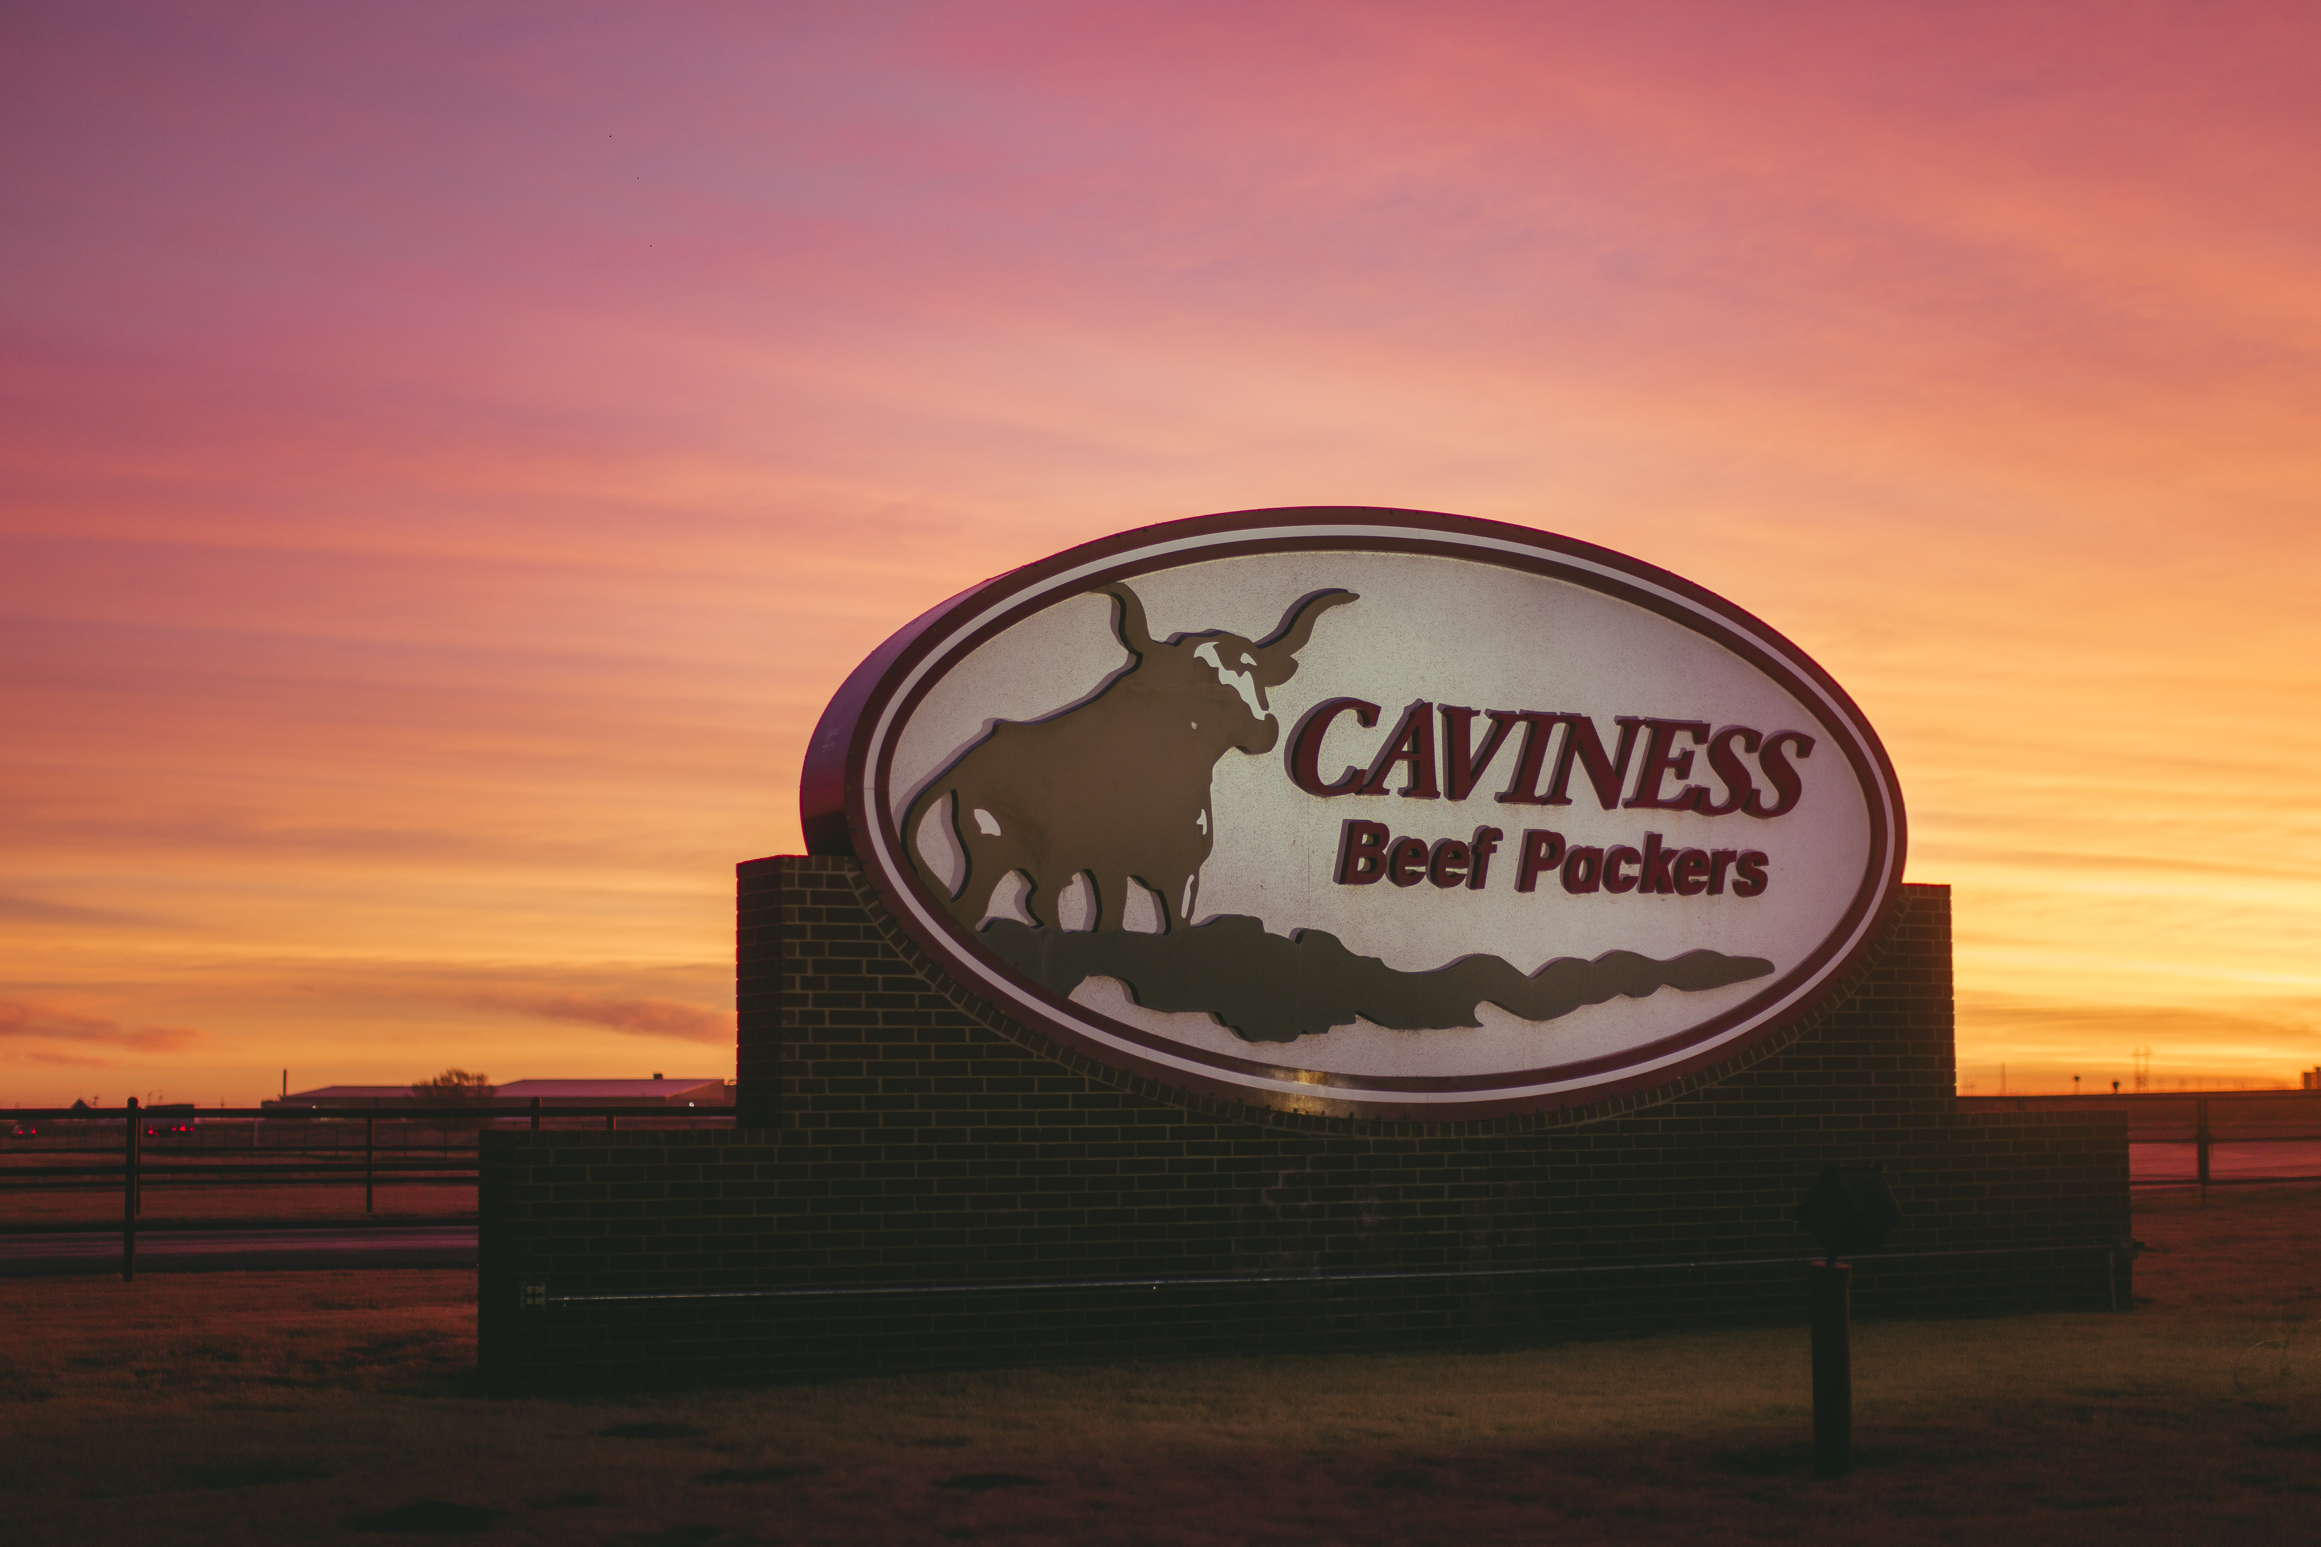

Slide 2


Slide 3
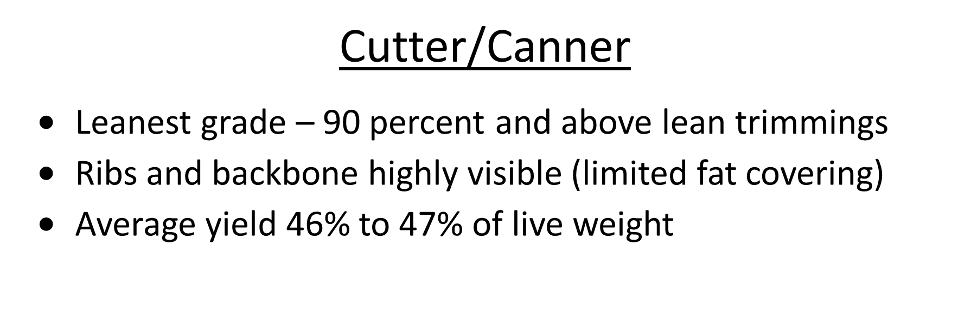


Slide 4
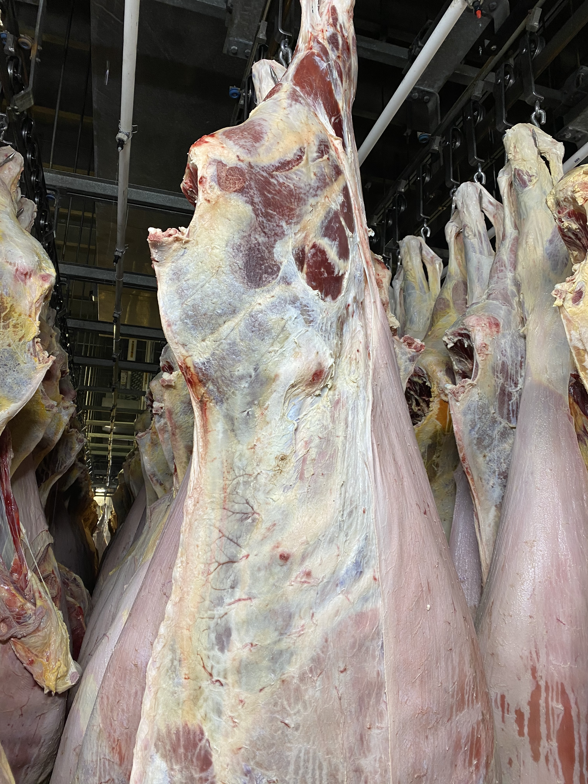
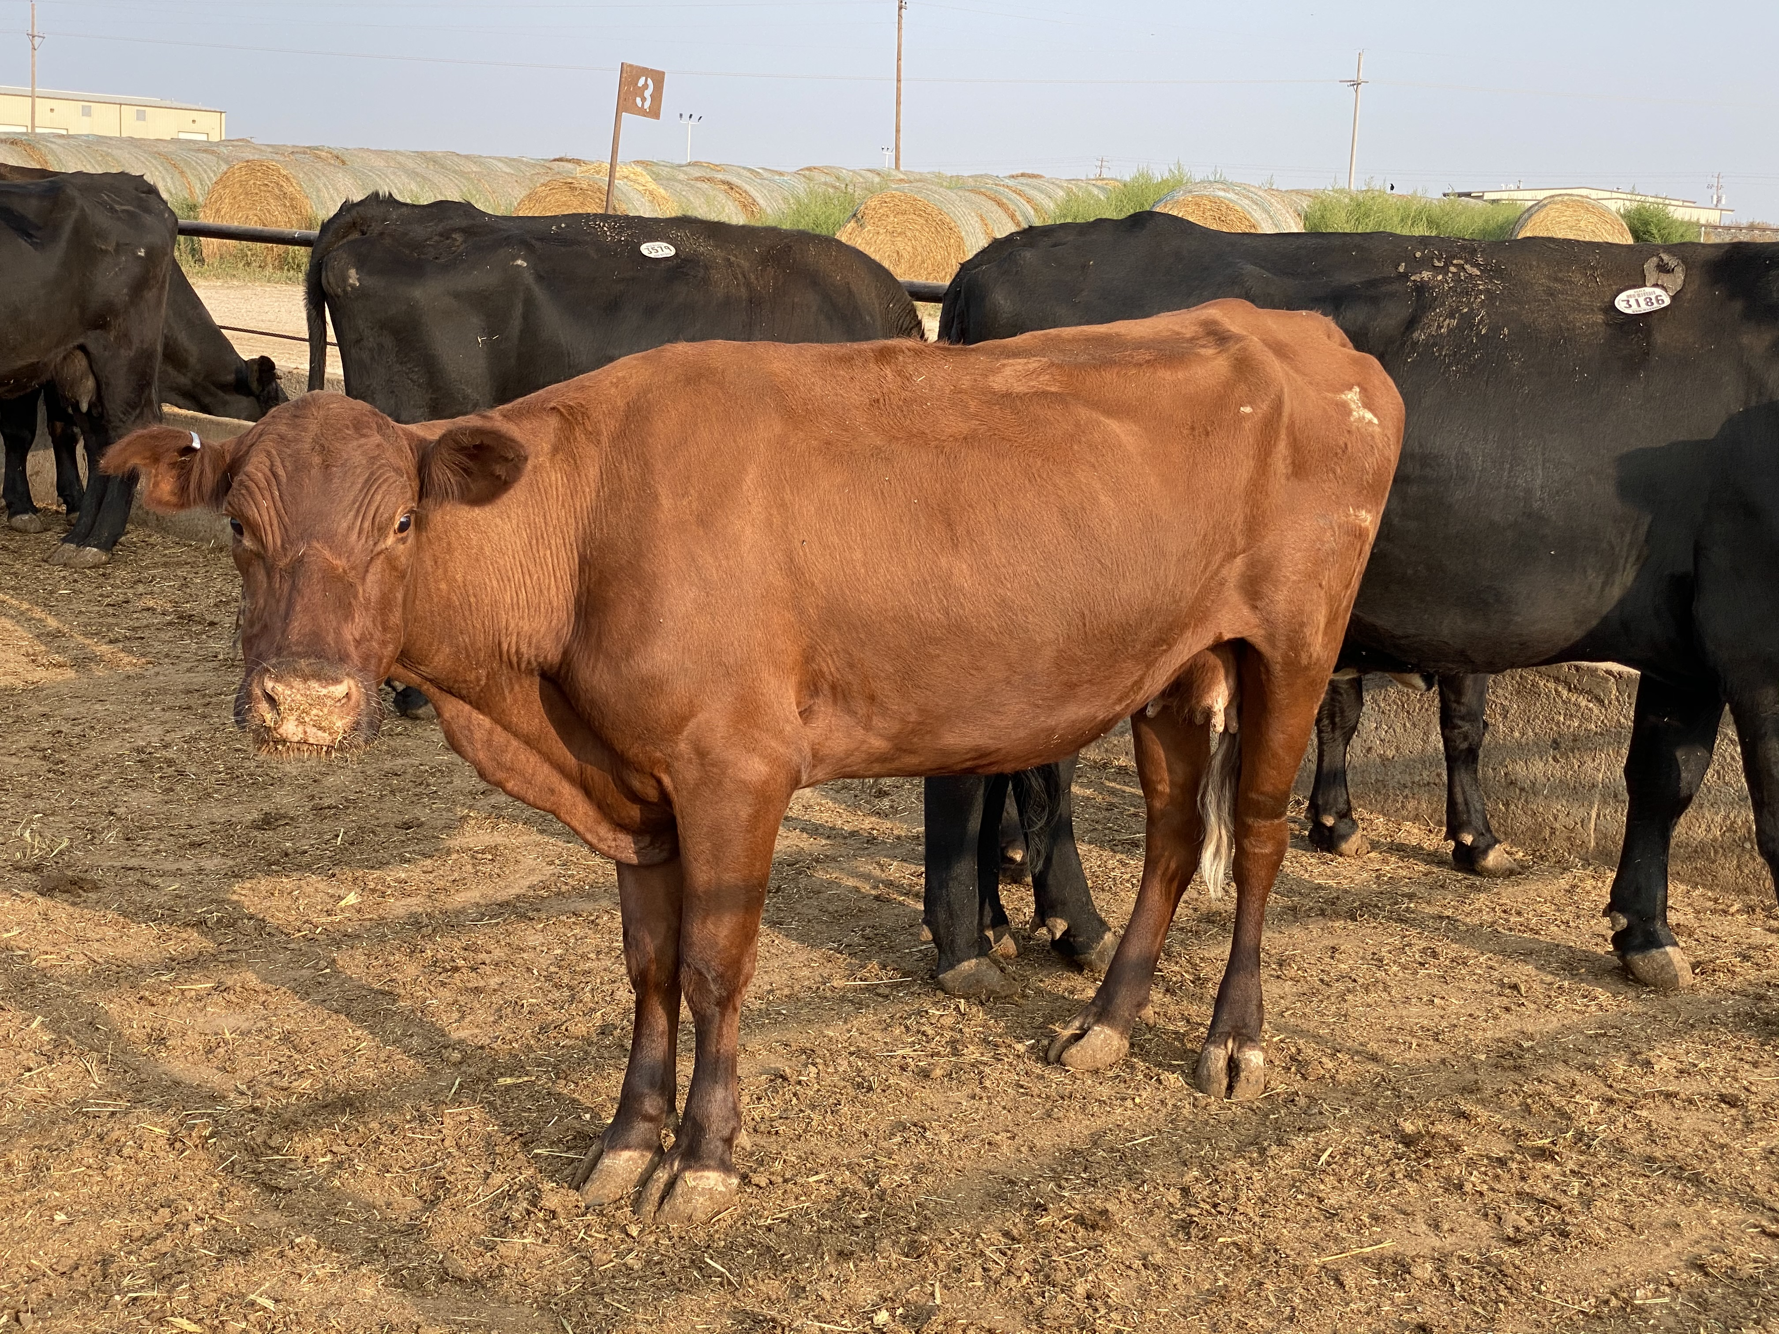
Cutter Cow

Slide 5
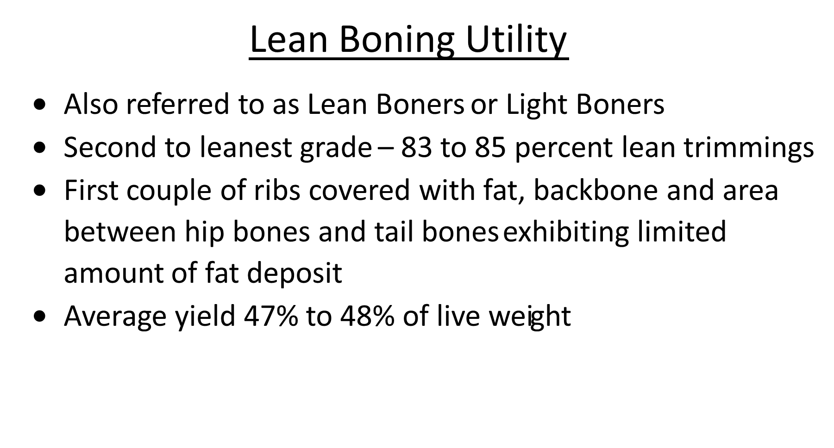

Slide 6
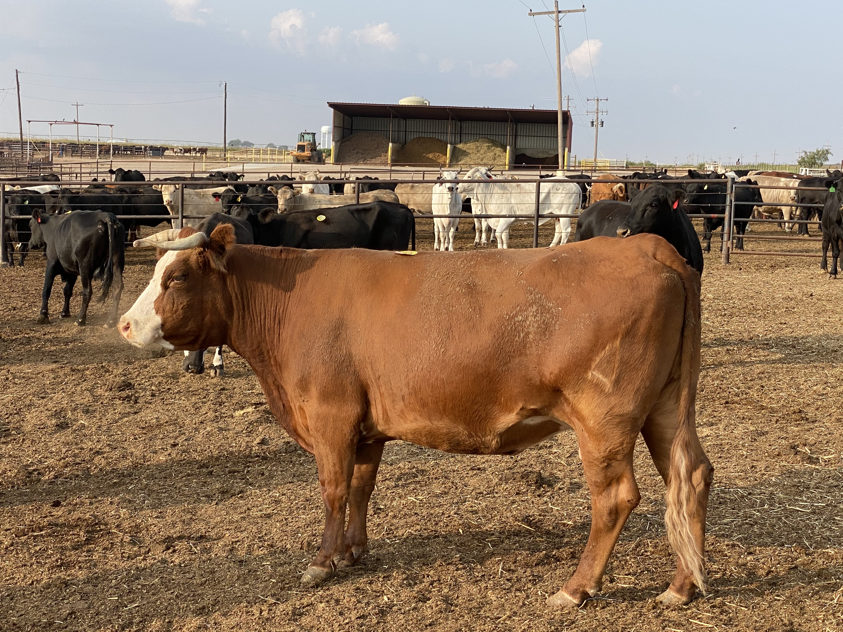
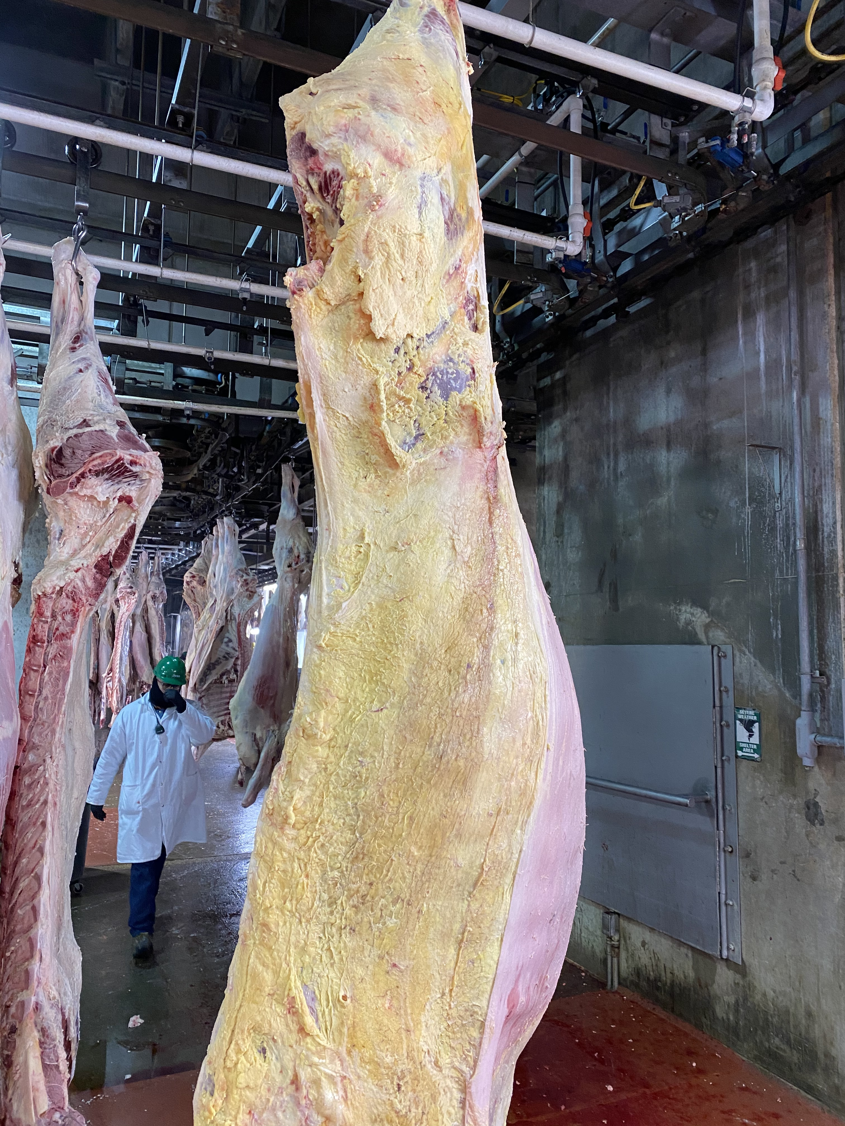
Lean Boning Utility Cow

Slide 7
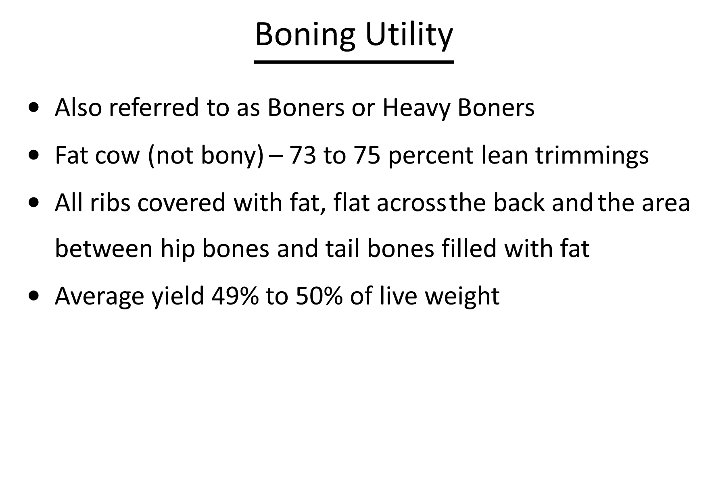

Slide 8
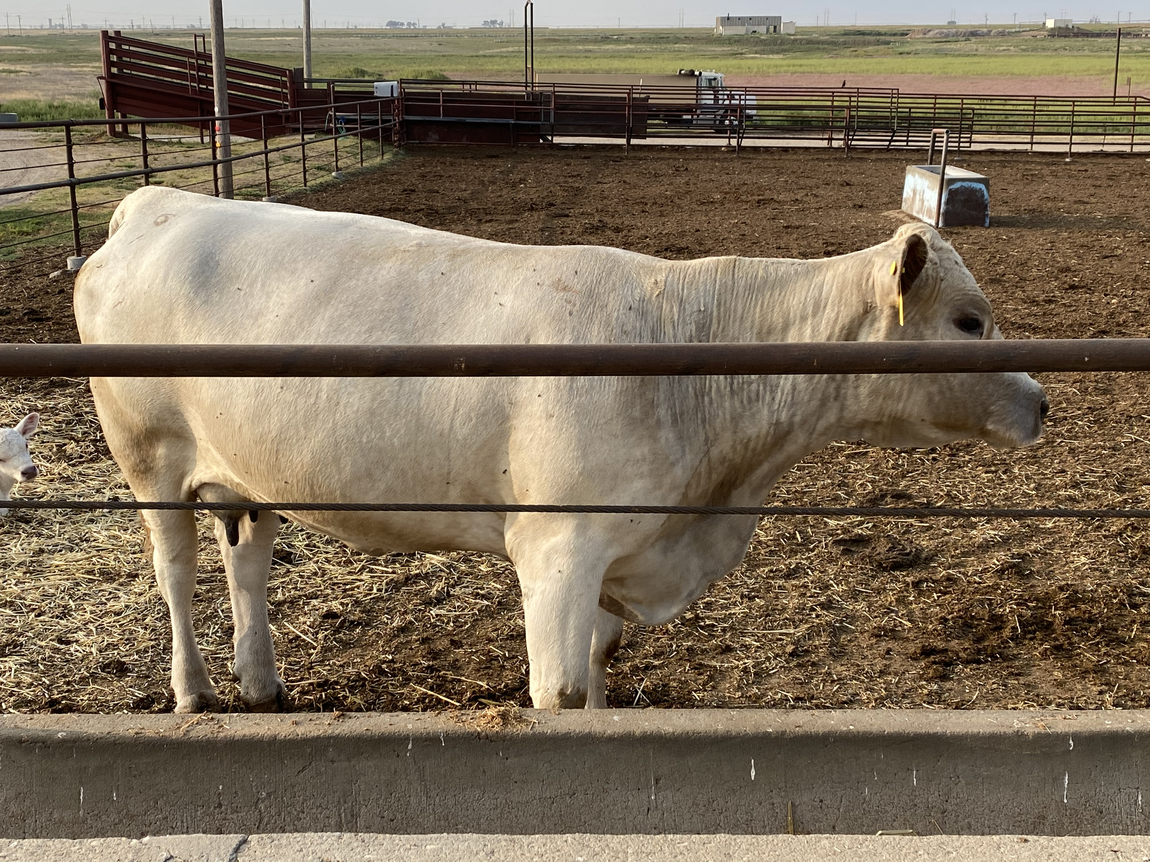
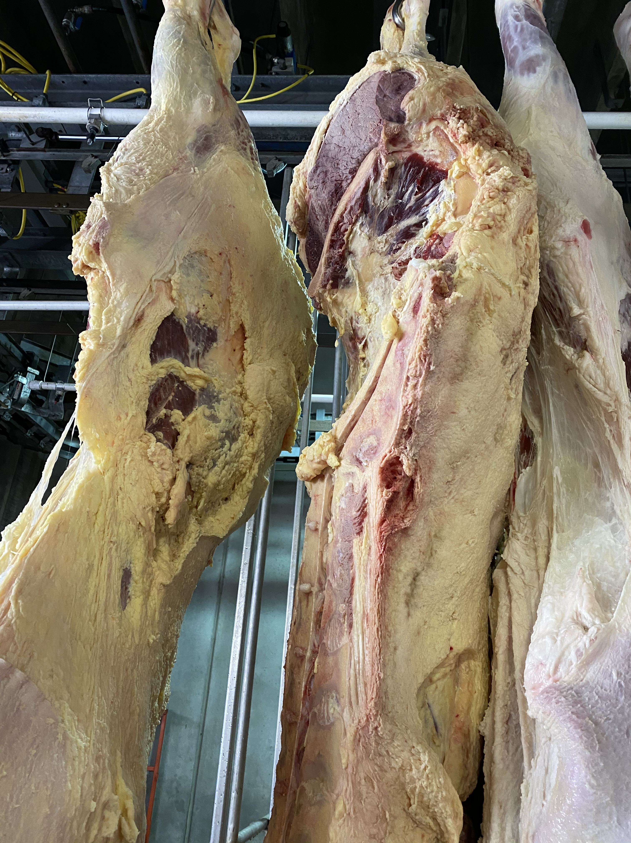
Boning Utility Cow

Slide 9
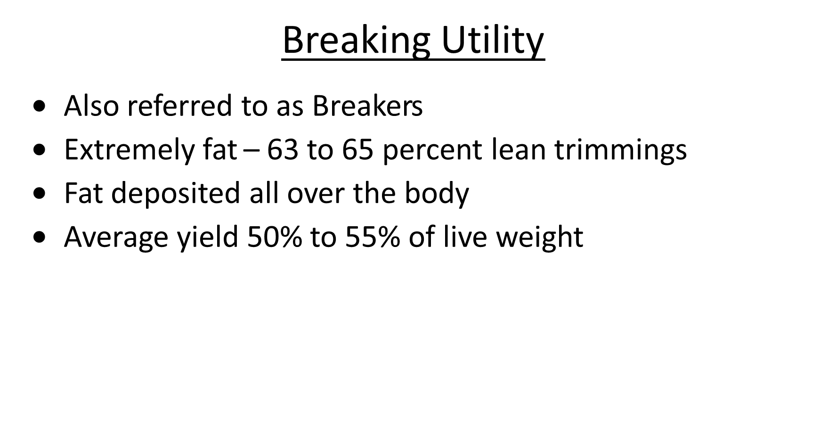

Slide 10
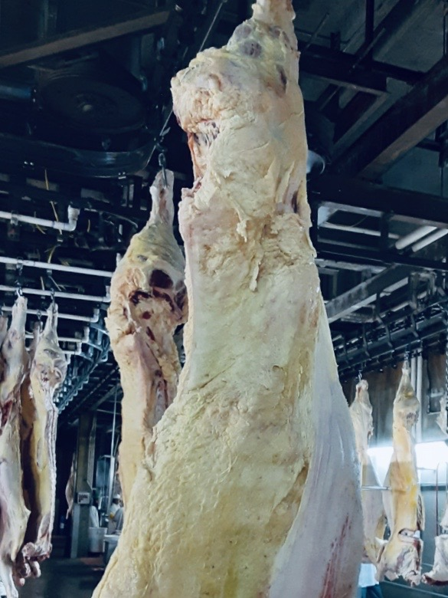
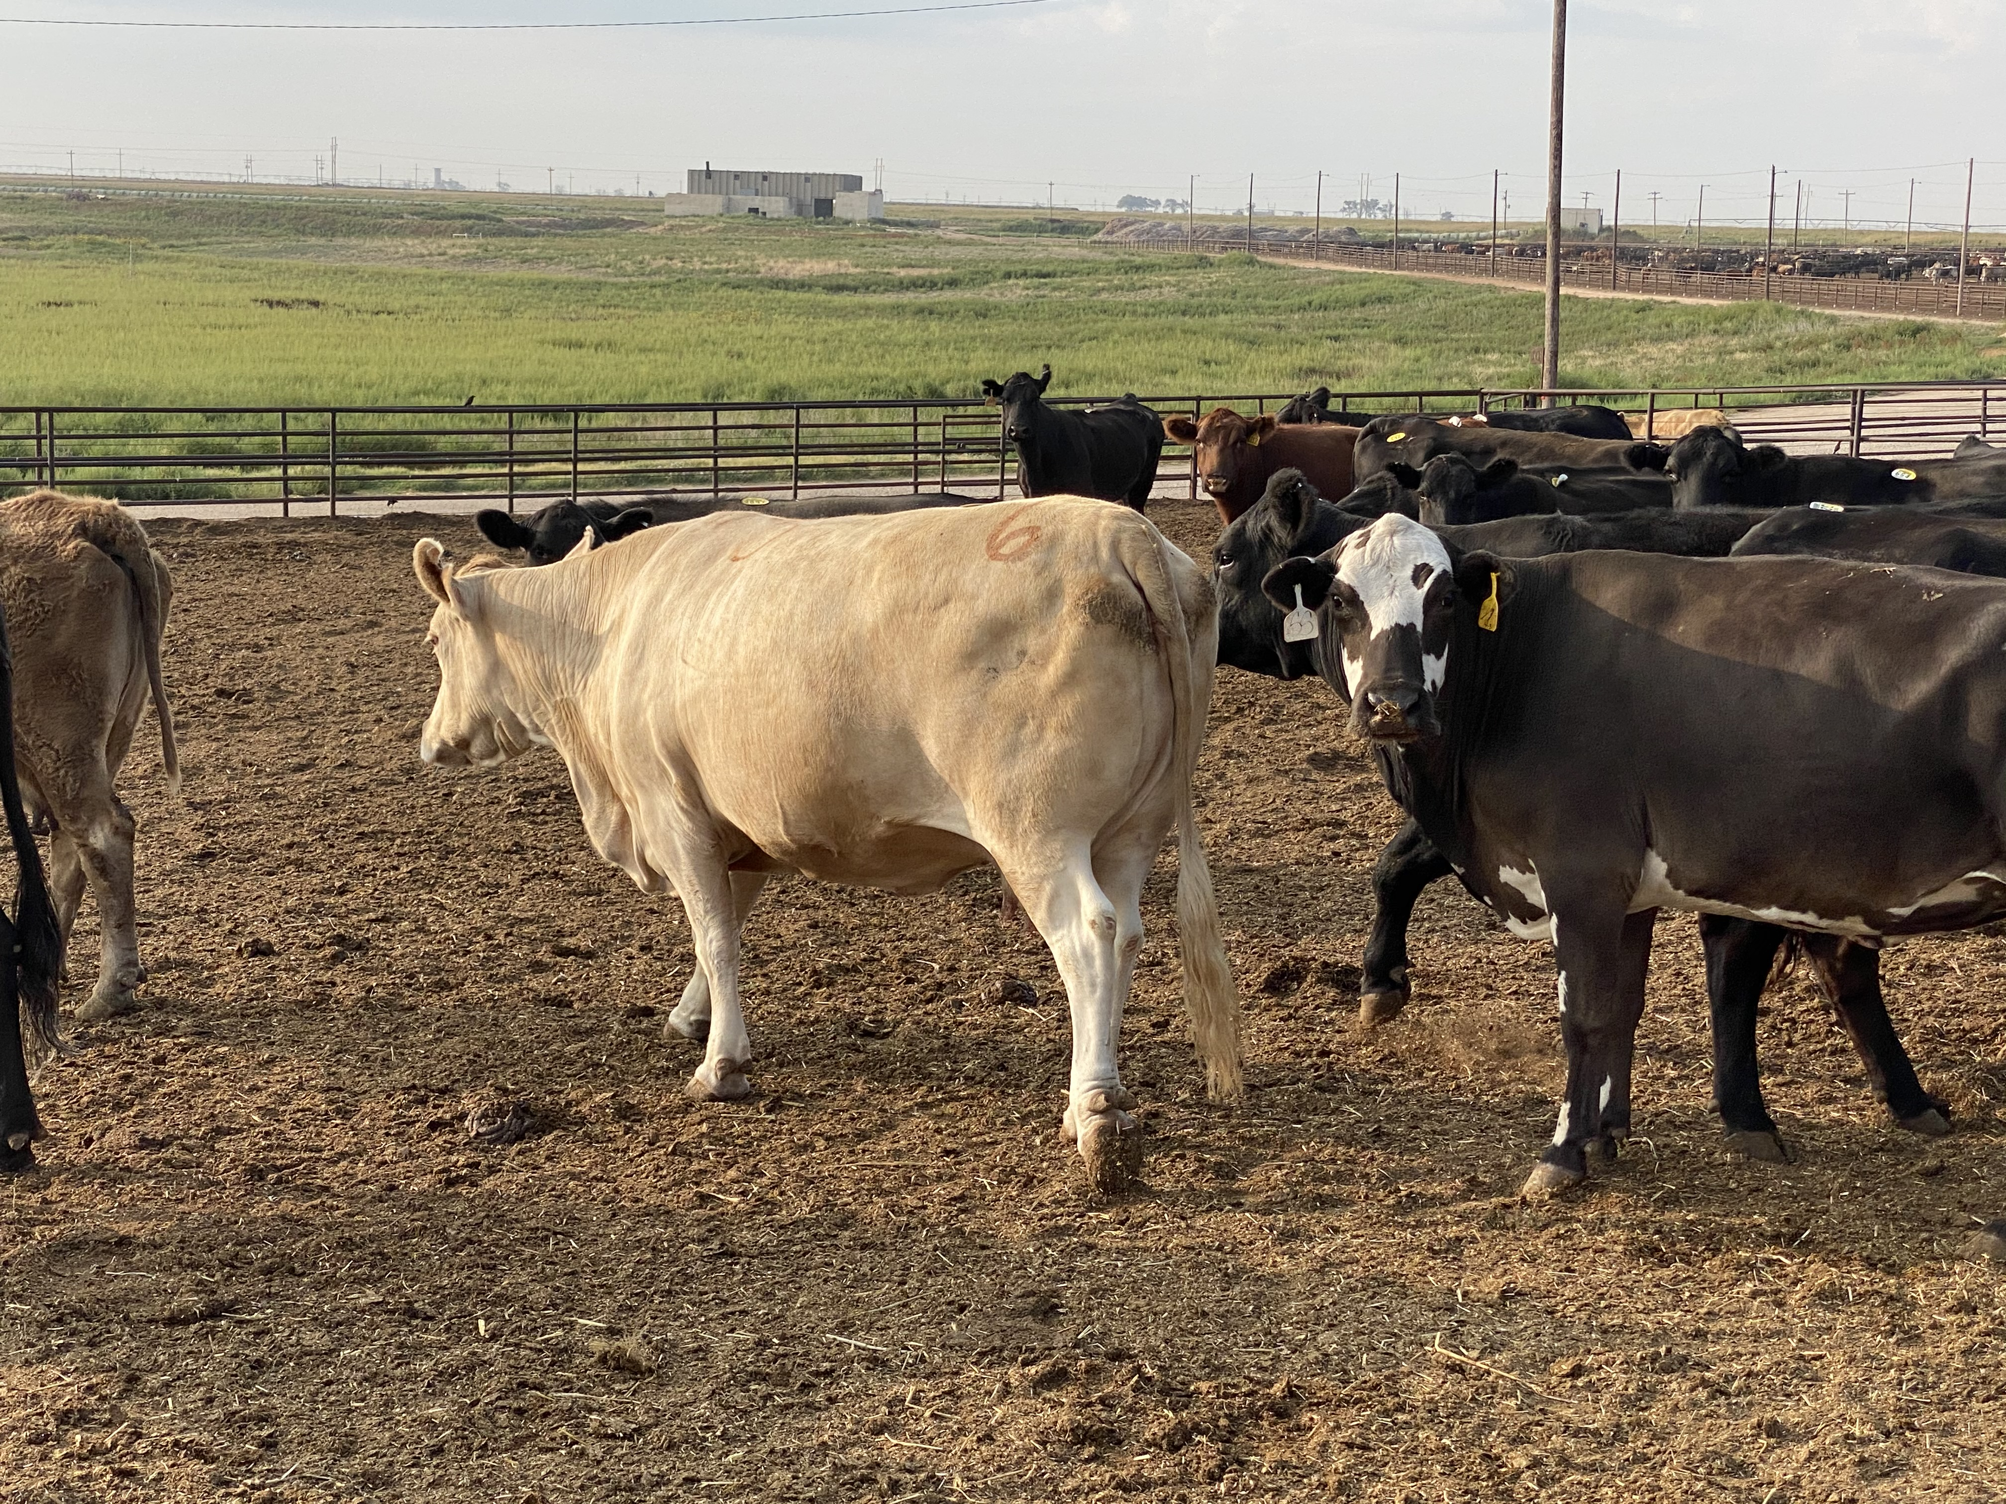
Breaking Utility Cow

Slide 11
Bulls
•
93 to 95 percent lean trimmings
•
Average yield 50 to 55 percent of live weight

Slide 13
Bulls
Weight Accumulated
Break Discount
800 & up - Bull base price
700 to 799 - Bull base price less $.01
600 to 699 - Bull base price less $.02
550 to 599 - Bull base price less $.03
500 to 549 - Cutter cow base price
450 to 499 - Cutter cow base price less $.03
400 to 449 - Cutter cow base price less $.09
350 to 399 - Cutter cow base price less $.15
300 to 349 - Cutter cow base price less $.21
250 to 299 - Cutter cow base price less $.27
200 to 249 - Cutter cow base price less $.33
150 to 199 - Cutter cow base price less $.39
100 to 149 - Cutter cow base price less $.45

Slide 15
Cutter Cow Weight Comparison

Slide 18
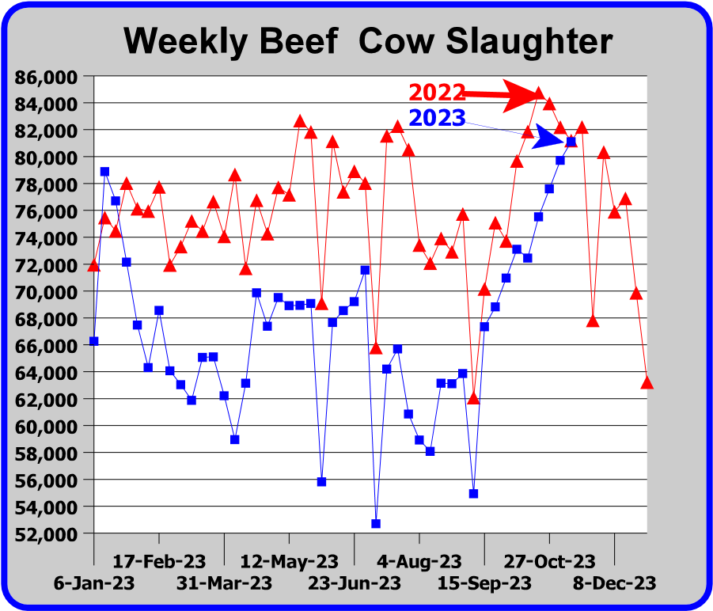

Slide 19













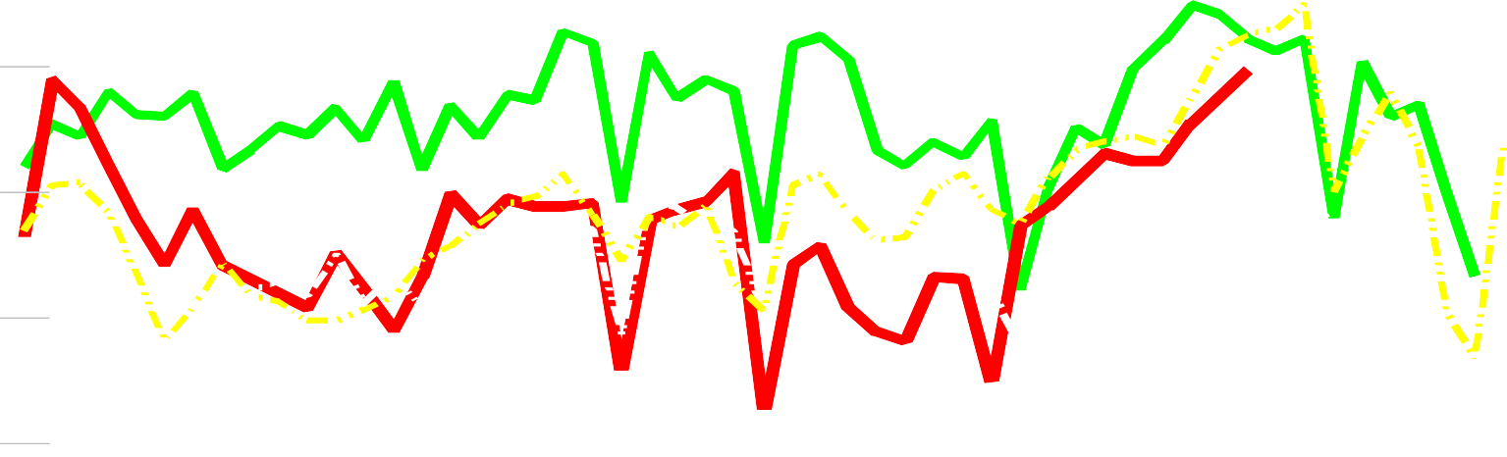
YTD =
2023
- 13 %
2022
+ 13 %
2021
+ 10%
2022
2015 - 2019 Ave.
2023
2010 - 2013 Ave.
Thru week ending Nov. 4th
90
80
70
60
50
2010 - 2013
U.S. cattle inventory liquidated
to a 60 year low due to drought
40
30
2/11/23
4/22/23
7/1/23
9/9/23
11/18/23
1/7/23
3/18/23
5/27/23
8/5/23
10/14/23
12/23/23

Slide 21

Caviness Beef
Built on Relationships
We work to constantly
innovate, develop long-standing connections and show respect for our resources.
We enjoy growing meaningful relationships with cattle producers and dairy operators across the United States

