Slide 1
Marcy Ward
Extension Livestock Specialist
2023 Joint Stockmen Convention 12/13/23

Slide 2
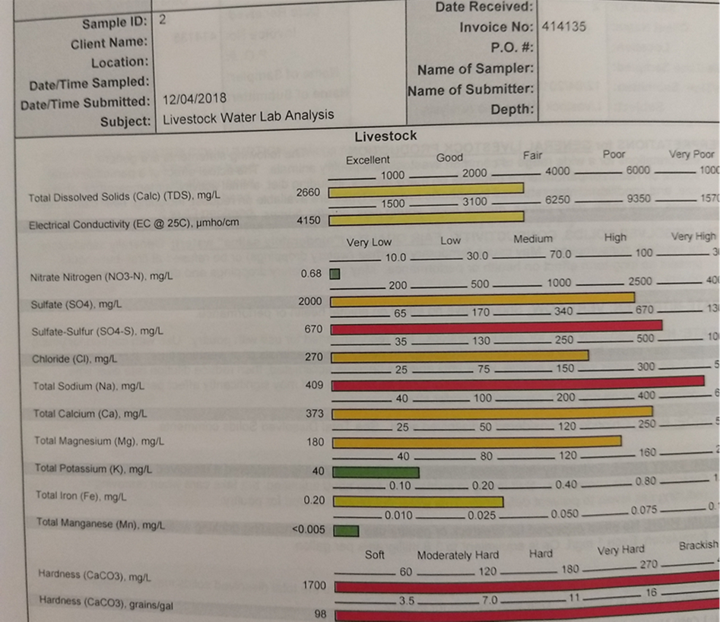
NM Water Quality Project
Took water samples from 7 ranches (and counting) across NM
Evaluated for micro and macro minerals, pH, and hardness
Used this information to demonstrate the need for water management.
Grant proposal would address how water quality impacts:
Water consumption
Cattle performance/health
Pasture utilization
Range Improvement Task Force

Slide 3
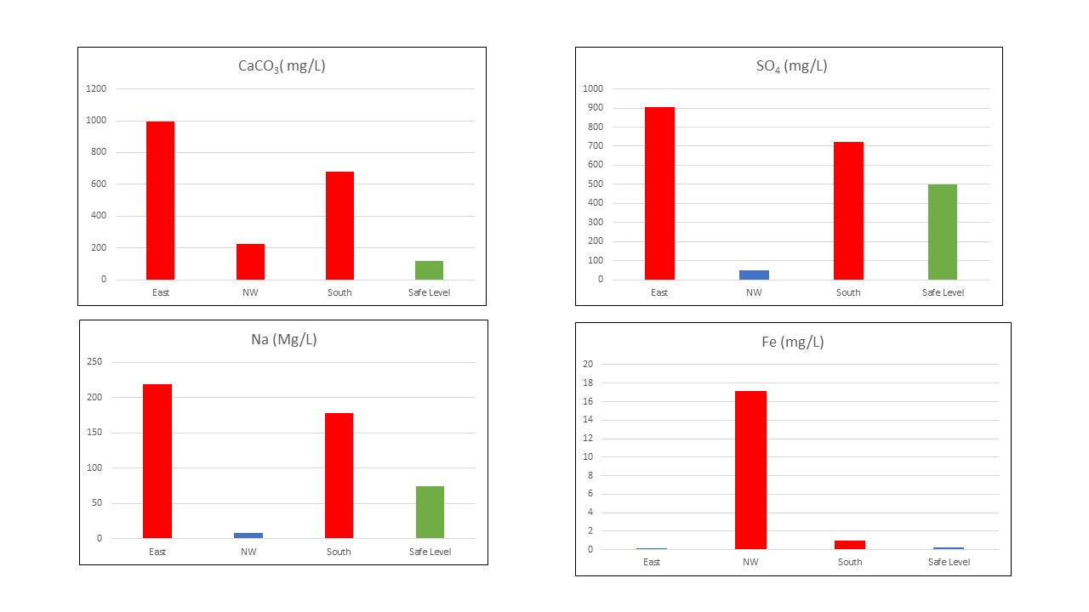
NM Water Quality Project
Range Improvement Task Force

Slide 4
Educating Youth In New Mexico
New Mexico Youth Ranch Management Camp
NM Youth Quality Assurance Program
NM Youth Beef Contest
Range Improvement Task Force

Slide 5
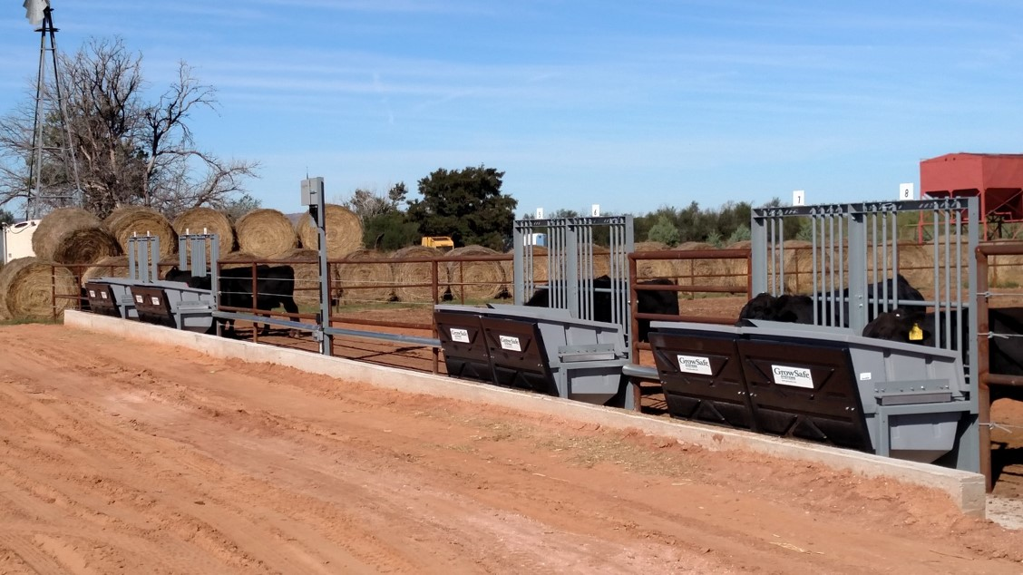
Tucumcari Bull Test
63rd Annual
156 Bulls on test
23 producers
8 breeds
Research partnerships
SALE: MARCH 9, 2024
https://tucbulltest.nmsu.edu/
Range Improvement Task Force

Slide 6
New Programming
Ranches raise 3 steers to 850 lbs
Cattle are received at the Tucumcari Bull Test Station in March
Cattle are fed to finish
Cattle will be harvested through a USDA facility
Gain and feed efficiency data
Carcass data
Products will be marketed both privately and publicly
Range Improvement Task Force

Slide 7
New Programming
Hosted by the New Mexico Producers and Marketing Association
Bulls will be fed for 60 days at a feedlot facility located near Abiquiu, NM
At the end of the feeding period, bulls will be tested for PAP and Fertility
Bull sale: SATURDAY MARCH 30, 2024
Range Improvement Task Force

Slide 8
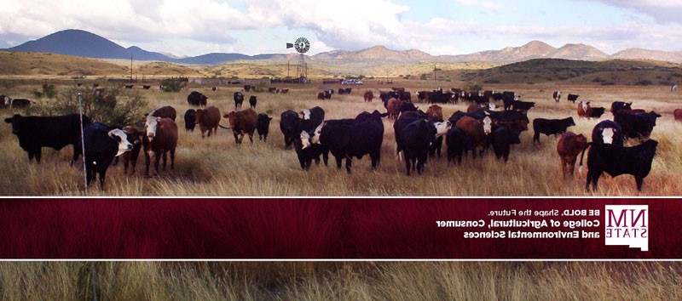
THANK YOU!
maward@nsmu.edu
575-644-3379

