Slide 1
Aligning Ranch Production Practices with the Market
What I heard today

Slide 2

Take Home
Know your market
  Higher volume = better returns
Know your product
Know your time
  Levels of marketing
“Not every shoe fits the same foot”

Slide 3
Level 1
Genetics Growth Products
Vaccines Vaccine documentation
Shrink Other Management
Bull purchase and connections

Slide 4
“Value-Added”
To What?
Important to establish a baseline and know where your operation is at before considering “Value-Added”.
  Your efforts might be better served on “traditional management” which adds value!
    Castration, horns, etc.
    Implants: are you paid not to implant?
    Lot size

Slide 5
First Question
How do you market your calves and how much time do you have to put into marketing?
What does your operation support?
  Forage
    Weaned calves: every 2 days weaned = 1 day grazing for 1 cow
  Pen space
  Time

Slide 7
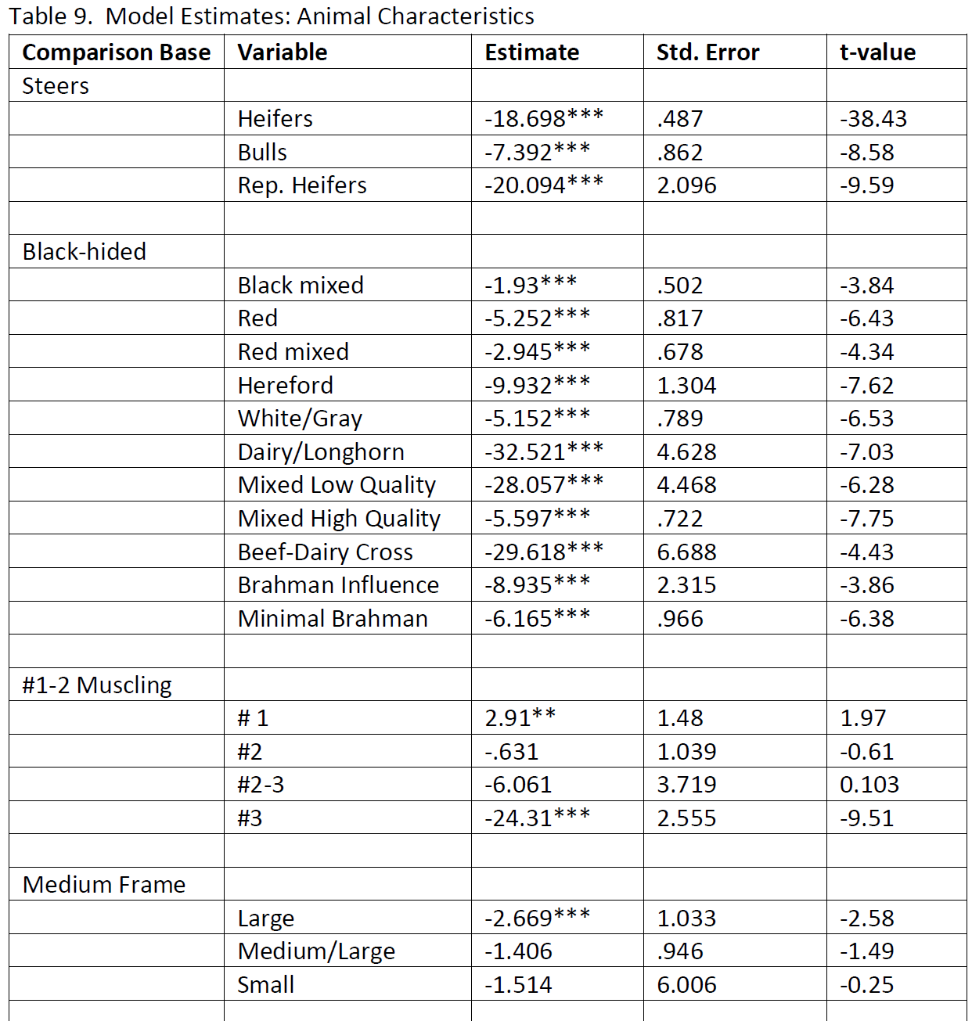

Slide 8
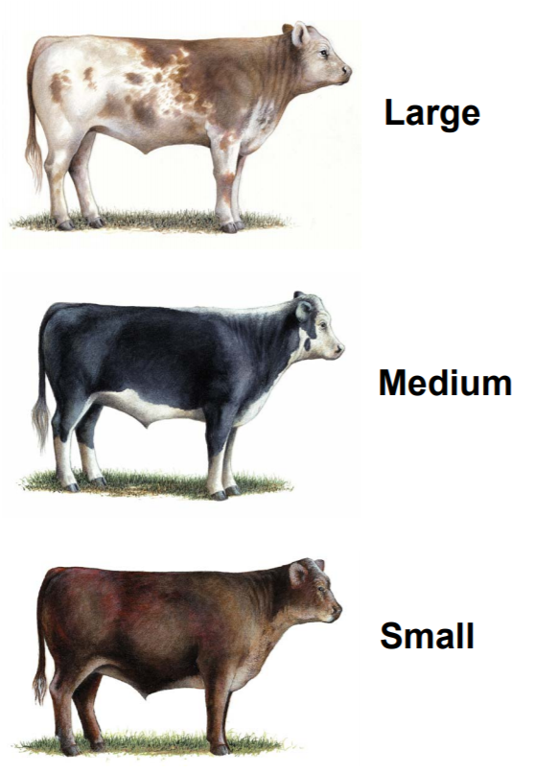
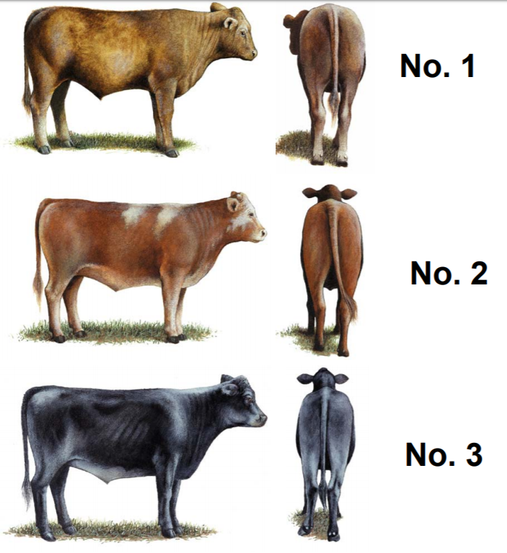
“Quality Program”

Slide 9
“Quality Program”
Assume selling 550 lb steers
Price discount of $6.06 #2-3
Difference is about $33/calf
If a bull breeds 25 cows for 5 years = $4200

Slide 10
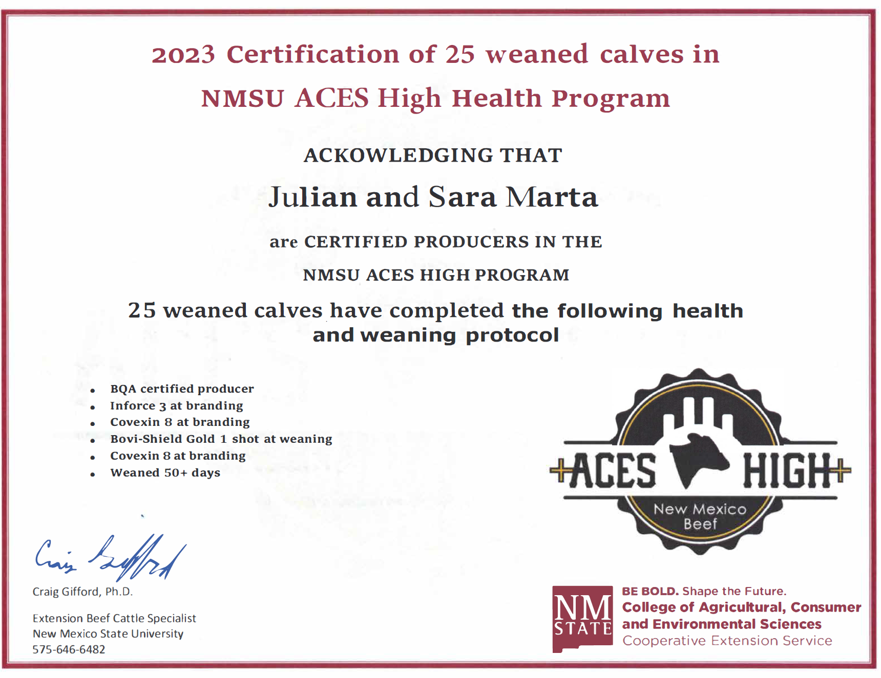
Health Program
Respiratory disease still major challenge in beef industry
Good vaccine program: 7-8 way, MLV respiratory, booster, and internal/external parasites
DOCUMENT!

Slide 11
Maintain low inputs
Cows match the environment
Tighten calving window early in the season
  Uniform crop
Fertility
Measure

Slide 12
Level 2
Certifications: Source and Age, NHTC, VNT

Slide 13
Considerations
Document with 3rd party (IMI)
$10+/cwt in returns
  Calculate for yourself
Mostly marketing yearling +
  Most weaned calves are all-natural, hormone free, grass-fed, etc.
Know your market before you start
  Putting a badge on a sale lot isn’t an automatic return

Slide 14
Level 3
Customer Direct
Retained ownership/packer
Consumers

Slide 15
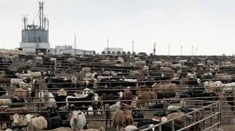
Retained Ownership
Send to wheat/pasture and or feedlot
  Financing
  Carrying calves without payment (transition)
  Cost of gain?
Sell to packer or sell on the grid
  Know your cattle and genetics

Slide 16
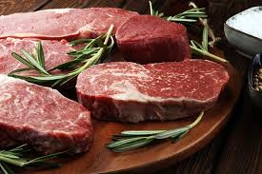
Selling to Consumers
Your cattle
  Control costs, temperament, and heartiness
Your story matters
  Know your customers (no hormones, gmo, etc.)
  Personable
Time for marketing
  Websites, social media, word of mouth, etc.
Know the regulations
Processing limitations

Slide 17
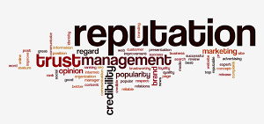
Flexibility
Make a plan for each potential phase
  Hay store
  Limitations in packers
  Marketing limiting by how much product you can produce
Futures market, insurance, etc.
  Protect yourself on a time sensitive product
Build your reputation

Slide 18
Questions

