Slide 1
“Using Strategic Supplemental Nutrition to Positively Improve Ranch Break-Even
John Paterson, PhD
Emeritus Professor, Montana State University
Consultant for Multimin USA

Slide 2

Three things that cause fear in a Montana Cowboy

Slide 3

Before I Start: Lessons Learned from Pop as a Kid
(Catron County)
I remember…
Hard work
Chipped beef on toast
Ride in back of PU
Always fixing fence
Gather in the Fall with Dad
Rotary Wall Phone
Cutting wood
Gas lights
Sunday School
Outhouse
Milk cows, chickens and
butcher in the fall
Raised in AZ and NM

Slide 4
Today’s Student In Animal Science
I Taught at the University for 40 years
1960’s- 65% had farm or ranch experience
1990’s- 30% or less had farm or ranch experience
2010’s- 15% have farm or ranch experience
Students of Today
70% are female
80% are urban
85% are interested in equine or companion animals

Slide 5

CS Ranch Cimmaron, NM

Slide 6
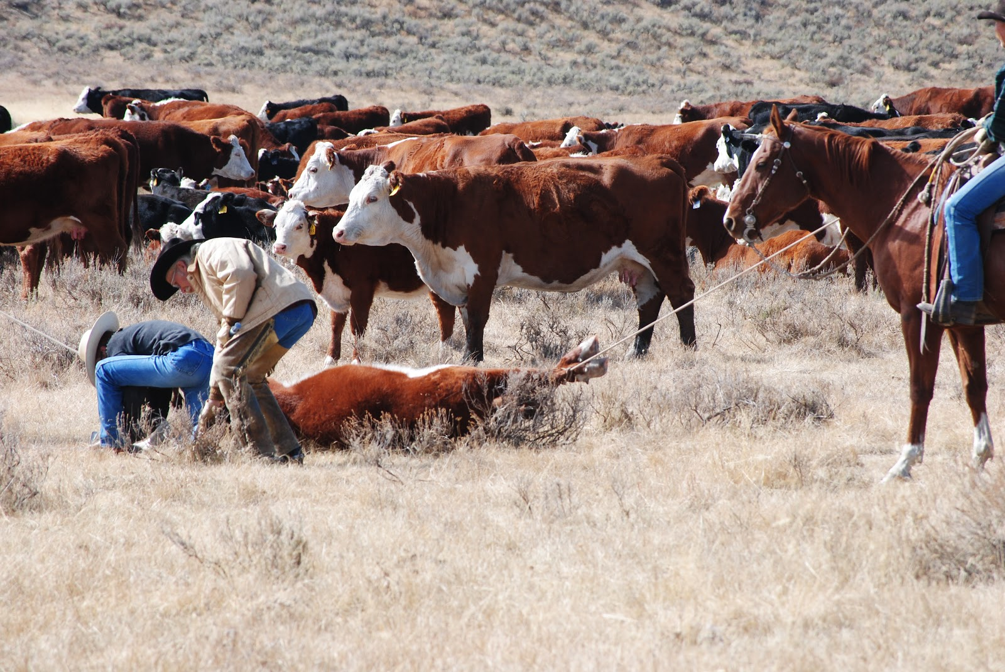
Why are Men and Women in the Ranching Business?

Slide 7
Perspective | Ranking by Seedstock, Cow/calf and Stocker Segments
It is a business | 1
I like animals | 2
It is my legacy | 3
Lifestyle | 4

Slide 8
The Focus of Today’s Presentation
I would like to focus on input factors that influence Ranch Breakeven
I will concentrate on Nutrition since ~65% of input costs have been attributed to forage
I will discuss on how mineral supplementation influences breakeven through improved body condition/immunity

Slide 9
First: What are Ranching Expectations?
Cows
Rancher
Calve in BCS 5-6
Good Colostrum
Good Calf Immunity
More Live Calves
More Milk & Calf Gain
Early Rebreeding
Check Hay Quality & Feeding Rates
Allow for Cold Stress
Supplement Minerals
Supplement Protein when diet <10%

Slide 10
What are Rancher’s Priorities?
Very high
priority
High priority
Lower priority

Slide 11
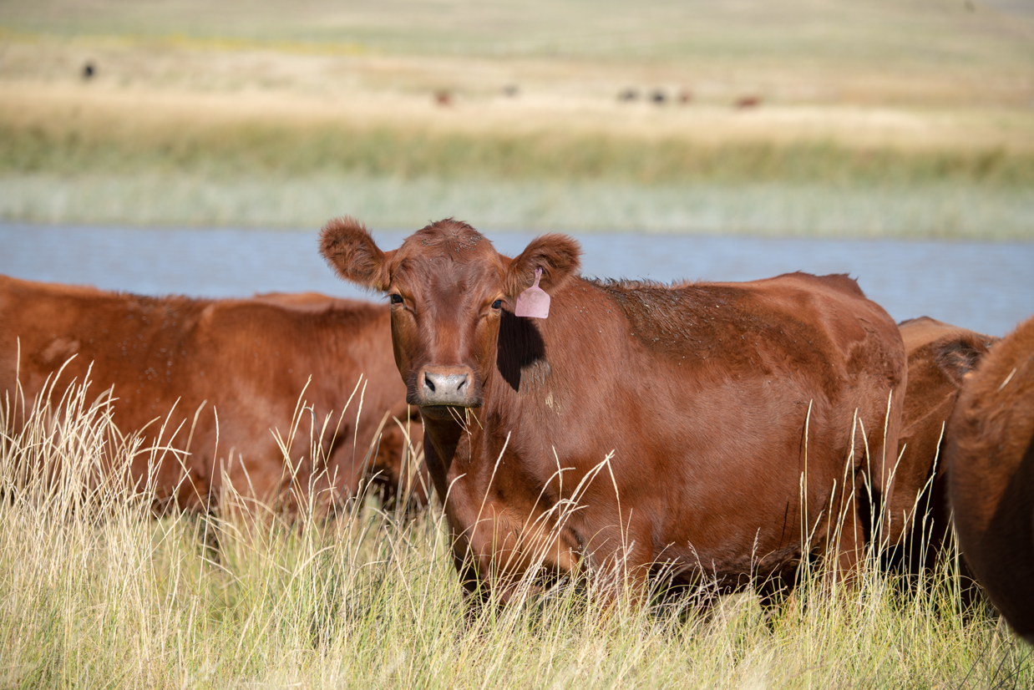
Is your ranch profitable? Breakeven
              Input (Cow herd costs)
Breakeven =
              Output (calf crop x
              weaning wt)

Slide 12
An example of a breakeven
$900/ year Cow Costs
(feed, vet, fuel, insurance, etc.)
500 lb. weaning weights x
85% calf crop
Breakeven =
Need $2.11/lb. to breakeven ($900/425=$2.11)

Slide 13
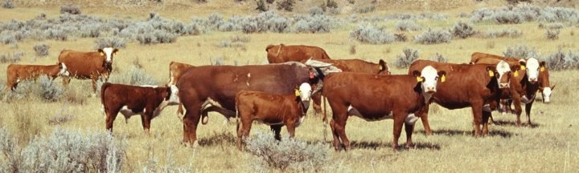
Nutrition of the Cowherd:
Basic Required Nutrients
Water Protein Energy Vitamins Minerals
Notes:
There are six basic nutrients that cattle or any animal needs. Those nutrients are water, protein, minerals, vitamins, fats, and carbohydrates to generate energy. The subsequent slides briefly discuss all of the nutrients.

Slide 14
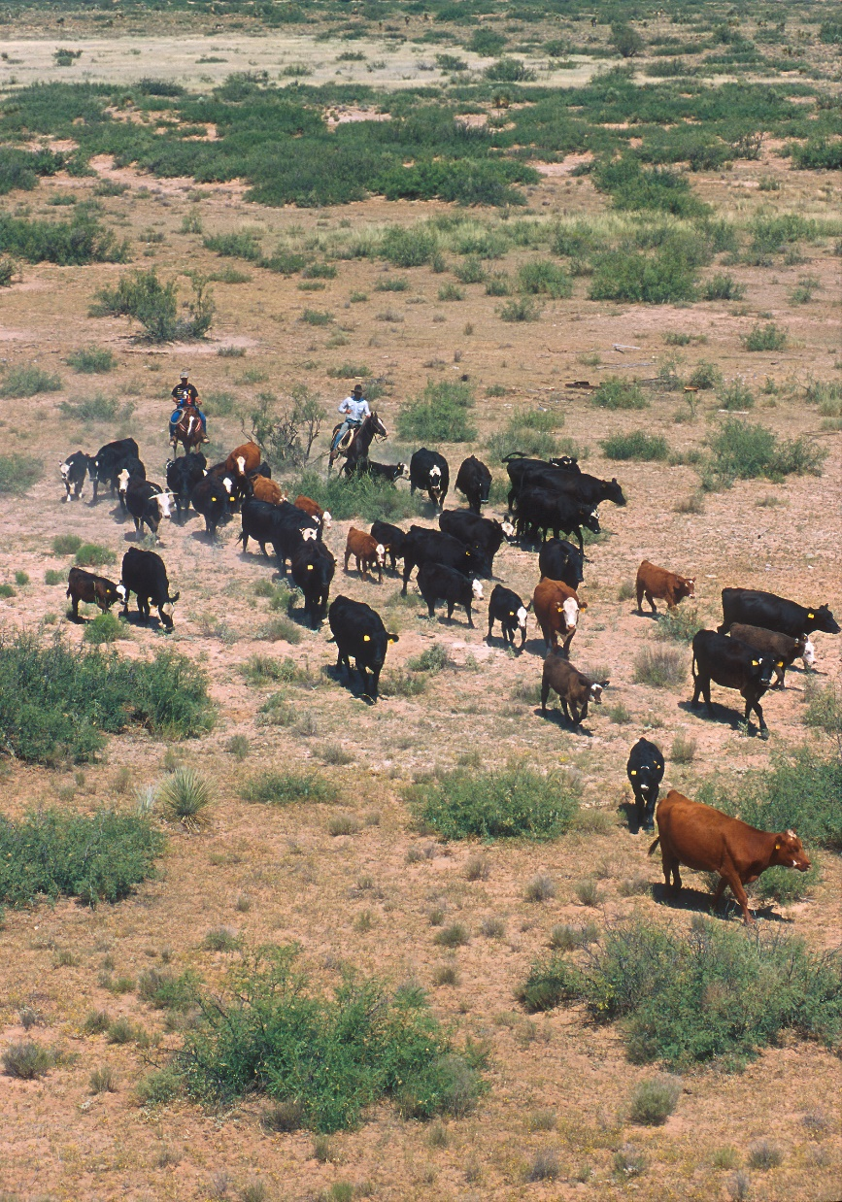
Mineral Deficiencies Cause—
Reproduction
• Poor Cycling (repeat breeding)
• Poor conception
Retained placenta
Immune system
• Poor ability to fight off disease
• Poor vaccine responses
• Increased disease
Foot rot
Poor growth rates
Increased Deaths

Slide 15
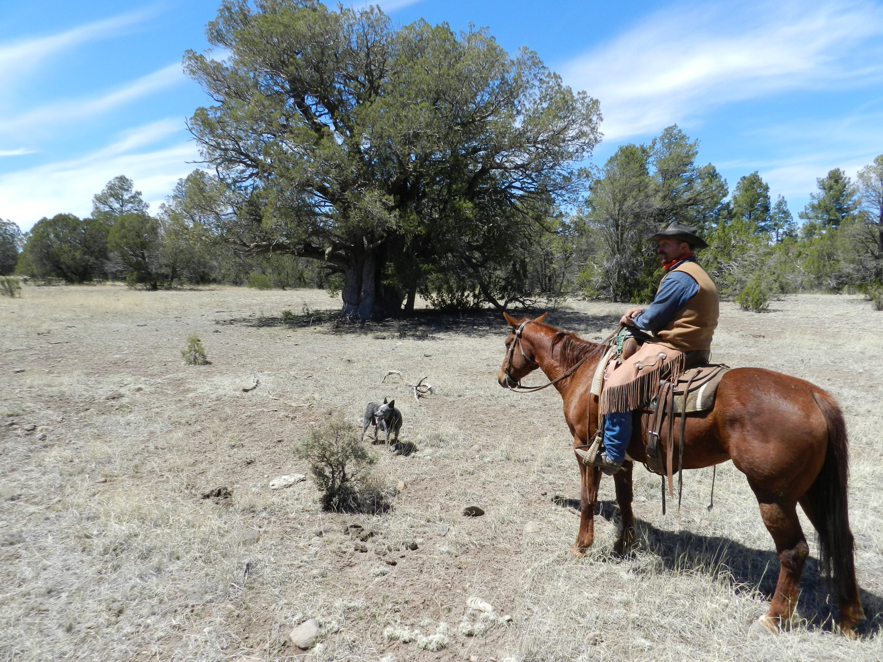
How does lack of forage affect the productivity of the cow?
Glenwood, NM

Slide 16
Interactions of Breed, Supplementation and Year on Productivity of Desert Range Cows (Bellido et al., 1981)
5 yr study at NMSU
Drought reduced gain from birth to weaning by 20%, weaning weight by 17% and increased calving interval by 16 d

Slide 17
How does drought influence mineral intake for a 1200 lb range cow?
Item | Normal forage intake | Drought forage intake
DM intake | 30 lbs | 20 lbs
Phosphorus | 27 g | 18 g
Copper | 108 mg | 72 mg
Why is Phosphorus Necessary During a Drought?

Slide 18
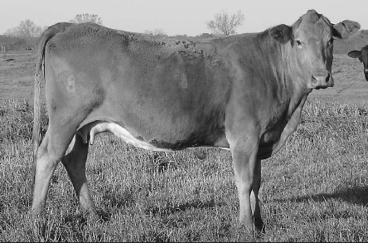
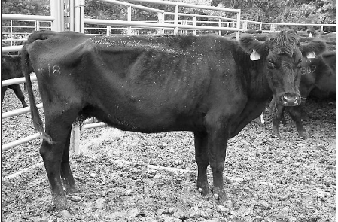
Performance of cows in different body conditions (Wikse et al, 1995)
BCS | Pregnancy rate, % | Weaning weight, lb | Lost income/cow, $
5 | 96 | 508 | $ 0
3 | 51 | 442 | $215
BCS 5
BCS 3

Slide 19
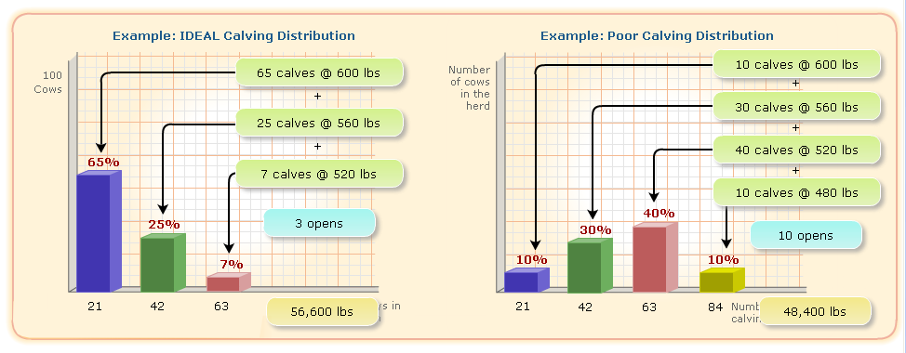
The Effects of Calving Distribution on Income
56,600 lbs weaned
48,400 lbs weaned
-
8,200 lbs less
x $2.80/lb = $22,960 difference due to drought and poor distribution
Notes:
What does this mean financially? Fewer pounds to sell!
Figure this out by adding together the total pounds for each herd. Now, subtract the Poor distribution herd’s total from the ideal Distribution’s herd’s total.
When you compare the two distributions, the difference in pounds weaned is more than eight thousand pounds!
Additionally, if you calculate the pounds produced per female exposed, you’ll notice that your cost of production increased because you had to pay to maintain seven additional cows that didn’t produce calves. As you can see, tracking your calving distribution can provide some important insights on your reproductive performance.

Slide 20
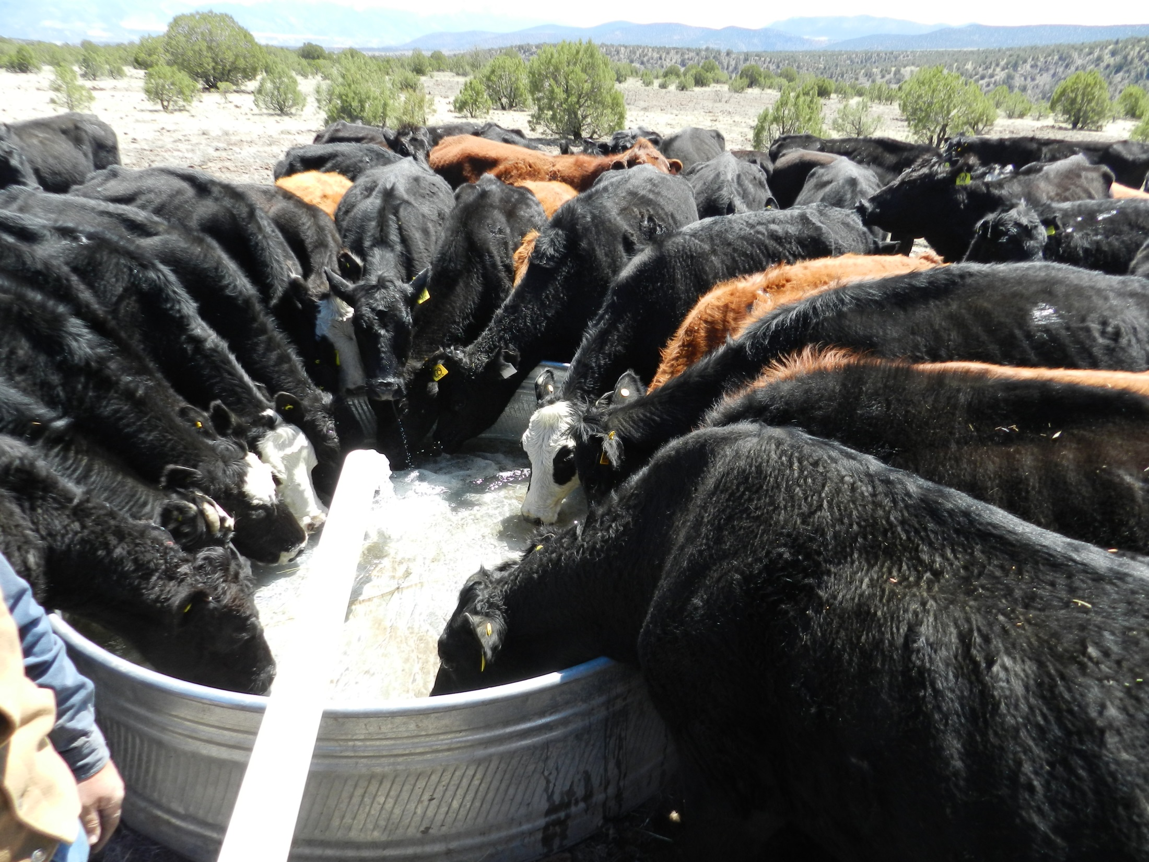
Can you guess what conception rates were?

Slide 21
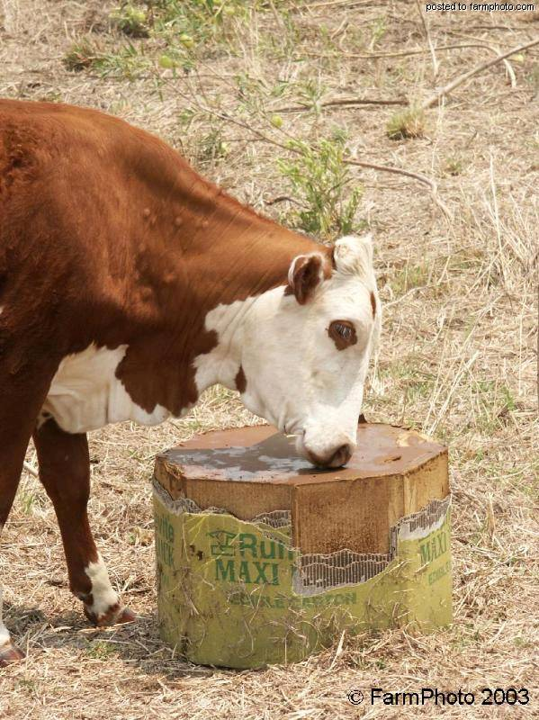
Why do we supplement cattle?

Slide 22
Minerals affect the following-
Reproduction
Scours
Embryo transfer
Milk production
Foot rot
Daily gain
Feed conversion
Health
Immunity

Slide 23
Macro-Mineral Deficiency Symptoms
 | Phosphorus | Calcium | Magnesium
Retained placenta | X
Reduced milk prod. | X | X
Lower conception rate | X | X
Smaller/weak calves | X | X
Poor herd health | X | X
Slow weight gains | X
Grass tetany |  |  | X
Milk fever |  |  | X

Slide 24
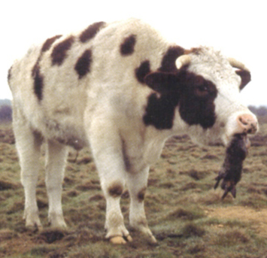
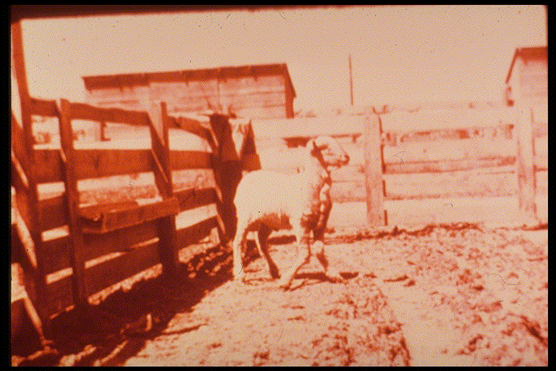
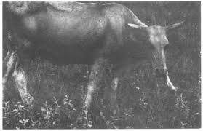
Phosphorus deficiency
Pica?

Slide 25
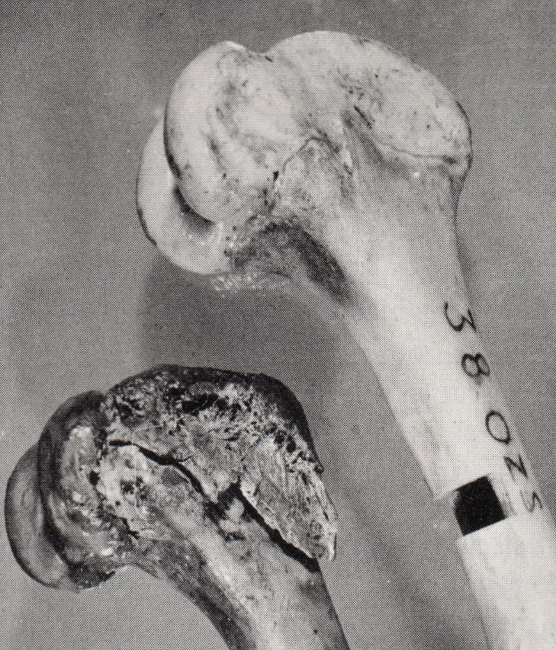
On P deficient soils,
ADG reduced by 20%
Calving rates
reduced by 40%
(Tyler, 2000)
P deficient
Femur bones,
Church 1988

Slide 26
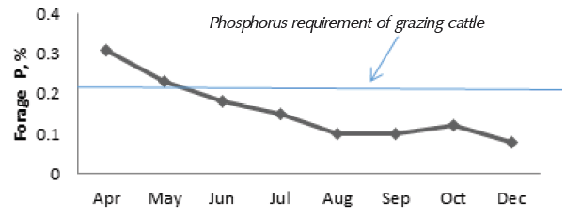
Changes in P content of Native Range

Slide 27
Examples of research which led us to supplement phosphorus to beef cattle:
King Ranch- from the 1930’s-1940’s
When P was supplemented:
  % calf crop weaned increased 41%
  Weaning weights increased by 60 lbs
(Herd, 1997 pastures contained .10% P, very deficient)

Slide 28
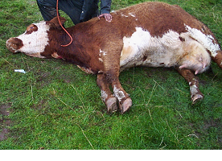
Magnesium (Tetany)
Fertilized pastures (N inhibits Mg absorption)
Little dry mature forage available?

Slide 29
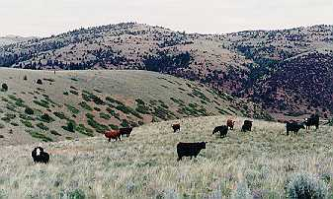
The trace minerals most likely to be deficient for grazing animals include:
Copper
Zinc
Cobalt
Selenium
Manganese

Slide 30
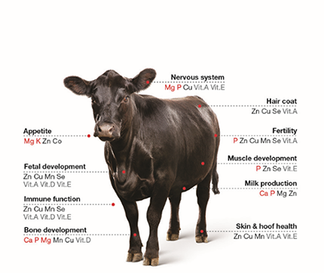
Why are Trace Minerals Necessary?

Slide 31
Examples of Deficiencies
Trace Mineral Deficiency | Reproductive Consequence
Selenium | Retained placenta
Copper | Depressed reproduction, impaired immune system, impaired ovarian function
Zinc | Reduced spermatogenesis
Manganese | Reduced ovulation, decreased conception, ligaments

Slide 32
How does Trace Mineral Status Affect the Beef Cow?
Normal
Immunity
Trace Mineral Intake
Fertility
Growth
Clinical Signs
Normal
Subclinical
Clinical
Time
Wikse, 1992. Texas A&M Beef Cattle Short Course.

Slide 33

Does Native Range Meet the Trace Mineral Requirements of Beef Cattle?

Slide 34
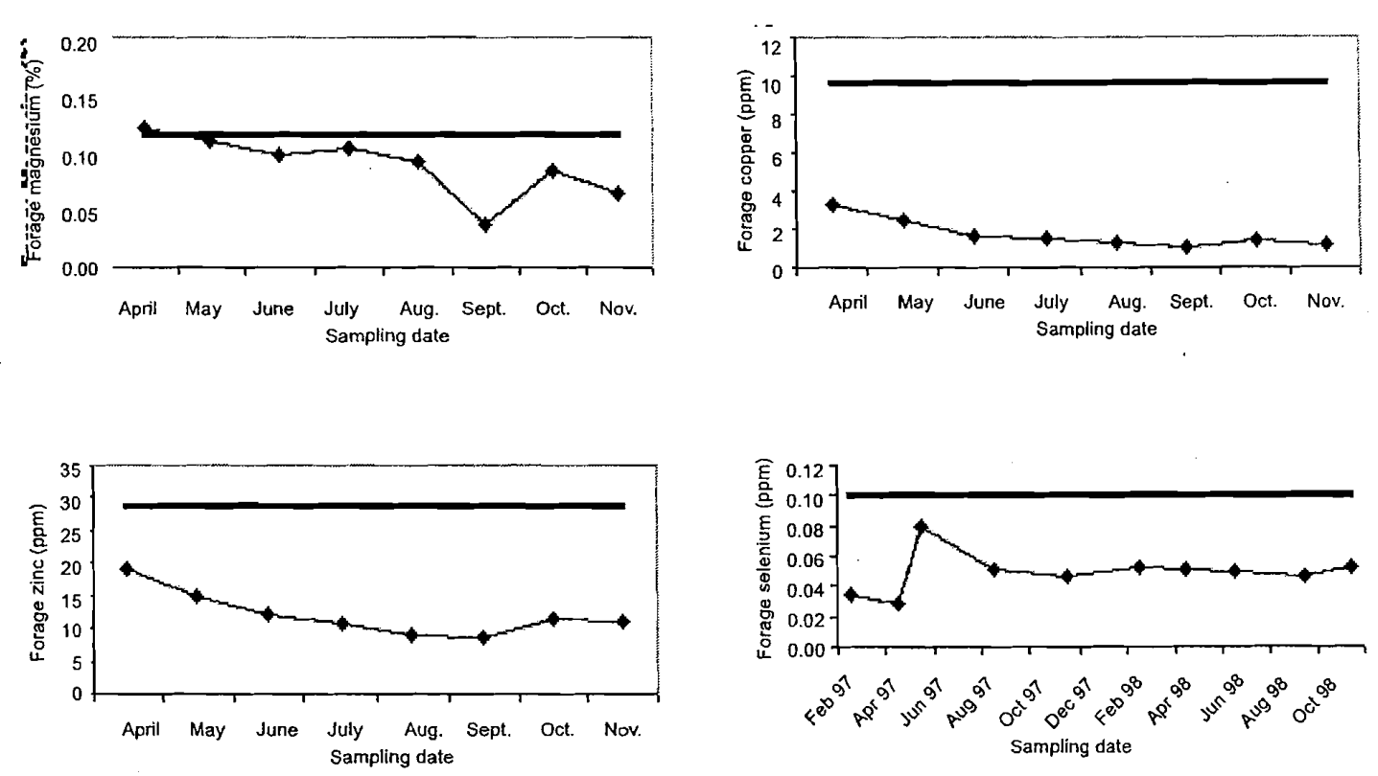
How Good is Range Forage in Meeting the Trace Mineral Needs of Cattle??
Bohnet

Slide 35
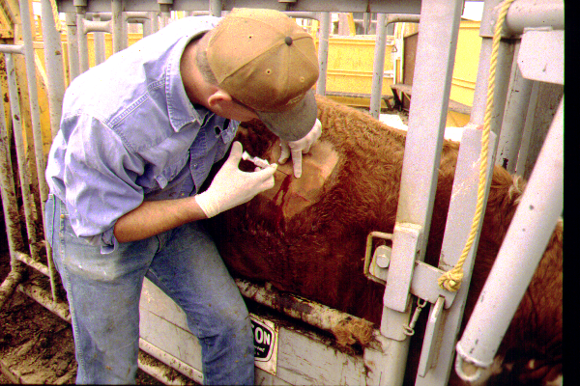
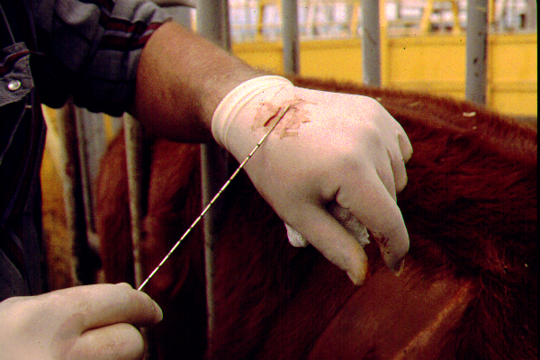
How can we determine if an animal is TM deficient?
We can biopsy the liver to estimate trace mineral status

Slide 36
Yearly Change in Cu for
MT Prison Cows
Blood
Liver
Ansotegui, 1996 (MT)

Slide 37
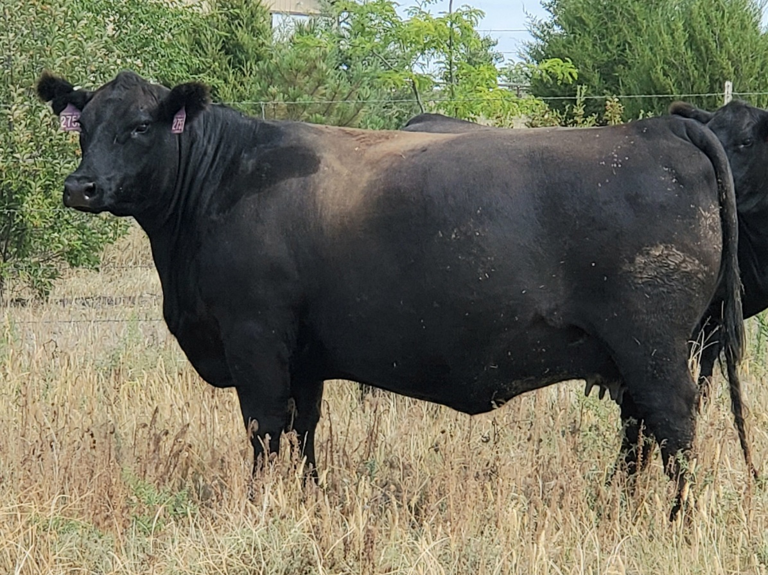
Hair discoloration is a potential sign of copper deficiency.
Deficiencies are easy to spot with visual evidence
However, not all deficiencies will present visual signs.

Slide 38
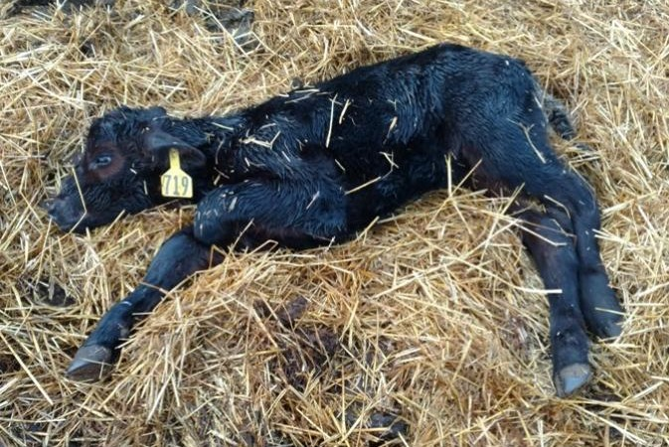
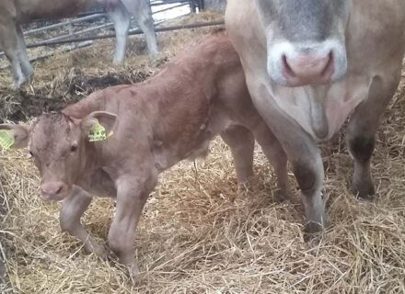
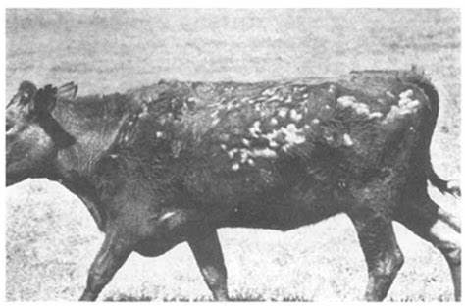
Other Examples
Selenium Deficiency
Manganese Deficiency
Zinc Deficiency

Slide 39

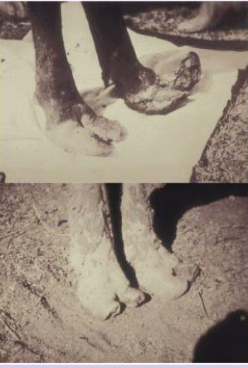
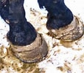
Side note:Selenium Toxicity in Horses and Cattle
General Custer
Alkali Disease- Selenium Toxicity
Cattle

Slide 40
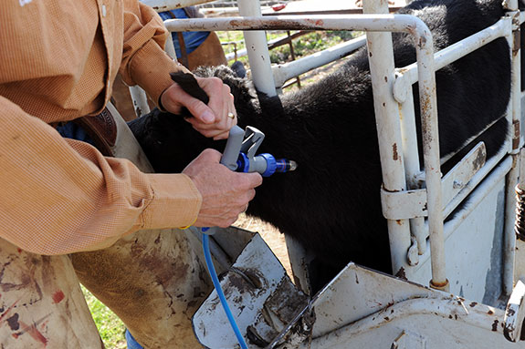
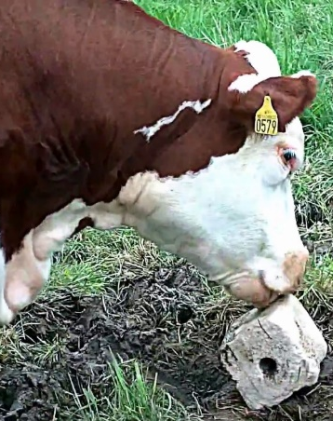
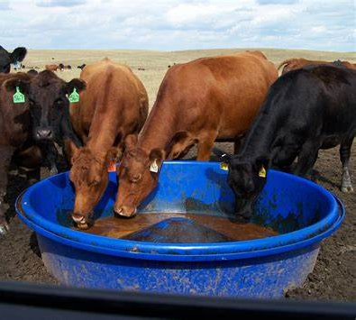
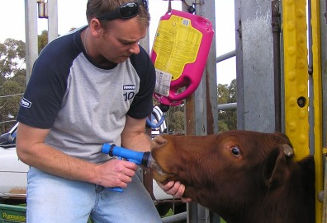
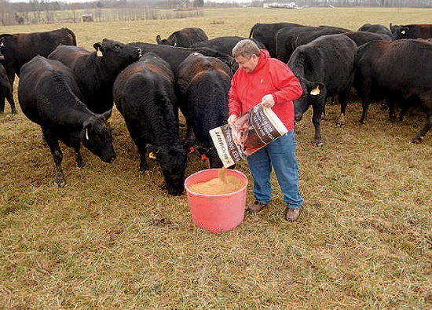
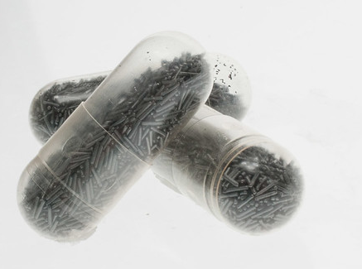
How are trace minerals provided to cattle?

Slide 41
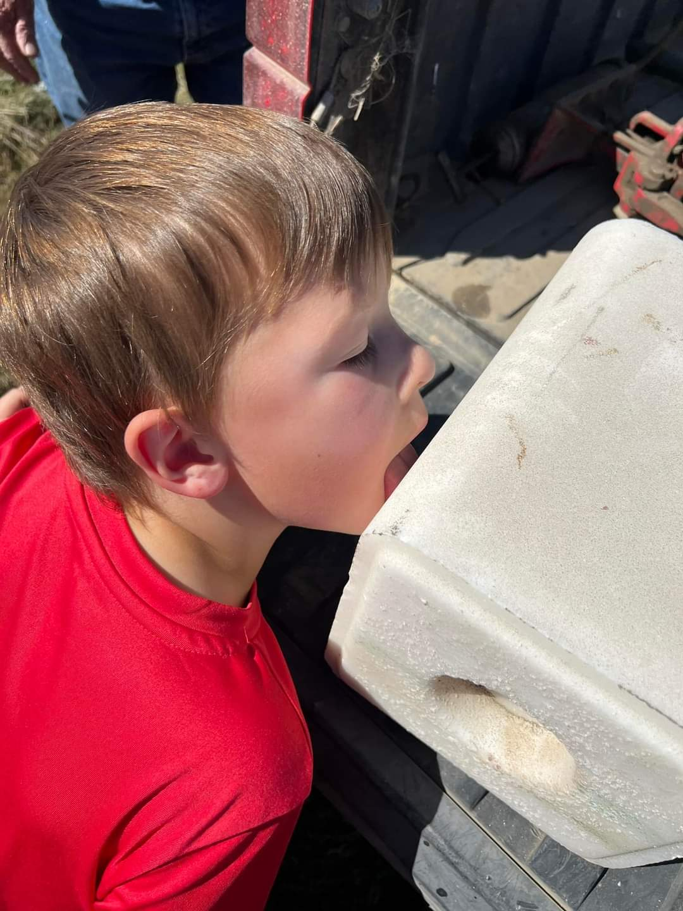
Orally supplemented trace mineral utilization is complicated by—
variation in consumption of
mineral supplements (over vs under
intakes)
2. minerals in the feed
3. the bioavailability of the trace
mineral, and
4. interference by other minerals
and compounds (antagonists,
e.g. sulfate, iron, molybdenum).
5. Time it takes to get to liver or
ovaries
Hutcheson and Eng

Slide 43
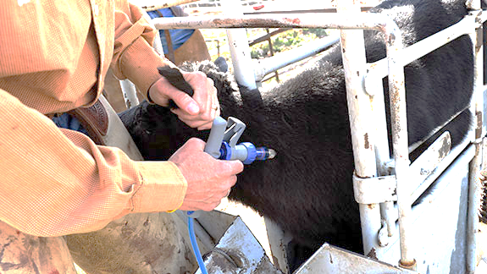
Injectable Trace Minerals

Slide 44
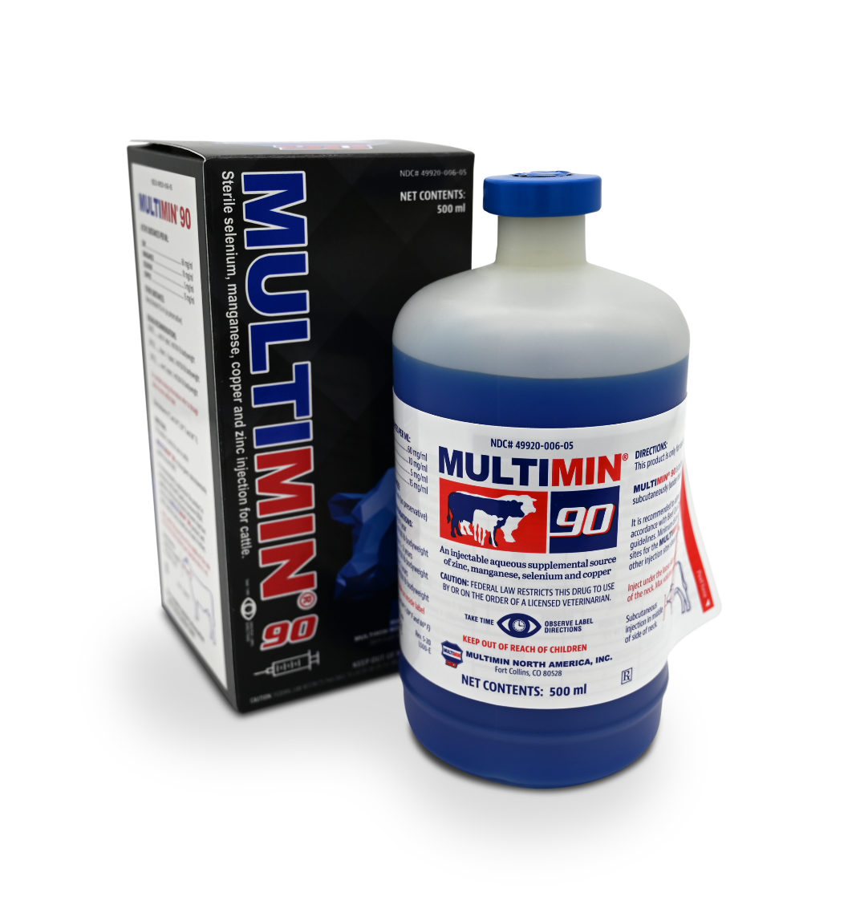
Multimin® 90 provides zinc, manganese, copper and selenium in a readily available injectable.

Slide 45
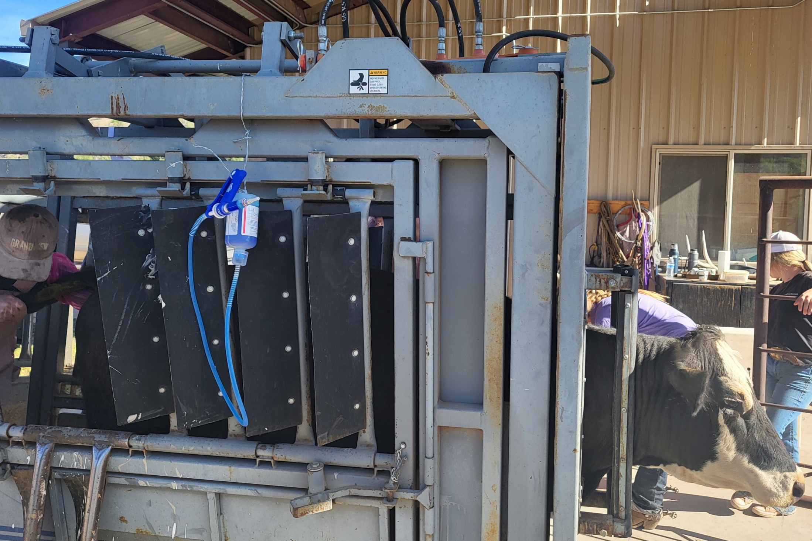
Tom Paterson Ranch, Alma, NM

Slide 46
How fast are supplemental trace minerals delivered to the liver?
Injectable trace minerals – within hours
Inorganic trace minerals- up to 40 days
Organic trace minerals- 14 days
Hanson, Iowa State

Slide 47
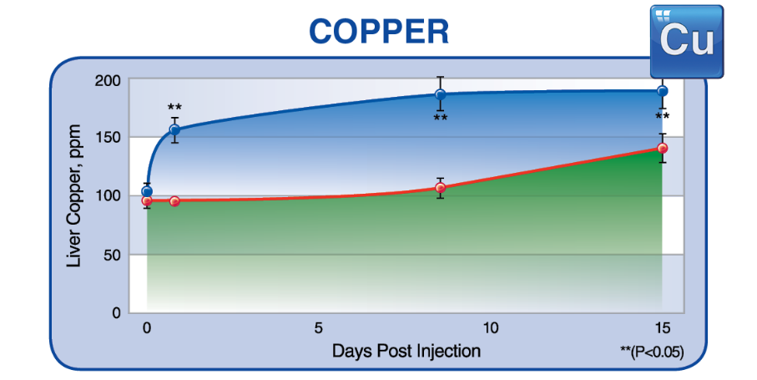
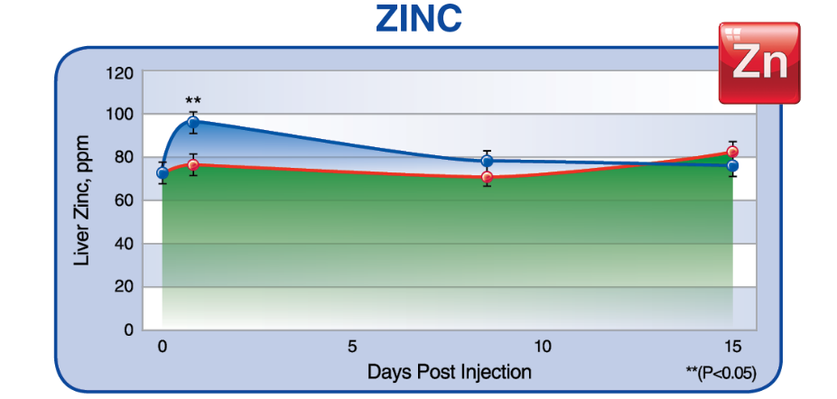
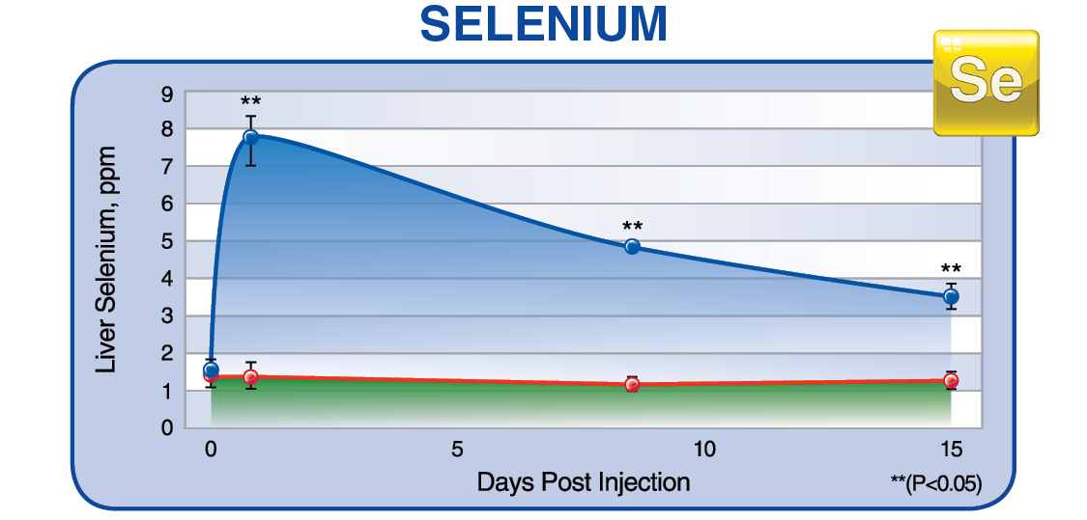
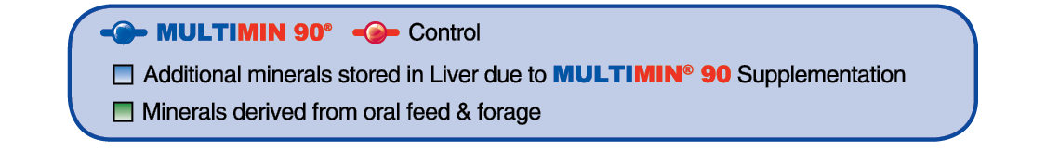
Injectable Trace Minerals Go to Liver Quickly

Slide 48
Injectable trace minerals (Multimin)
Use of injectable trace mineral (MultiMin) to beef cows at beginning of fixed-time AI regimen (Vedovatto et al., 2019, FL)
Item | Multimin | Saline | P =
Mean BCS (d -11 to 30) | 4.7 | 4.3 | 0.06
Pregnancy rate to AI | 54.2 | 49.4 | < 0.01
Cows with BCS < 5.0** | 53.7 | 48.1 | < 0.01
Cows with BCS ≥ 5.0 | 57.9 | 58.1 | < 0.01
Thin cows
DROUGHT
Notes:
COWS THAT NEED!

Slide 49
Use of injectable trace minerals
(MultiMin prior to embryo transfer)
Measurement | Control (n = 276) | MultiMin (n = 219) | P-value
Heifers pregnant at 23 days, % | 36 | 48 | 0.01
Heifers pregnant at 48 days, % | 30 | 43 | 0.05
Sales

Slide 50
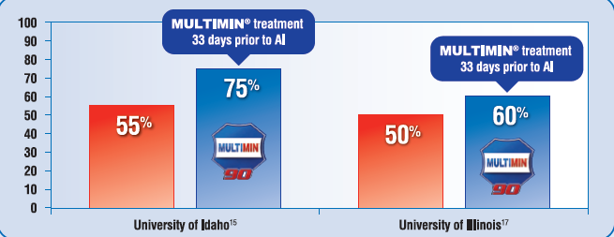
HEIFER Results

Slide 51
Kansas State University showed 12% more cows calved in the first 20 days of the calving season than noninjected cows

Slide 52
Effect of Multimin on Pregnancy Rates
University | Control | Multimin Injected
Texas A&M | 81 | 94
Kansas State | 90 | 93
NW-Missouri State | 65 | 74
Simple Average | 79 | 87

Slide 53
Comparison of breakeven costs
(Avg of 3 University studies)
$900 /year cow cost
Breakeven
(No Multimin) =
= $2.28 BE
500 lb WW x 79% preg
Breakeven
(Plus Multimin) =
$910/year cow cost
= $2.09 BE
500 lb WW x 87% preg

Slide 54
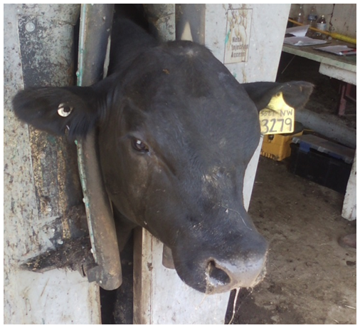
One University study showed improved bull fertility after use of injectable trace minerals.
Improved sperm motility at 10 months of age.
Improved sperm motility and morphology between 10 and 12 months of age.
3% more bulls passing their BSE at 12 months of age.
54
G.W. Preedy, S.L. Hill, J.S. Stevenson, R.L. Weaber, K.C. Olson; The Professional Animal Scientist 34: 1-9
Notes:
This experiment evaluated effects of supplemental s.c.
trace-mineral injections on growth and breeding soundness
of bull calves. Weaned bulls (n = 488; initial BW =
308 ± 45 kg, initial age = 203 ± 17 d) of 2 breeds (Angus
and Charolais) and originating from 13 ranches in the
Great Plains were transported to a common confinement
facility and assigned randomly to 2 treatments: (1) s.c.
injections of trace mineral (TM) containing 15 mg/mL
Cu, 5 mg/mL Se, 10 mg/mL Mn, and 60 mg/mL Zn or (2)
s.c. injections of physiological saline (control). Treatments
were administered at arrival (d −2 or −1; 1 mL per 45
kg of BW) and on d 90 ± 1 (1 mL per 68 kg of BW). On
d 0, bulls were stratified by treatment, breed, and ranch
of origin and assigned randomly to 8 pens in which they
were fed a growing diet for 225 d. The diet was formulated
to promote a 1.5-kg ADG at a DMI of 2.6% of BW and
to meet or exceed NRC (2000) requirements for Ca, Co,
Cu, I, Mg, Mn, Na, P, K, Se, and Zn. Initial BW were
measured and pretreatment blood plasma samples were
collected on d −2 or −1. Breeding soundness examinations
(BSE) were conducted and BW were measured at 10 and
12 mo of age (d 90 ± 1 and d 150 ± 1, respectively). Scrotal
circumference was measured and semen samples were
collected via electro-ejaculation. Motility and morphology
of sperm were evaluated via light microscopy. Scrotal
circumference, BW, and ADG did not differ (P ≥ 0.16)
between treatments at any time. Proportions of control and
TM-treated bulls achieving minimal satisfactory BSE
classifications did not differ at 10 mo of age (P = 0.98; 50
± 3.8% for both TM and control) or at 12 mo of age (P =
0.43; 89 and 86 ± 2.2% for TM and control, respectively).
Conversely, improved (P = 0.05) sperm motility was detected
in TM-treated bulls compared with control-treated
bulls at 12 mo of age; moreover, TM-treated bulls had
greater (P ≤ 0.05) improvements in sperm morphology
and motility between 10 and 12 mo of age than control treated
bulls. Among bulls that failed BSE at 10 mo of
age, more TM-treated bulls tended (P = 0.10) to pass
BSE at 12 mo of age than control-treated bulls (98 and
94 ± 1.6% for TM and control, respectively). Under the
conditions of this experiment, sperm motility and morphology
at 12 mo of age were improved in bulls treated
with injectable TM at 7 and 10 mo of age compared with
bulls treated with saline.

Slide 55
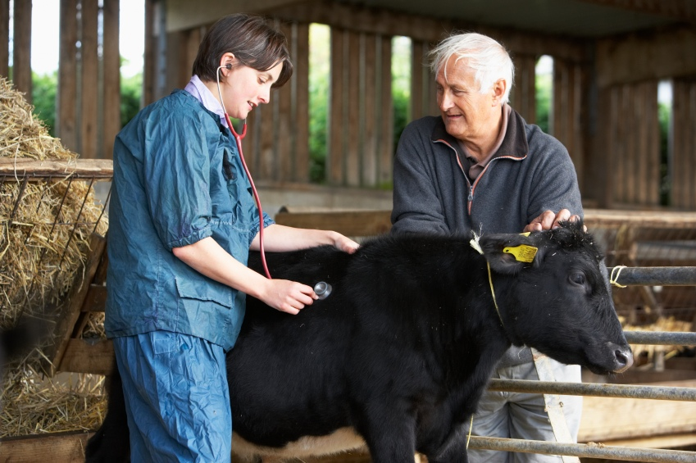
If Your Calves are Sick, Don’t Blame Your Veterinarian, It May be a Nutritional Problem

Slide 56
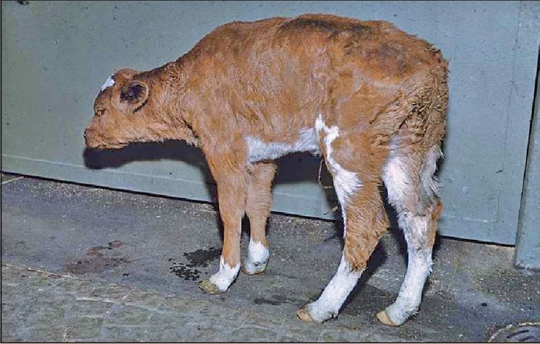
Do trace minerals help improve immunity and decrease sickness?

Slide 57
Incidence of Sickness in Texas “Ranch to Rail” Cattle
Percentage of
producers
using a
complete
mineral
supplement
0
<20
100
20 to 39
40 to 59
60 to 90
Gill et al.
% of cattle pulled due to sickness

Slide 58
Results of Two Light Calf Studies
Bull Calves
(OSU)
Heifer Calves
(U of AR)
 | Control | MULTIMIN®
% morbidity | 71ª | 63^{b}
% cattle treated 2 times | 15.5 | 8.6
% cattle treated 3 times | 4.2 | 1.4
ADG, lb. | 1.92ª | 2.09^{b}
Feed: Gain | 4.35ª | 3.84^{b}
 | Control | MULTIMIN®
% morbidity | 87ª | 55^{b}
% cattle treated 2 times | 51.6ª | 19.4^{b}
% cattle treated 3 times | 32.3ª | 9.7^{b}
ADG, lb. | 2.00ª | 2.38^{b}
Feed: Gain, lb. | 5.88ª | 5.26^{b}
Final weight, lb. | 547ª | 568^{b}
344 lb. bull calves
Sale barn origin
42 day study
Oklahoma State University
438 lb. heifer calves
Sale barn origin
55 day study
University of Arkansas
Sources: Berry, et al, Oklahoma State University; Richeson & Kegley, University of Arkansas

Slide 59
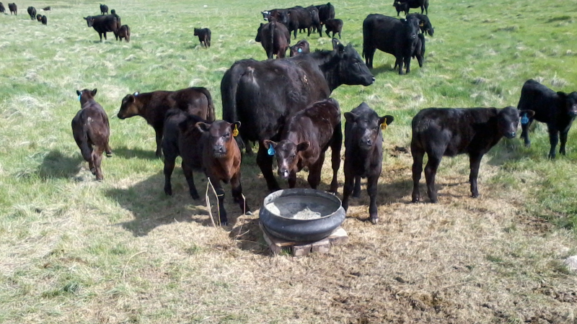
What are the recommendations for using an Injectable TM?
INJECTION
Feeding LOOSE MINERALS

Slide 60
An injectable TM DOES NOT replace your loose mineral supplementation program.
An ITM COMPLIMENTS your mineral supplementation program. It is a strategic supplement used when stress is evident by improving immune status.
Remember we also need Phosphorus, Calcium, Magnesium from a loose mineral supplement.

Slide 61
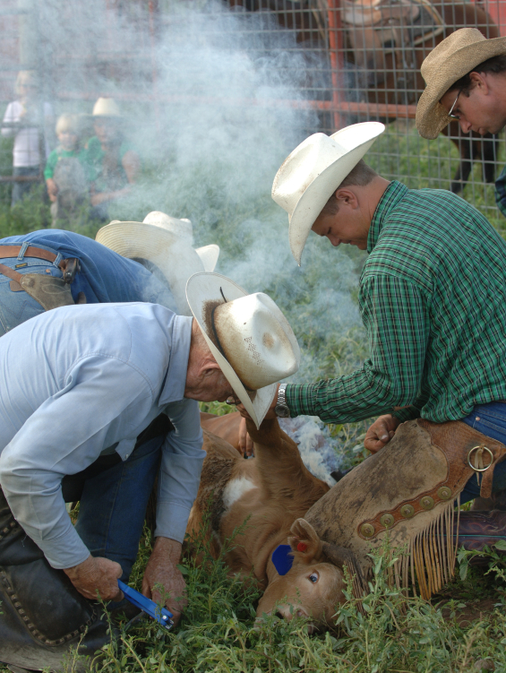
When Do We Recommend the Use of an Injectable Trace Mineral?

Slide 62




When to supplement with injectable trace minerals
Heifers and Cows
Last trimester of pregnancy
30 days pre-breeding or at CIDR insertion (11 days before AI)
Bulls
Weaning
90 days post weaning
45-60 days before breeding season
Calves
Branding/first vaccination
Weaning/ preconditioning
Stockers/Feedlot
Processing or arrival

Slide 63
Summary of Mineral Nutrition
All problems are not due to minerals. Make sure that cows are receiving adequate energy and protein to meet their nutritional demands during pregnancy, nursing, rebreeding and weaning.
Monitor mineral consumption. Best formulation in the world won’t work if cows won’t eat it.
An effective diagnosis of mineral problem may include clinical signs, soil analysis, forage analysis, water analysis, mineral analysis of supplement, and mineral concentrations in blood and liver.

Slide 64
Vaccination programs work better if there is a good loose mineral program.
An injectable trace mineral has been shown to improve morbidity rates, pregnancy rates and total income when given at strategic times

Slide 65


Thank you for allowing me to be a part of your conference---JP

